Slide 1
The Joy of the Lord is Your Strength
Nehemiah 8:1-10

Slide 2
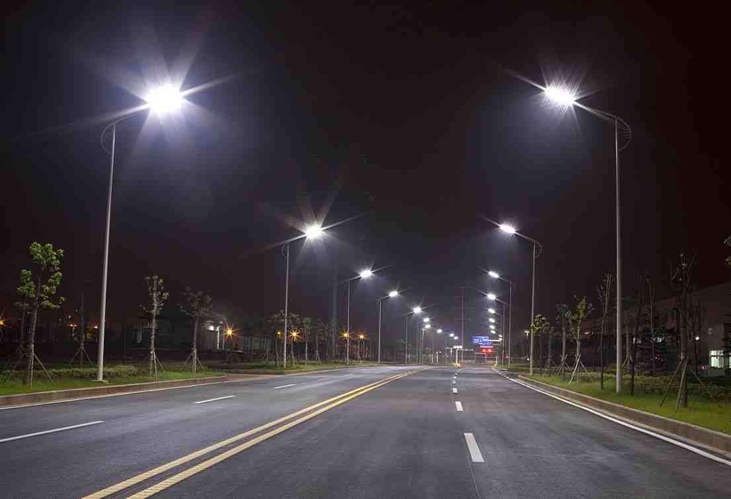
The blessing of night lighting

Slide 3
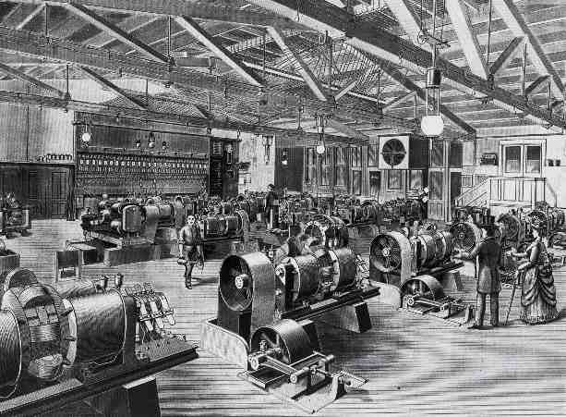
Brush Magneto-Electric Machine
Cleveland, Ohio 1879

Slide 4
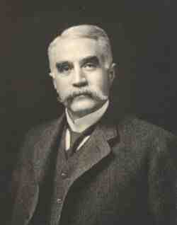
April 29, 1979 Cleveland Public Square
Charles F. Brush

Slide 5
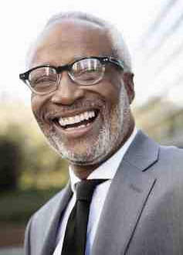
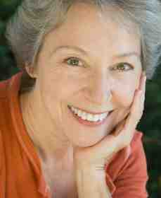
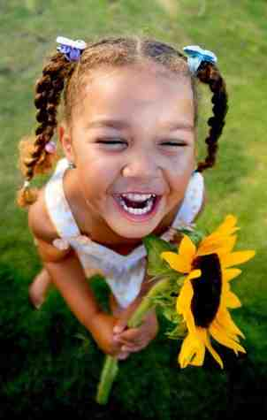
Nehemiah 8:10 Then Nehemiah said to them, "Go your way, eat the fat, drink the sweet, and send portions to those for whom nothing is prepared; for this day is holy to our Lord. Do not sorrow, for the joy of the Lord is your strength."

Slide 6
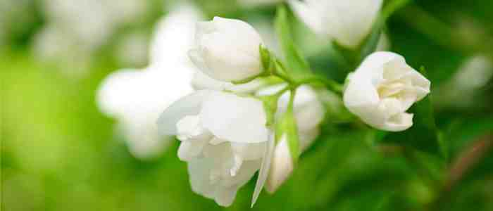
Joy from knowing God
John 15:11 "These things I have spoken to you, that My joy may remain in you, and that your joy may be full.
Galatians 5:22-23 the fruit of the Spirit is love, joy, peace, longsuffering, kindness, goodness, faithfulness, 23 gentleness, self-control. Against such there is no law.
Philippians 4:4 Rejoice in the Lord always. Again I will say, rejoice!
1 John 1:4 And these things we write to you that your joy may be full.

Slide 7
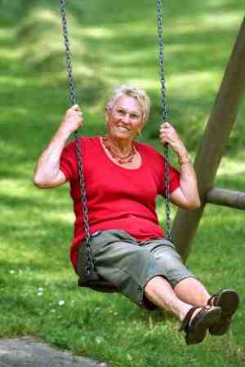
God desires for us to stay encouraged..

Slide 8
Nehemiah..
God’s manual on leadership.. “greatest leadership book ever written!”

Slide 9
Nehemiah.. strength
Ch 1 Nehemiah serving King of Persia..
Delegation of friends from Jerusalem
Nehemiah feels burden to act
Nehemiah 1:10 these are Your servants and Your people, whom You have redeemed by Your great power, and by Your strong hand.
GOD’S STRENGTH IS GREAT

Slide 10
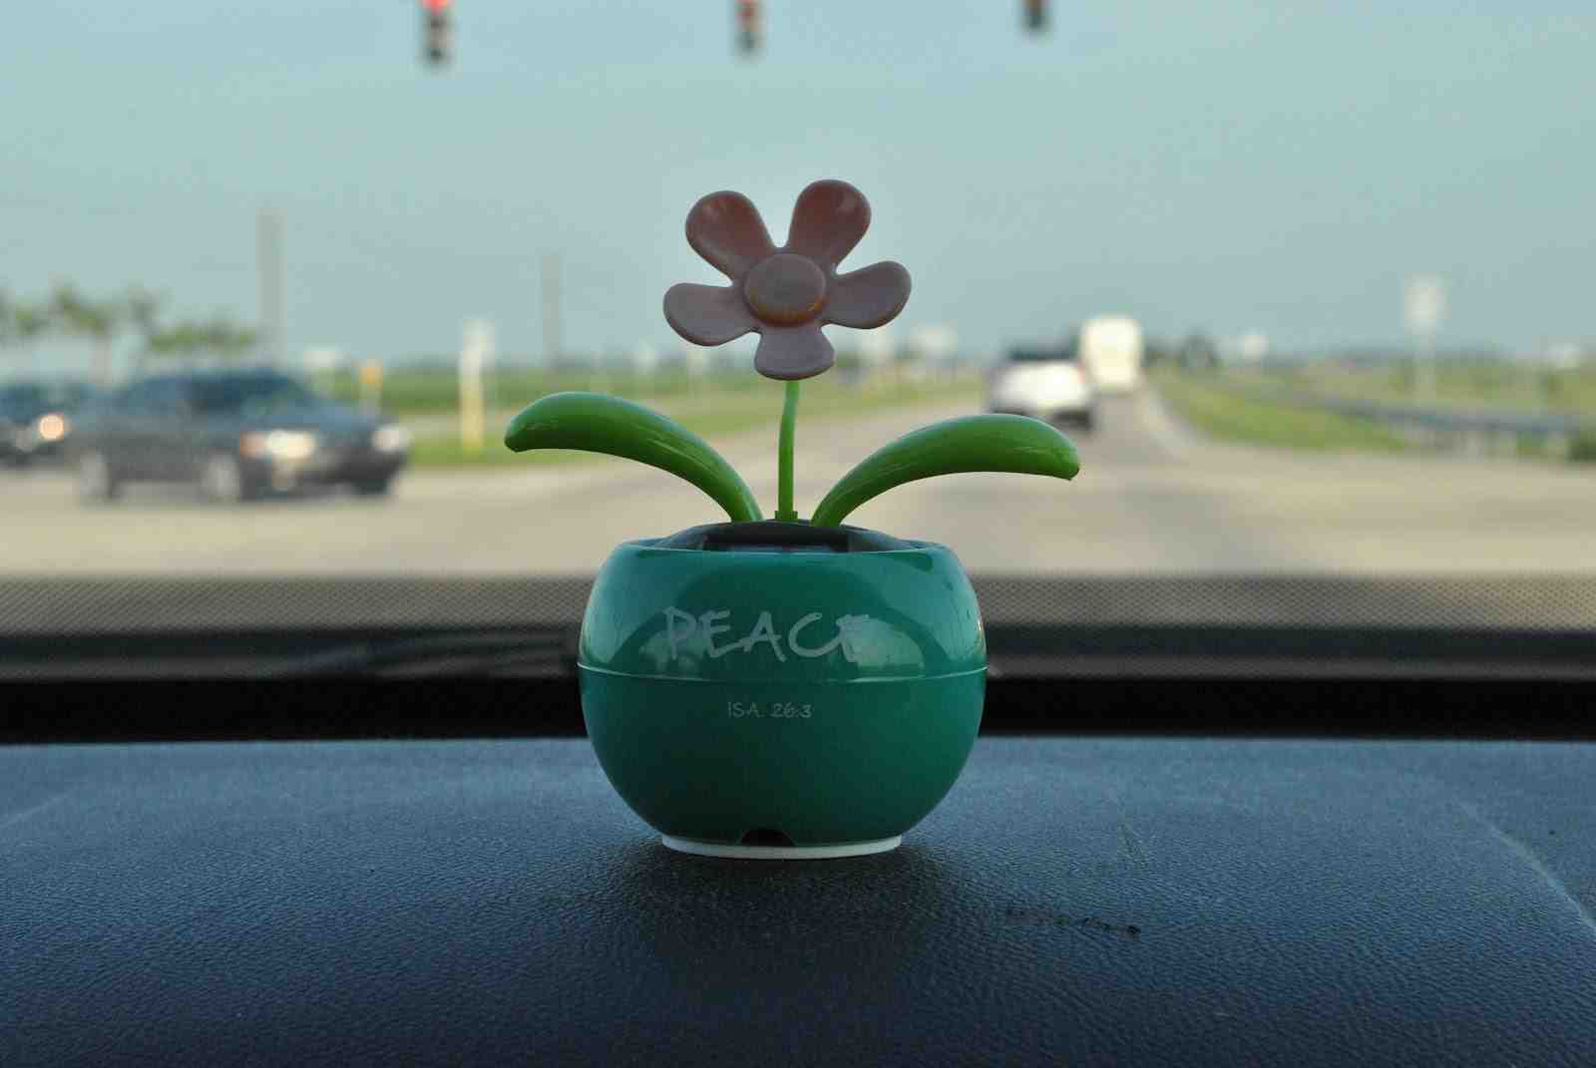
GO and DO SOMETHING in the STRENGTH of the LORD!

Slide 11
Nehemiah.. strength
Ch 2-4 Nehemiah begins his work..
Goes out at night to inspect the city
Gathers leaders and organizes the work
Trouble begins and discouragement sets in
Nehemiah 4:10 Then Judah said, "The strength of the laborers is failing, and there is so much rubbish that we are not able to build the wall."
OUR STRENGTH IS SMALL

Slide 12
Nehemiah.. strength
Ch 6 – Nehemiah seeks the help of God
Enemies ask Nehemiah to meet with them
Nehemiah refuses to stop work for them
Nehemiah prays
Nehemiah 6:8-9 For they all were trying to make us afraid, saying, "Their hands will be weakened in the work, and it will not be done." Now therefore, O God, strengthen my hands.
6:15-16 The wall was completed in 52 days!
WE PLEAD FOR GOD’S STRENGTH

Slide 13
Nehemiah.. strength
Ch 8 – Spiritual rededication of the people
The people gather as one in the water gate
Ezra reads the law for all to hear
The people understand and are convicted
Nehemiah 8:10 Nehemiah said to them, "Go your way, eat the fat, drink the sweet, and send portions to those for whom nothing is prepared; for this day is holy to our Lord. Do not sorrow, for the joy of the Lord is your strength."
GOD IMPARTS HIS STRENGTH
THROUGH JOY

Slide 14
Nehemiah’s pattern ...
GOD’S STRENGTH IS VERY GREAT
(He calls us to join Him in fulfilling His will)
OUR STRENGTH IS SMALL
(We do our best but our strength gives out)
WE PLEAD FOR GOD’S STRENGTH
(When we cry out to God He gives us His word)
HE IMPARTS HIS STRENGTH THROUGH JOY
(Clear understanding of His will brings a surge of joy
which imparts the strength needed to finish the job)

Slide 15
The Joy of the Lord is Your Strength
Nehemiah 8:1-10

