Slide 1
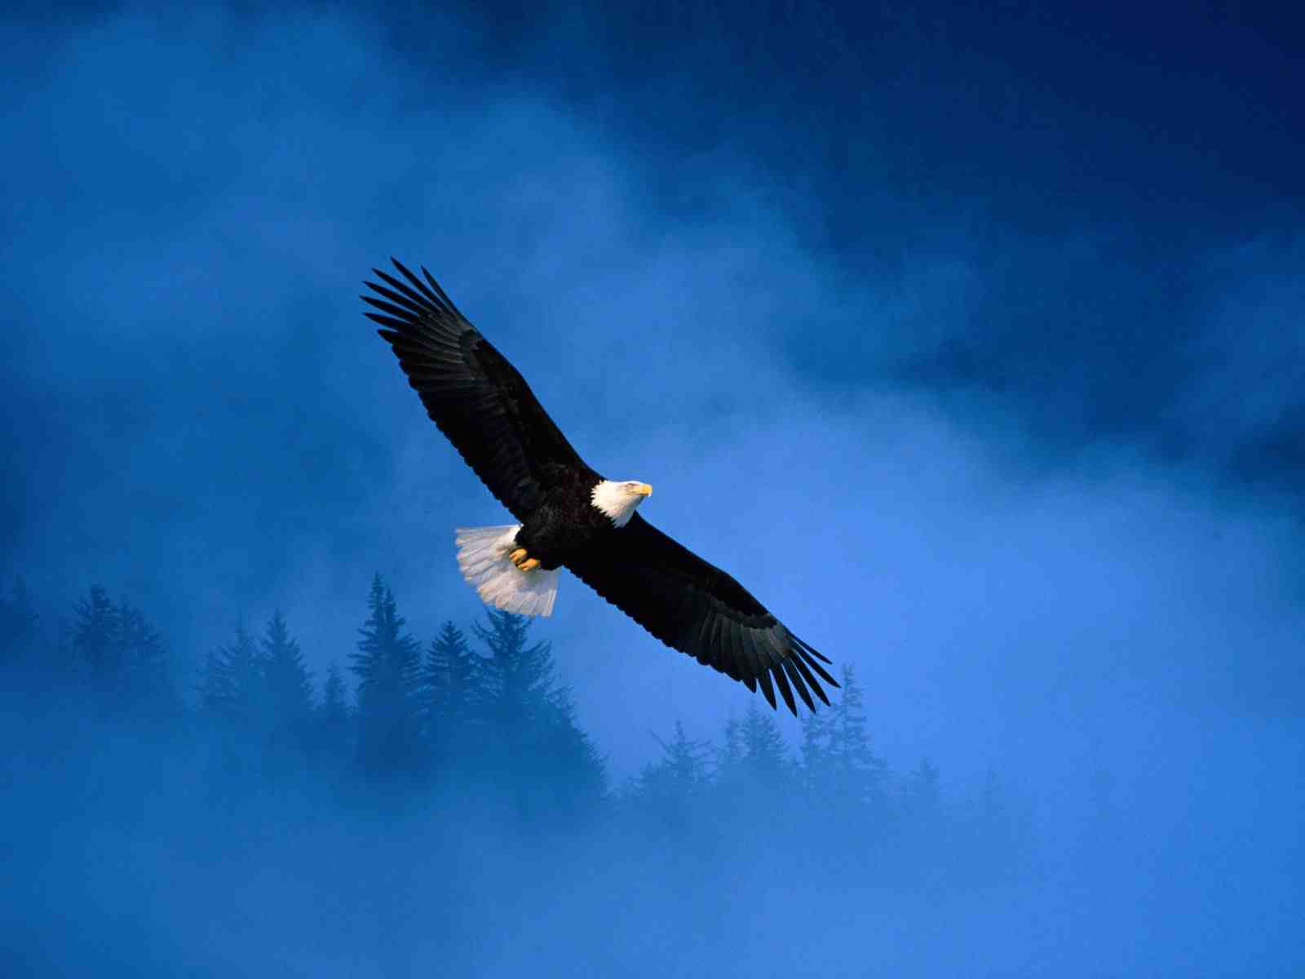
Renewing Our Strength
Isaiah 40:27-31

Slide 2
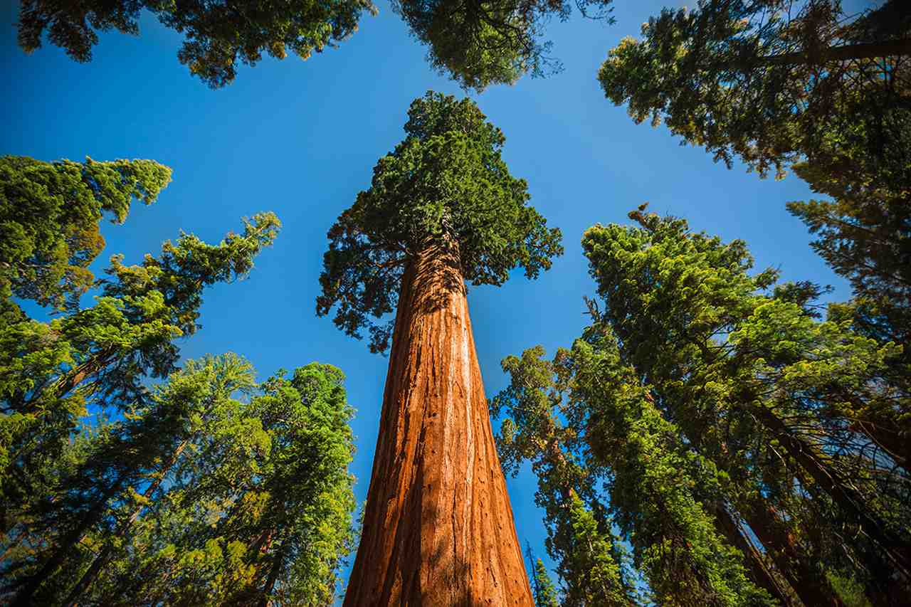
Living in God’s Strength..
Eph 6:10 Be strong in the Lord, and His mighty power."

Slide 3
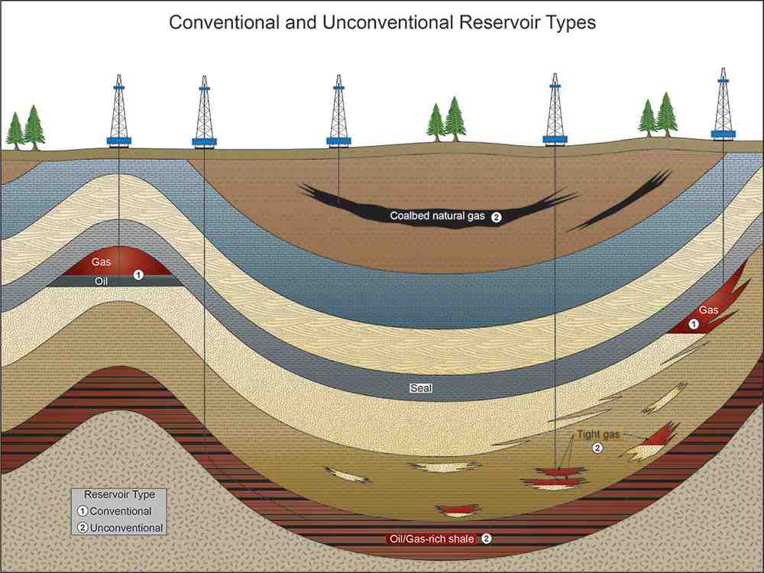
We depend on limited natural resources
for energy production

Slide 4
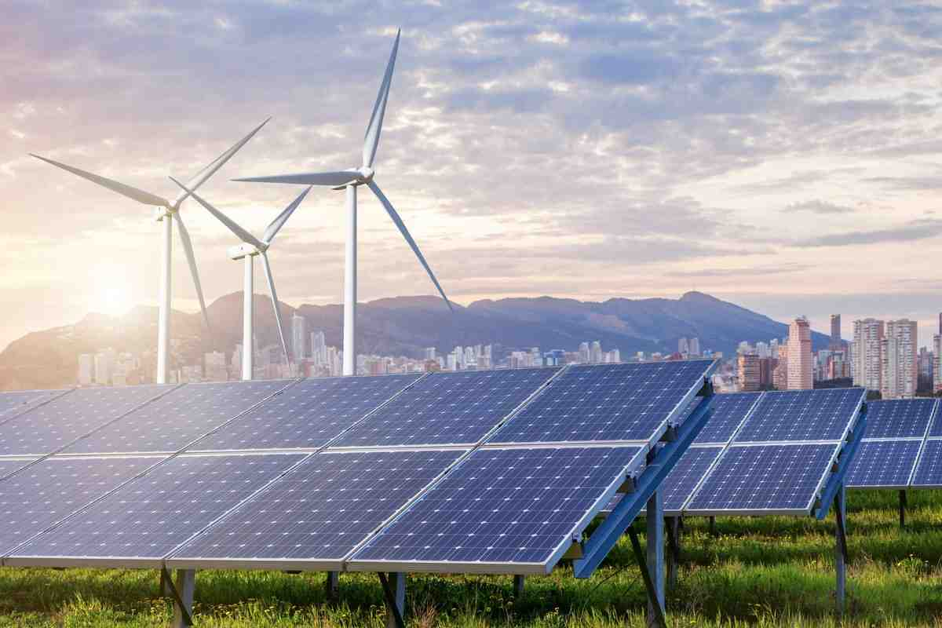
New forms of renewable energy..

Slide 5
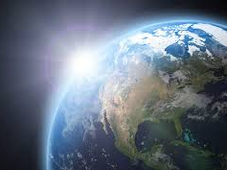
John 8:12 "I am the light of the world.
He who follows Me shall not walk in darkness, but have the light of life."

Slide 6
Isaiah 40:31 But those who wait on the Lord shall renew their strength; they shall mount up with wings like eagles, they shall run and not be weary, they shall walk and not faint.

Slide 7
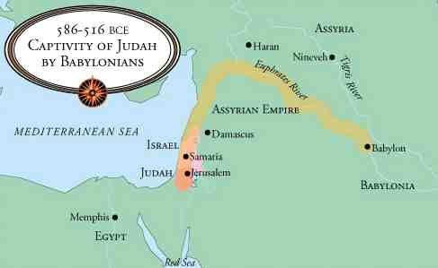
Jewish captives 500 miles from Jerusalem in refugee camps

Slide 8
27 chapters of tenderness & hope
Written by Isaiah to the returning refugees from Babylon

Slide 9
Isaiah 40 The Majesty of God
1-5 "Comfort, yes, comfort My people!" says your God.
2 "Speak comfort to Jerusalem, and cry out to her, that her warfare is ended, that her iniquity is pardoned; For she has received from the Lord's hand double for all her sins."

Slide 10
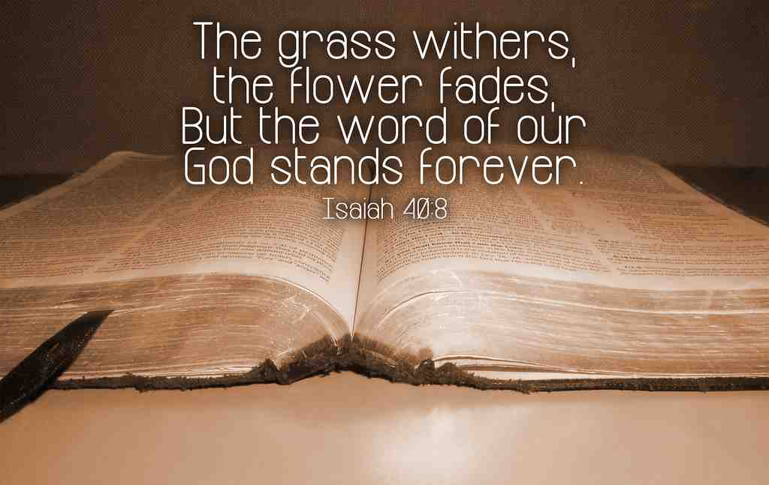
Isaiah 40 The Majesty of God
6-8 "All flesh is grass, And all its loveliness is like the flower of the field... 8 The grass withers, the flower fades, But the word of our God stands forever."

Slide 11
Isaiah 40 The Majesty of God
40:9 O Zion, You who bring good tidings, Get up into the high mountain; O Jerusalem, You who bring good tidings, Lift up your voice with strength, Lift it up, be not afraid; Say to the cities of Judah, "Behold your God!"

Slide 12
Isaiah 40:10-31 Images of God
12 Who has measured the waters in the hollow of His hand, measured heaven with a span and calculated the dust of the earth in a measure? Weighed the mountains in scales and the hills in a balance?

Slide 13
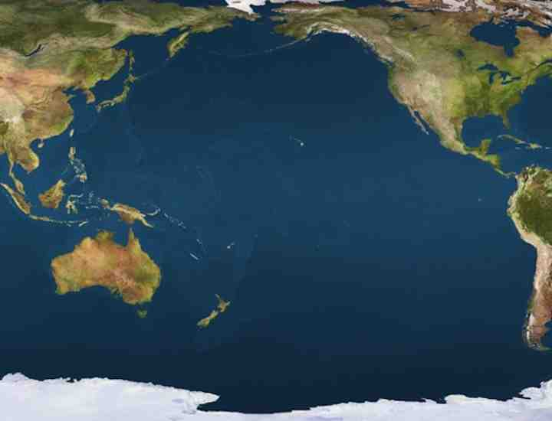
Measuring the waters in His hand

Slide 14
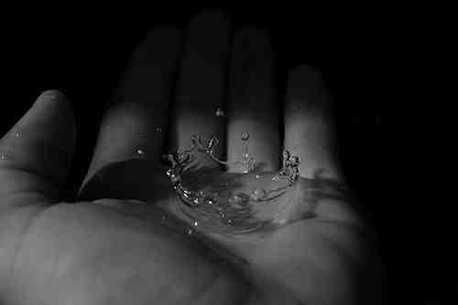
Isaiah 41:10-13 Fear not, for I am with you; Be not dismayed, for I am your God. I will strengthen you, Yes, I will help you, I will uphold you with My righteous right hand.' 13 For I, the Lord your God, will hold your right hand, Saying to you, 'Fear not, I will help you.'

Slide 15
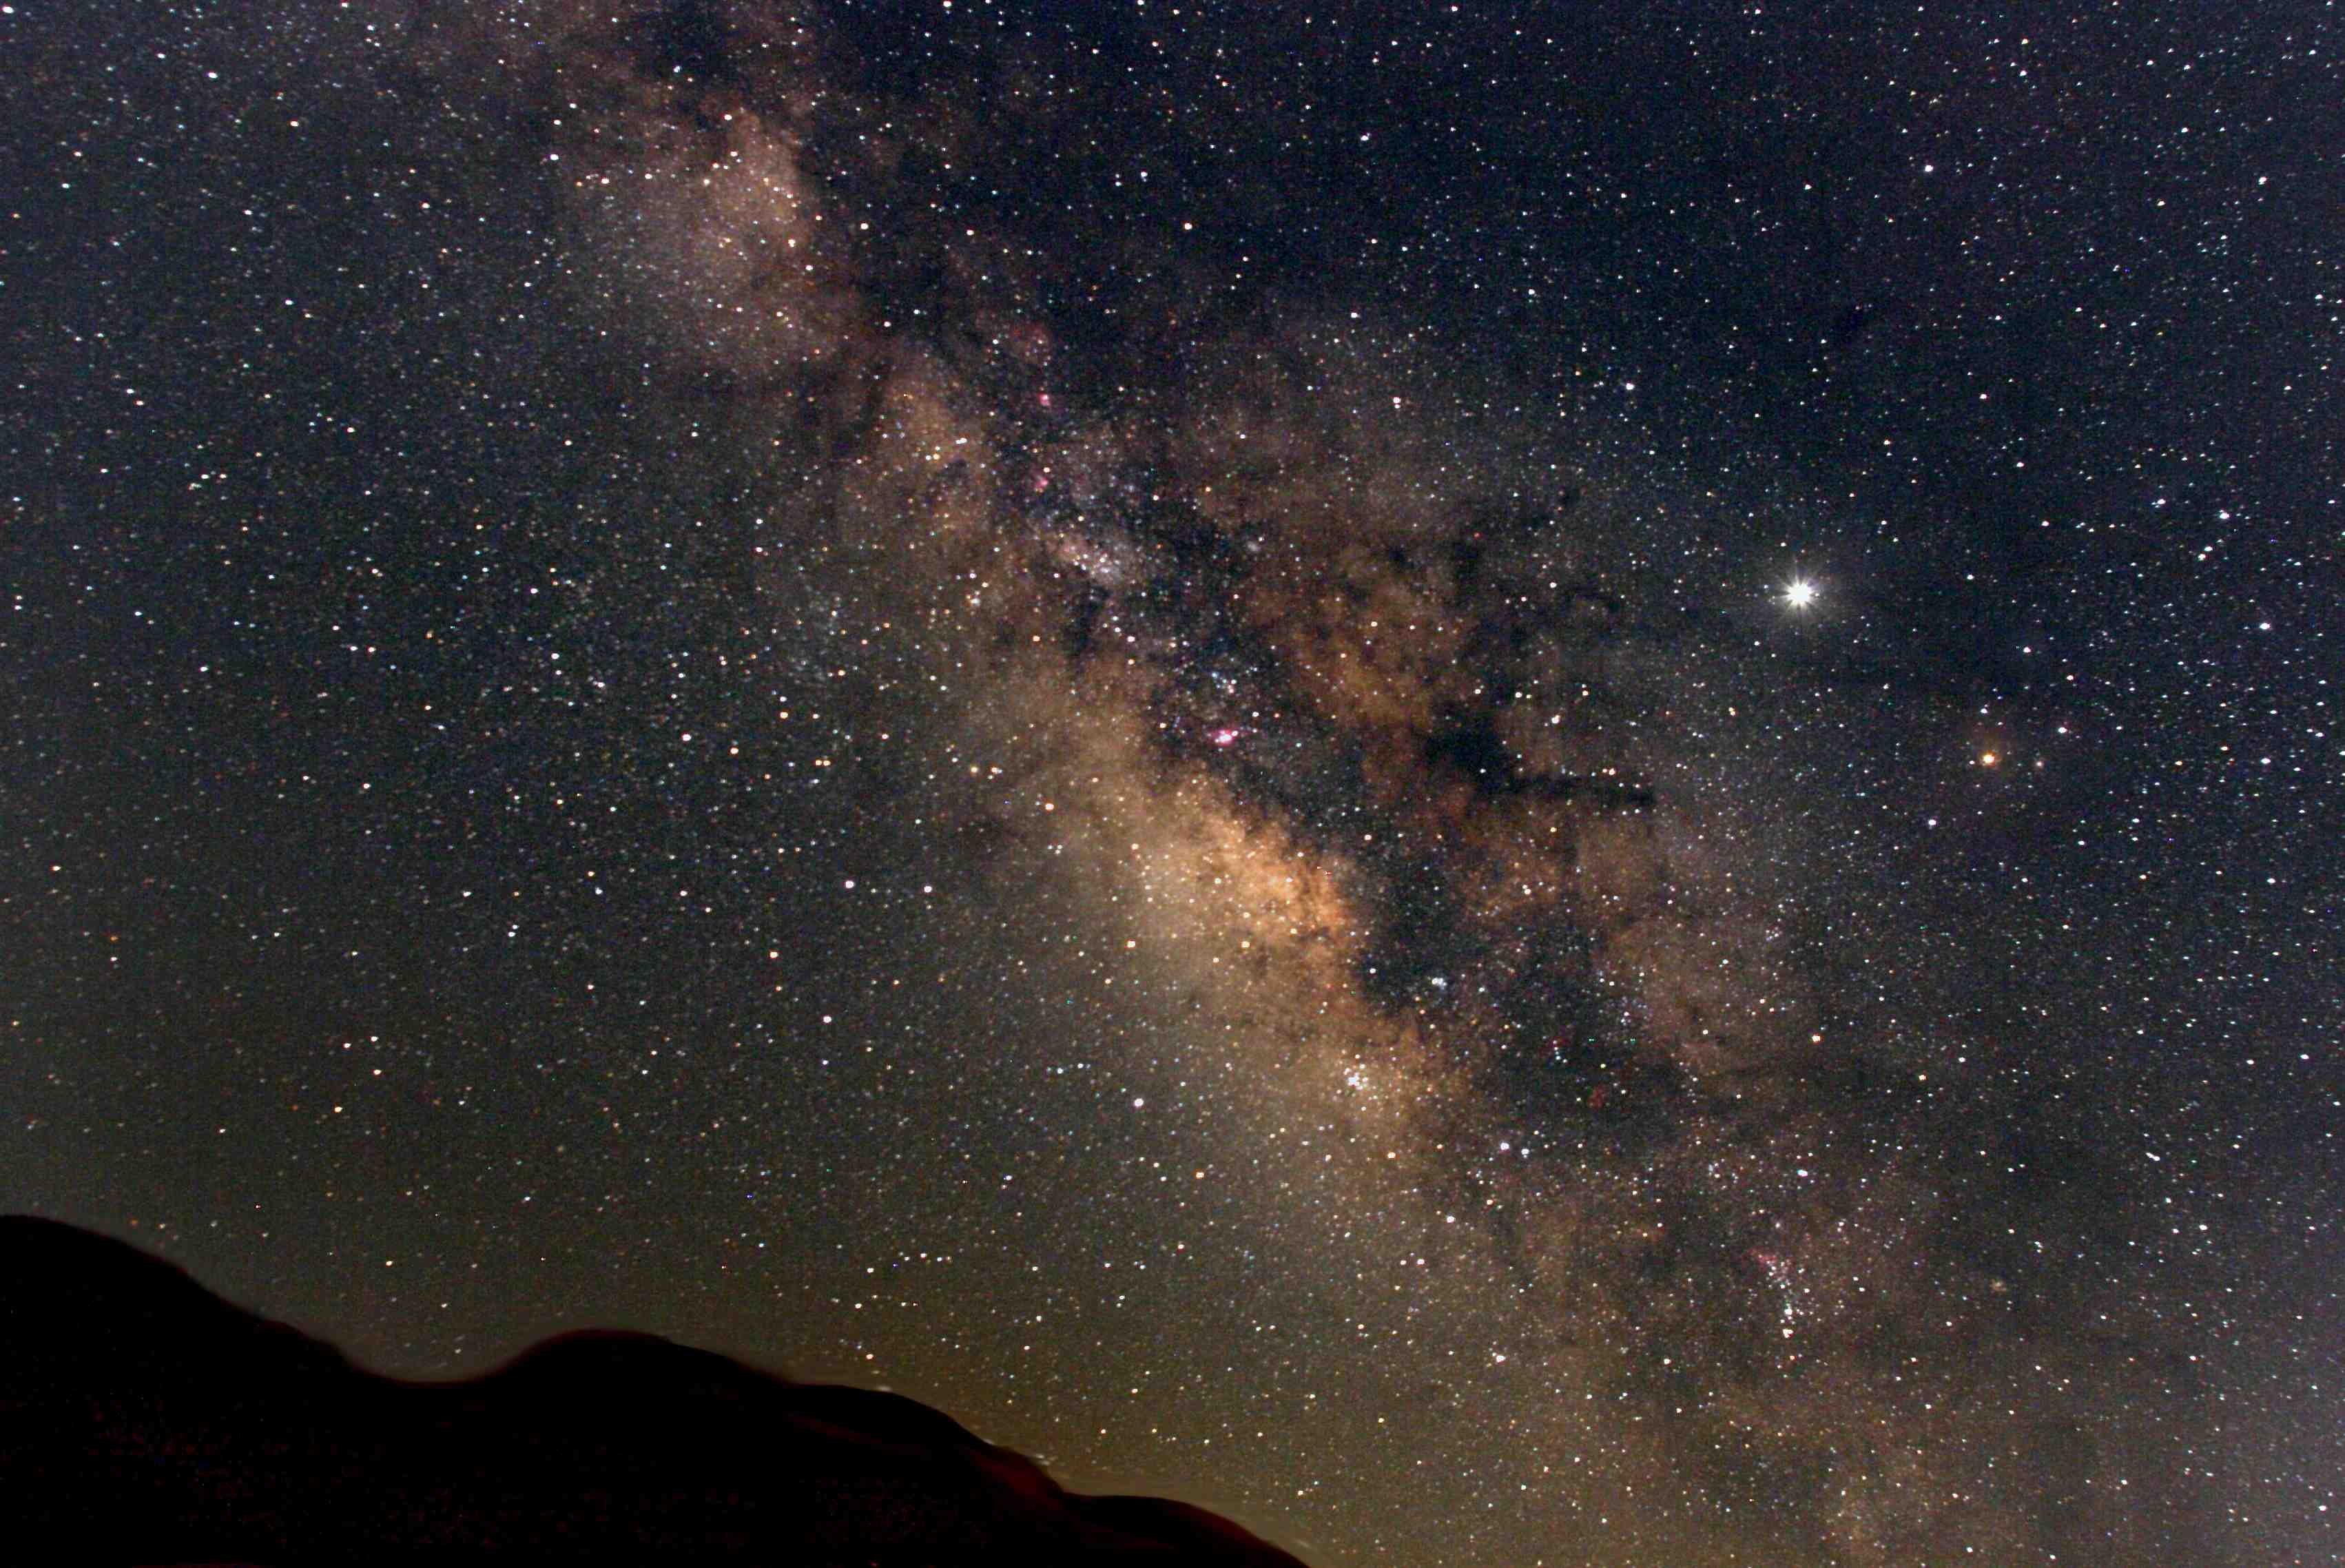
Who has measured the heavens with the span of His hand?

Slide 16
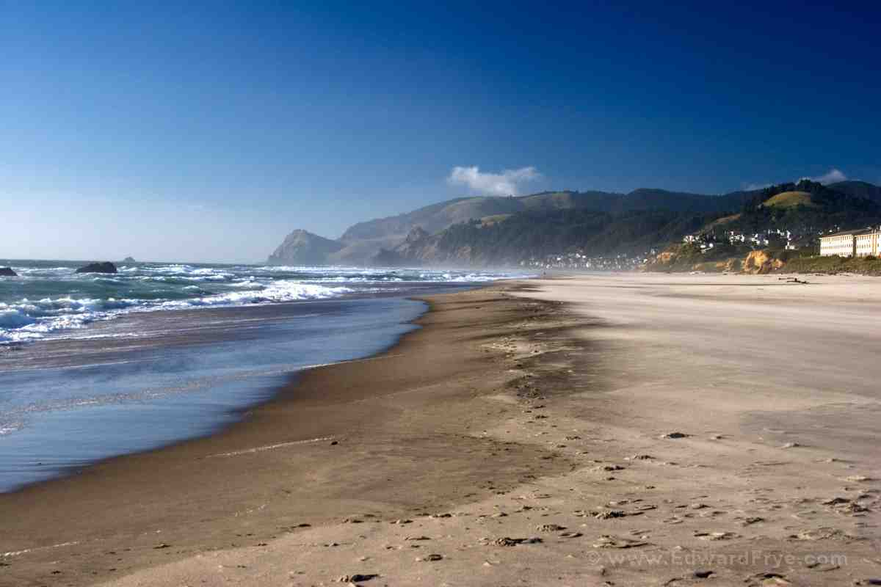
Who has calculated the dust of the earth?

Slide 17
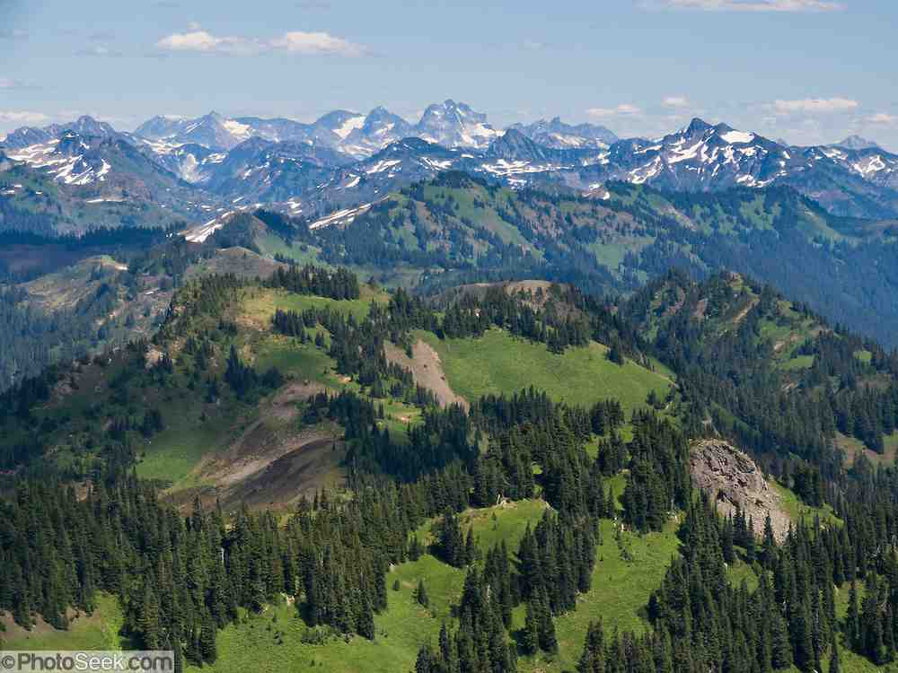
Who has weighed the mountains?

Slide 18
Isaiah 40:10-31 Images of God
13-14 Who has directed the Spirit of the Lord, Or as His counselor has taught Him? 14 With whom did He take counsel, and who instructed Him, And taught Him in the path of justice? Who taught Him knowledge, And showed Him the way of understanding?

Slide 19
Isaiah 40:10-31 Images of God
13-14 Who has directed the Spirit of the Lord, Or as His counselor has taught Him? 14 With whom did He take counsel, and who instructed Him, And taught Him in the path of justice? Who taught Him knowledge, And showed Him the way of understanding?

Slide 20
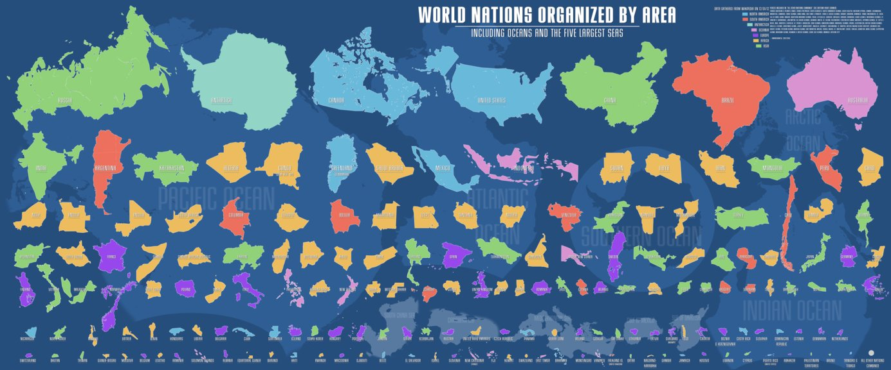
Isaiah 40:10-31 Images of God
Isaiah 40:15 Behold, the nations are as a drop in a bucket, And are counted as the small dust on the scales; Look, He lifts up the isles as a very little thing.

Slide 21
Isaiah 40:10-31 Images of God
Isaiah 40:21-22 Have you not known? Have you not heard? Has it not been told you from the beginning? Have you not understood from the foundations of the earth? 22 It is He who sits above the circle of the earth, And its inhabitants are like grasshoppers, Who stretches out the heavens like a curtain, And spreads them out like a tent to dwell in.

Slide 22
Isaiah 40:10-31 Images of God
Isaiah 40:23-24 He brings the princes to nothing; He makes the judges of the earth useless. 24 Scarcely shall they be planted, Scarcely shall they be sown, Scarcely shall their stock take root in the earth, When He will also blow on them, And they will wither, And the whirlwind will take them away like stubble.

Slide 23
Isaiah 40:10-31 Images of God
23-24 He brings the princes to nothing; He makes the judges of the earth useless. 24 Scarcely shall they be planted, Scarcely shall they be sown, Scarcely shall their stock take root in the earth, When He will also blow on them, And they will wither, And the whirlwind will take them away like stubble.
25 "To whom then will you liken Me, Or to whom shall I be equal?" says the Holy One.

Slide 24
Isaiah 40:10-31 Images of God
23-24 He brings the princes to nothing; He makes the judges of the earth useless. 24 Scarcely shall they be planted, Scarcely shall they be sown, Scarcely shall their stock take root in the earth, When He will also blow on them, And they will wither, And the whirlwind will take them away like stubble.
25 "To whom then will you liken Me, Or to whom shall I be equal?" says the Holy One.

Slide 25
Isaiah 40:10-31 Images of God
Isaiah 40:27-31 Why do you say, O Jacob, And speak, O Israel: "My way is hidden from the Lord, And my just claim is passed over by my God"? 28 Have you not known? Have you not heard? The everlasting God, the Lord, The Creator of the ends of the earth, Neither faints nor is weary. His understanding is unsearchable.

Slide 26
Isaiah 40:10-31 Images of God
29 He gives power to the weak, And to those who have no might He increases strength. 30 Even the youths shall faint and be weary, And the young men shall utterly fall,
31 But those who wait on the Lord Shall renew their strength; They shall mount up with wings like eagles, They shall run and not be weary, They shall walk and not faint.

Slide 27
Renewing Our Strength
Isaiah 40:27-31

