Slide 1
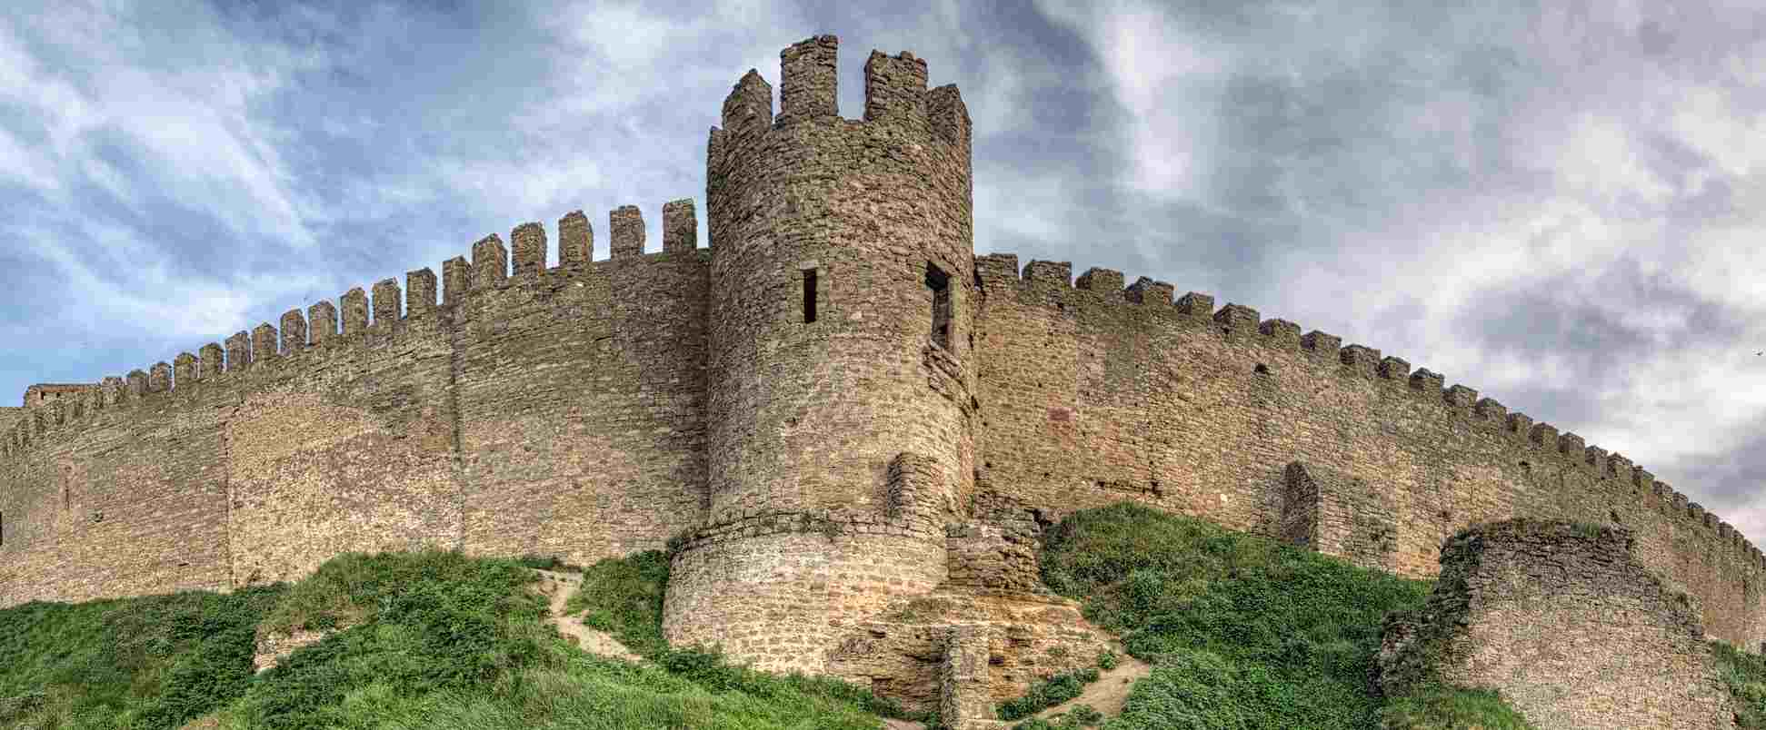
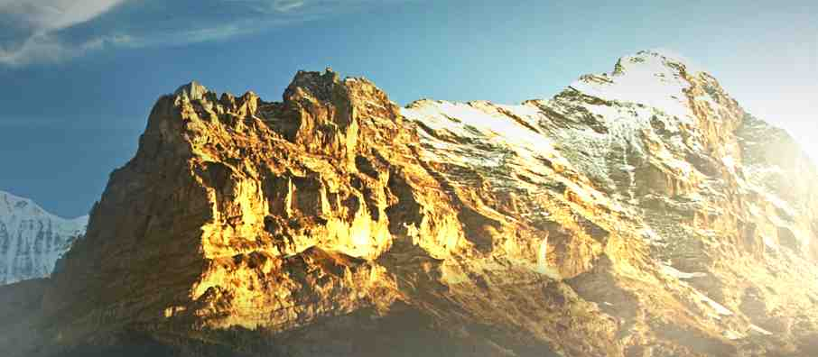
God is our Refuge and Strength
Psalm 46:1-11

Slide 2
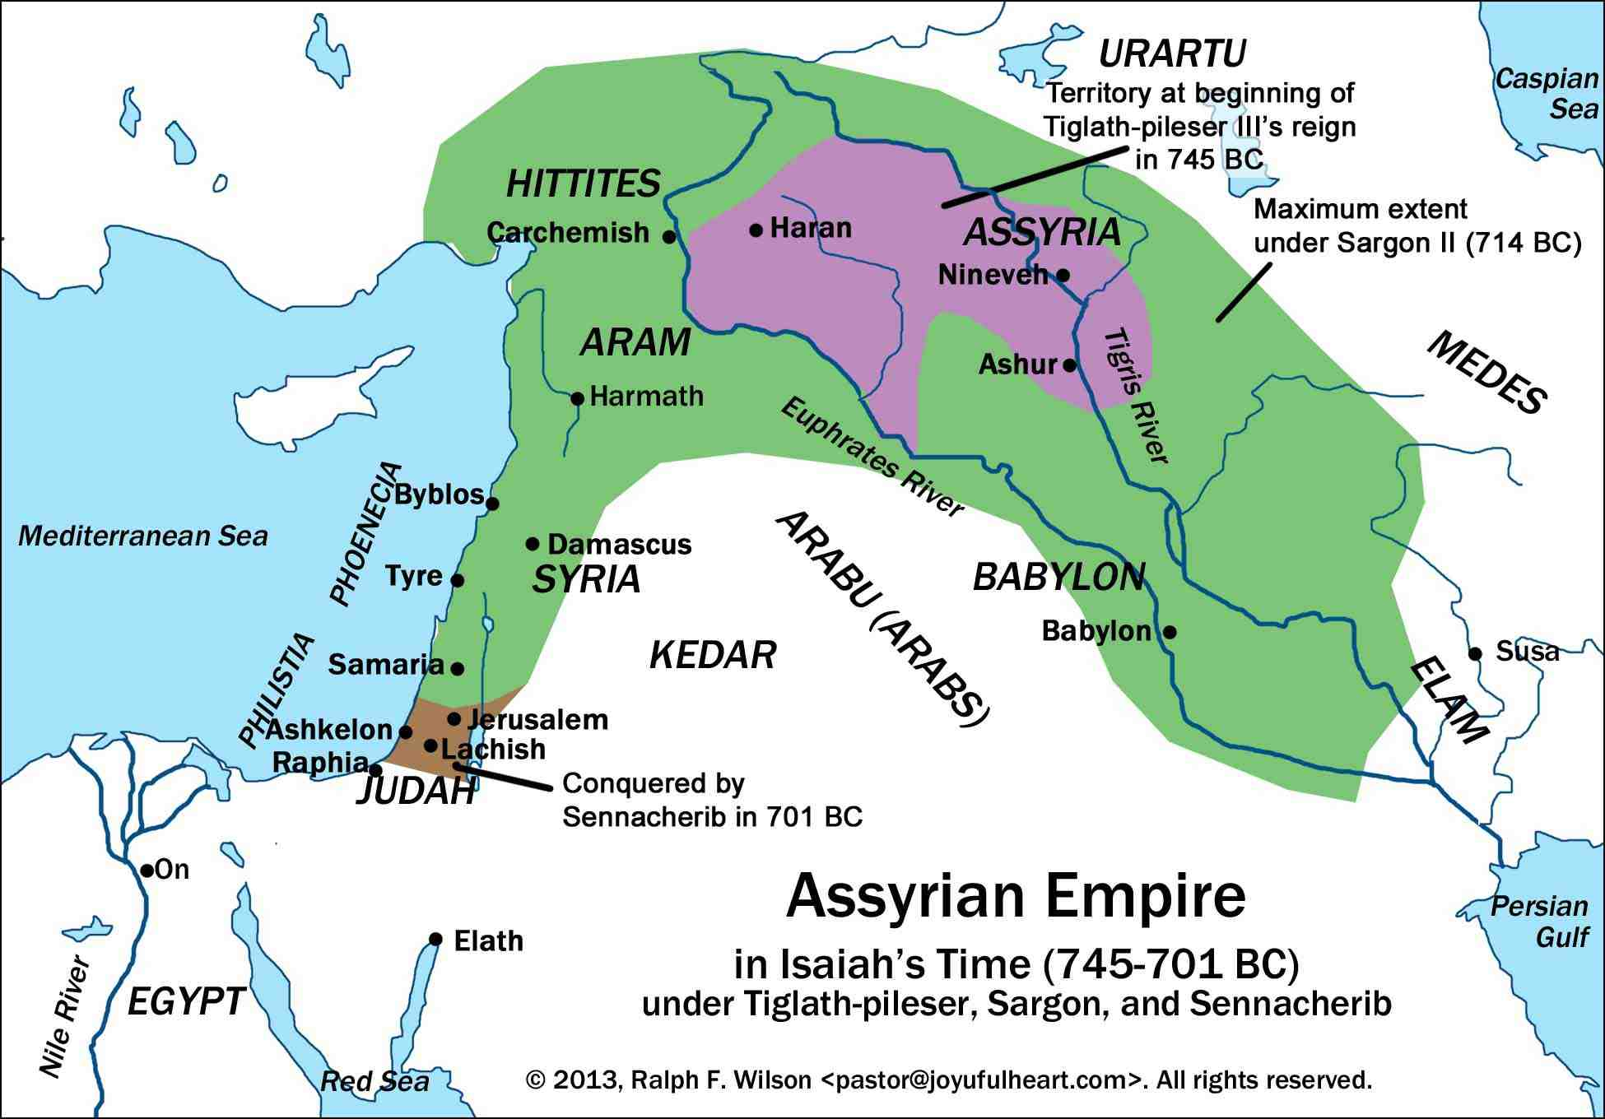

Slide 3
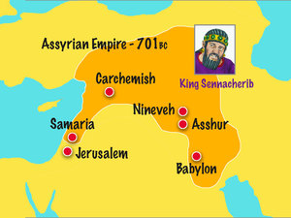
Background: Invasion of Judah by King Sennacherib of Assyrian in 701 B.C.

Slide 4
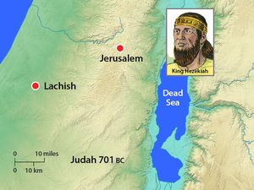

Slide 5
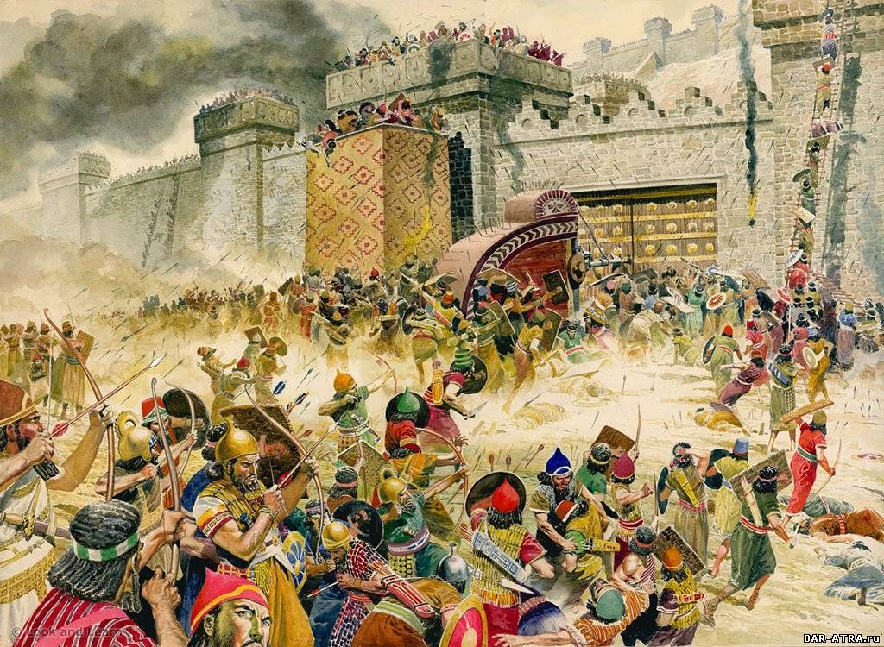
Assyrians conquer and burn city of Lachish

Slide 6
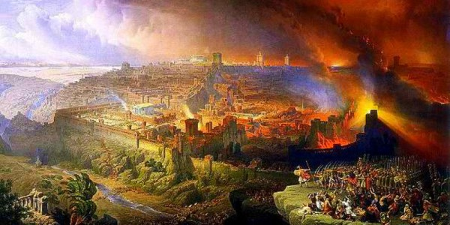
Distant fires of burning cities

Slide 7
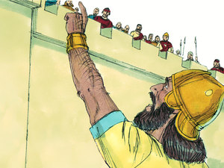
Sennacherib sends messenger demanding surrender of Hezekiah

Slide 8
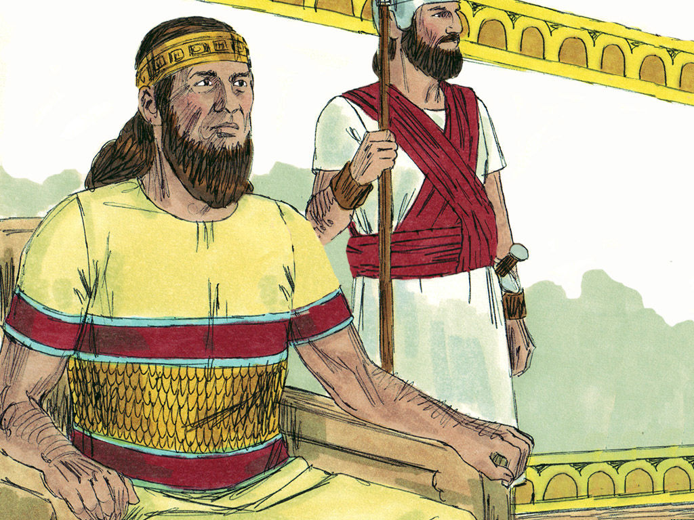
Hezekiah prays to God to show His power

Slide 9
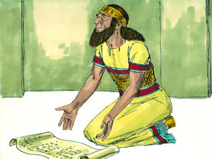
2 Kings 19:17-19 Truly, Lord, the kings of Assyria have laid waste the nations and their lands, 18 and have cast their gods into the fire; for they were not gods, but the work of men's hands — wood and stone. Therefore they destroyed them. 19 Now therefore, O Lord our God, I pray, save us from his hand, that all the kingdoms of the earth may know that You are the Lord God, You alone."

Slide 10
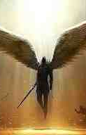
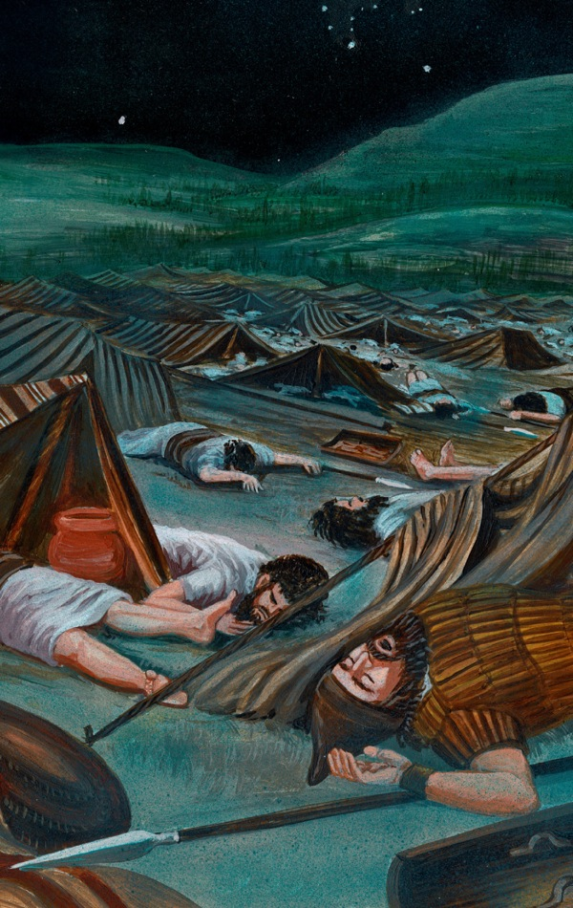
God sends just one angel

Slide 11
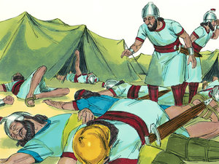
In morning 185,000 Assyrians found dead

Slide 12
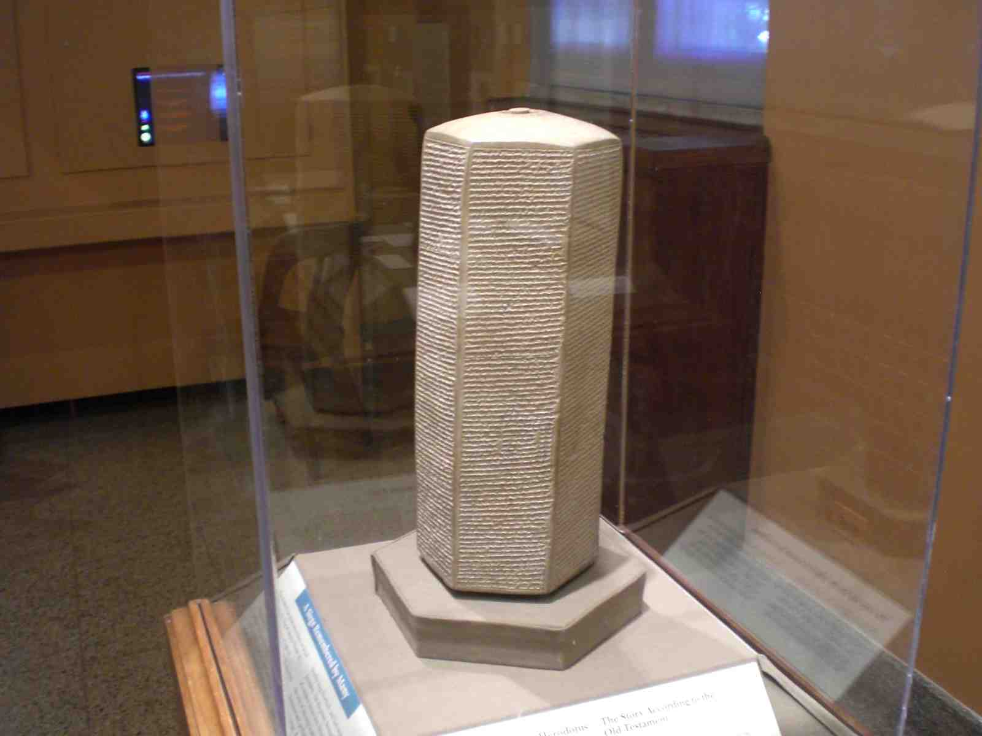
Taylor Prism, British Museum

Slide 13
God is Our Refuge
God is for us a place to which we may flee for safety.. for strength in danger

Slide 14
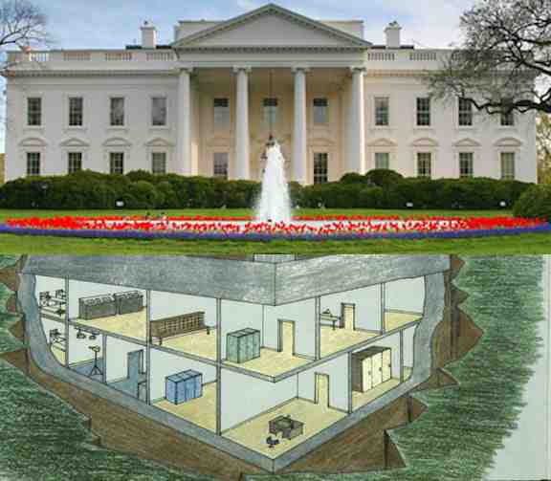
White House superbunker

Slide 15
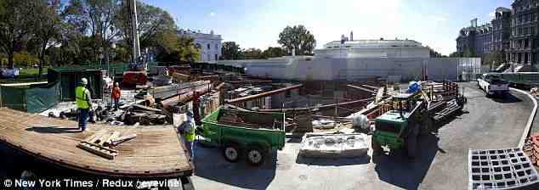
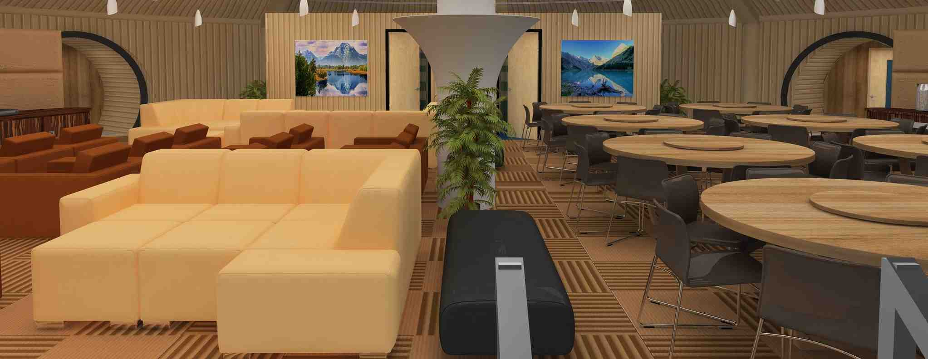

Slide 16
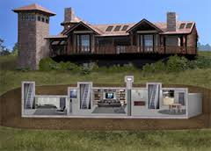
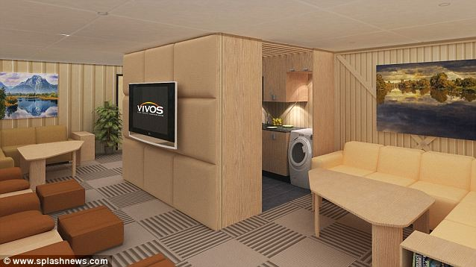
Doomsday bunkers

Slide 17
God is Our Refuge
Psalm 18:2-3 My God is my Rock, in whom I take refuge. Be my rock of refuge, to which I can always go.
Psa 18:30 The word of the Lord is proven; He is a shield to all who take refuge in Him.
Psa 119:114 You are my refuge and shield; I have put my hope in your word.
Psa 61:3 For You have been my refuge, a strong tower against the foe.

Slide 18
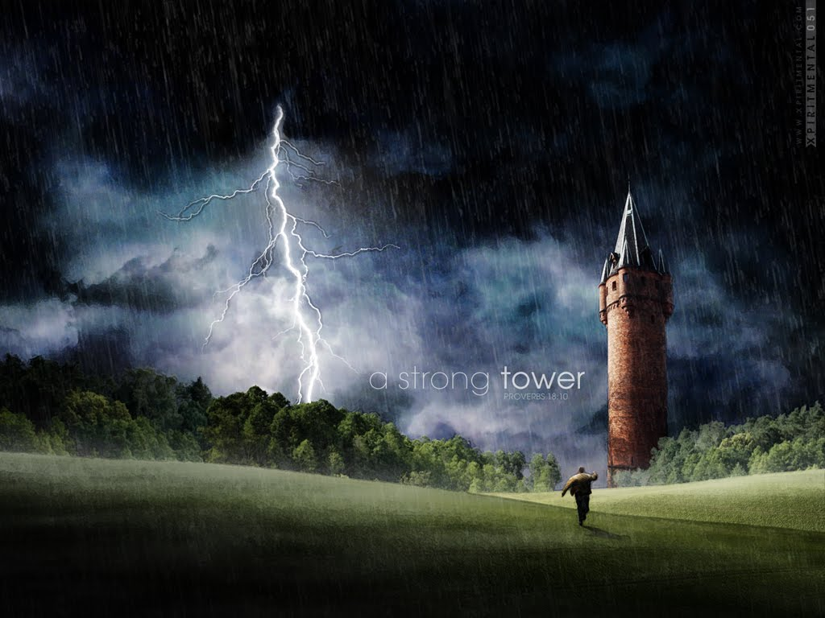
Psalm 18:10 The name of the Lord is a strong tower; the righteous run to it and are safe.

Slide 19
God is Our Refuge
Psalms 46:1-3 God is our refuge and strength, A very present help in trouble. 2 Therefore we will not fear, even though the earth be removed, And though the mountains be carried into the midst of the sea; 3 Though its waters roar and be troubled, though the mountains shake with its swelling.

Slide 20
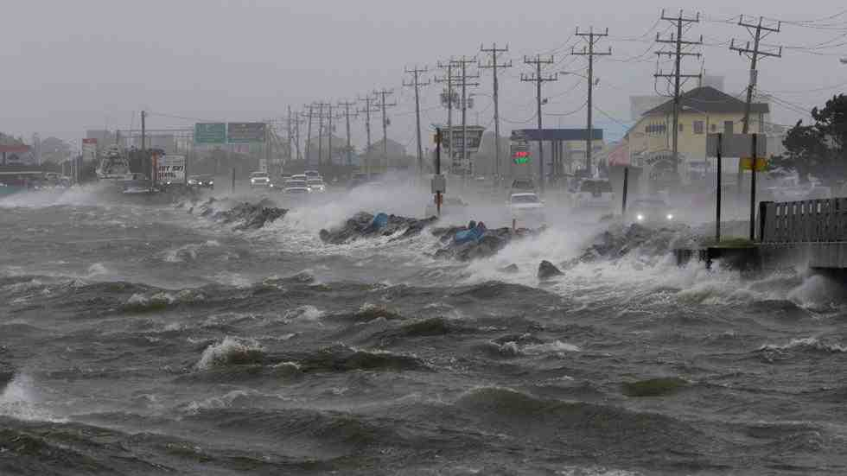
Hurricane Hermine, Virginia Beach

Slide 22
God is our Strength
He is our refuge around us
He is our strength inside us
A very present help in trouble

Slide 23
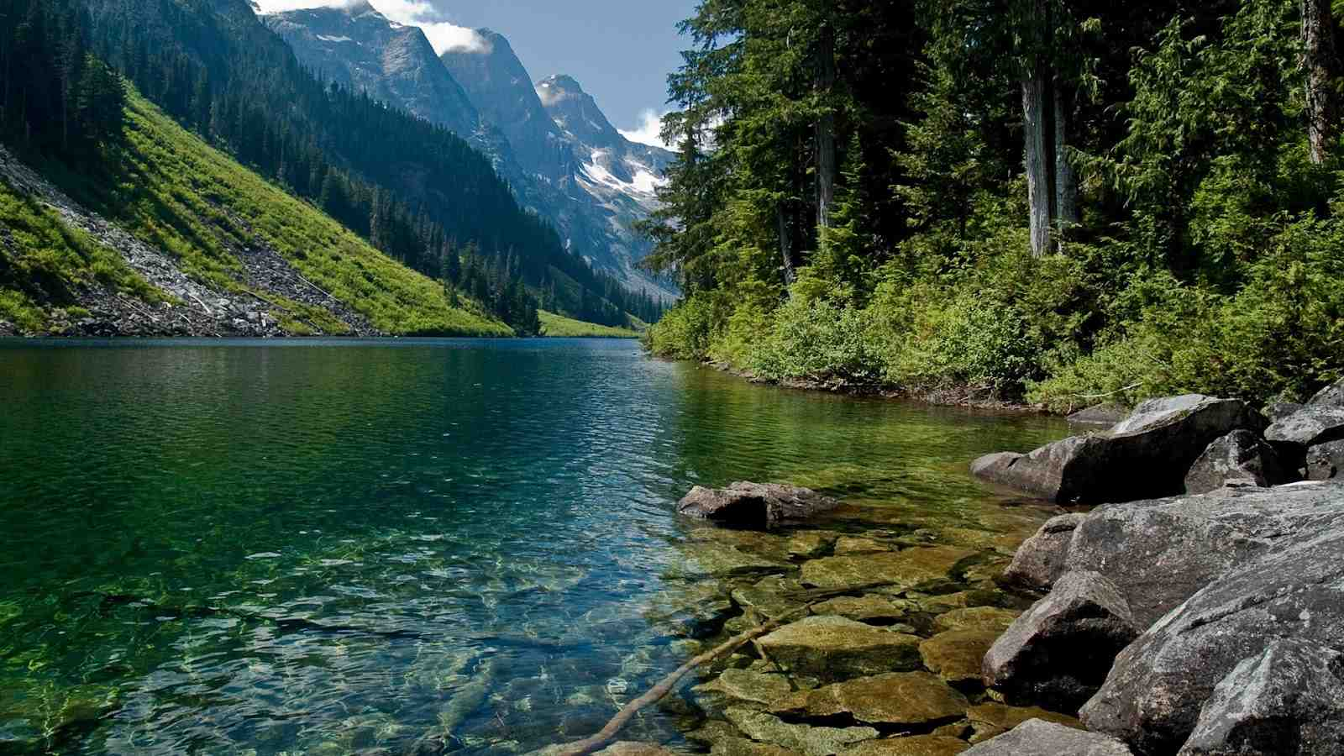
God is our River
Psalms 46:4 There is a river whose streams shall make glad the city of God, The holy place of the tabernacle of the Most High.

Slide 24
God is our River
Jeremiah 2:13 'For My people have committed two evils: They have forsaken Me, the fountain of living waters, And hewn themselves cisterns — broken cisterns that can hold no water.
Jeremiah 17:7-8 "Blessed is the man who trusts in the Lord, And whose hope is the Lord. 8 For he shall be like a tree planted by the waters, Which spreads out its roots by the river, And will not fear when heat comes; But its leaf will be green, And will not be anxious in the year of drought, Nor will cease from yielding fruit.

Slide 25
Jesus is our River
John 4:14 whoever drinks of the water that I shall give him will never thirst. But the water that I shall give him will become in him a fountain of water springing up into everlasting life."
John 7:37-39 "If anyone thirsts, let him come to Me and drink. 38 He who believes in Me, as the Scripture has said, out of his heart will flow rivers of living water." 39 But this He spoke concerning the Spirit, whom those believing in Him would receive; for the Holy Spirit was not yet given, because Jesus was not yet glorified.

Slide 26
God is the Lord of Hosts
Psalms 46:8-11 Come, behold the works of the Lord, Who has made desolations in the earth. 9 He makes wars cease to the end of the earth; He breaks the bow and cuts the spear in two; He burns the chariot in the fire.
10-11 Be still, and know that I am God; I will be exalted among the nations, I will be exalted in the earth! 11 The Lord of hosts is with us; The God of Jacob is our refuge. Selah

Slide 27
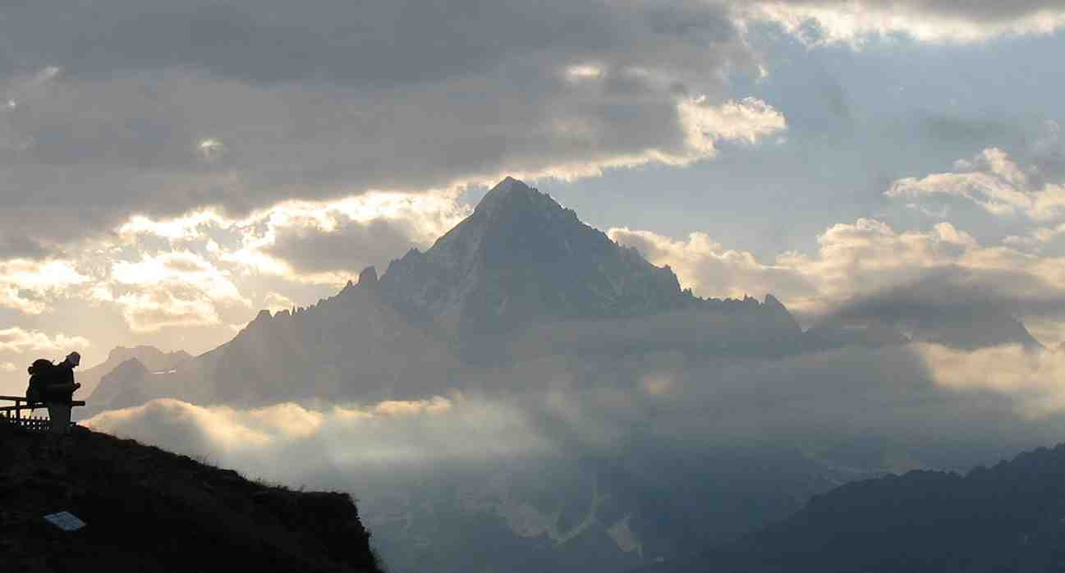
God is our Refuge
We will not fear
Be still and know that I am God

Slide 28
God is our Refuge and Strength
Psalm 46:1-11

Slide 29
