Slide 1
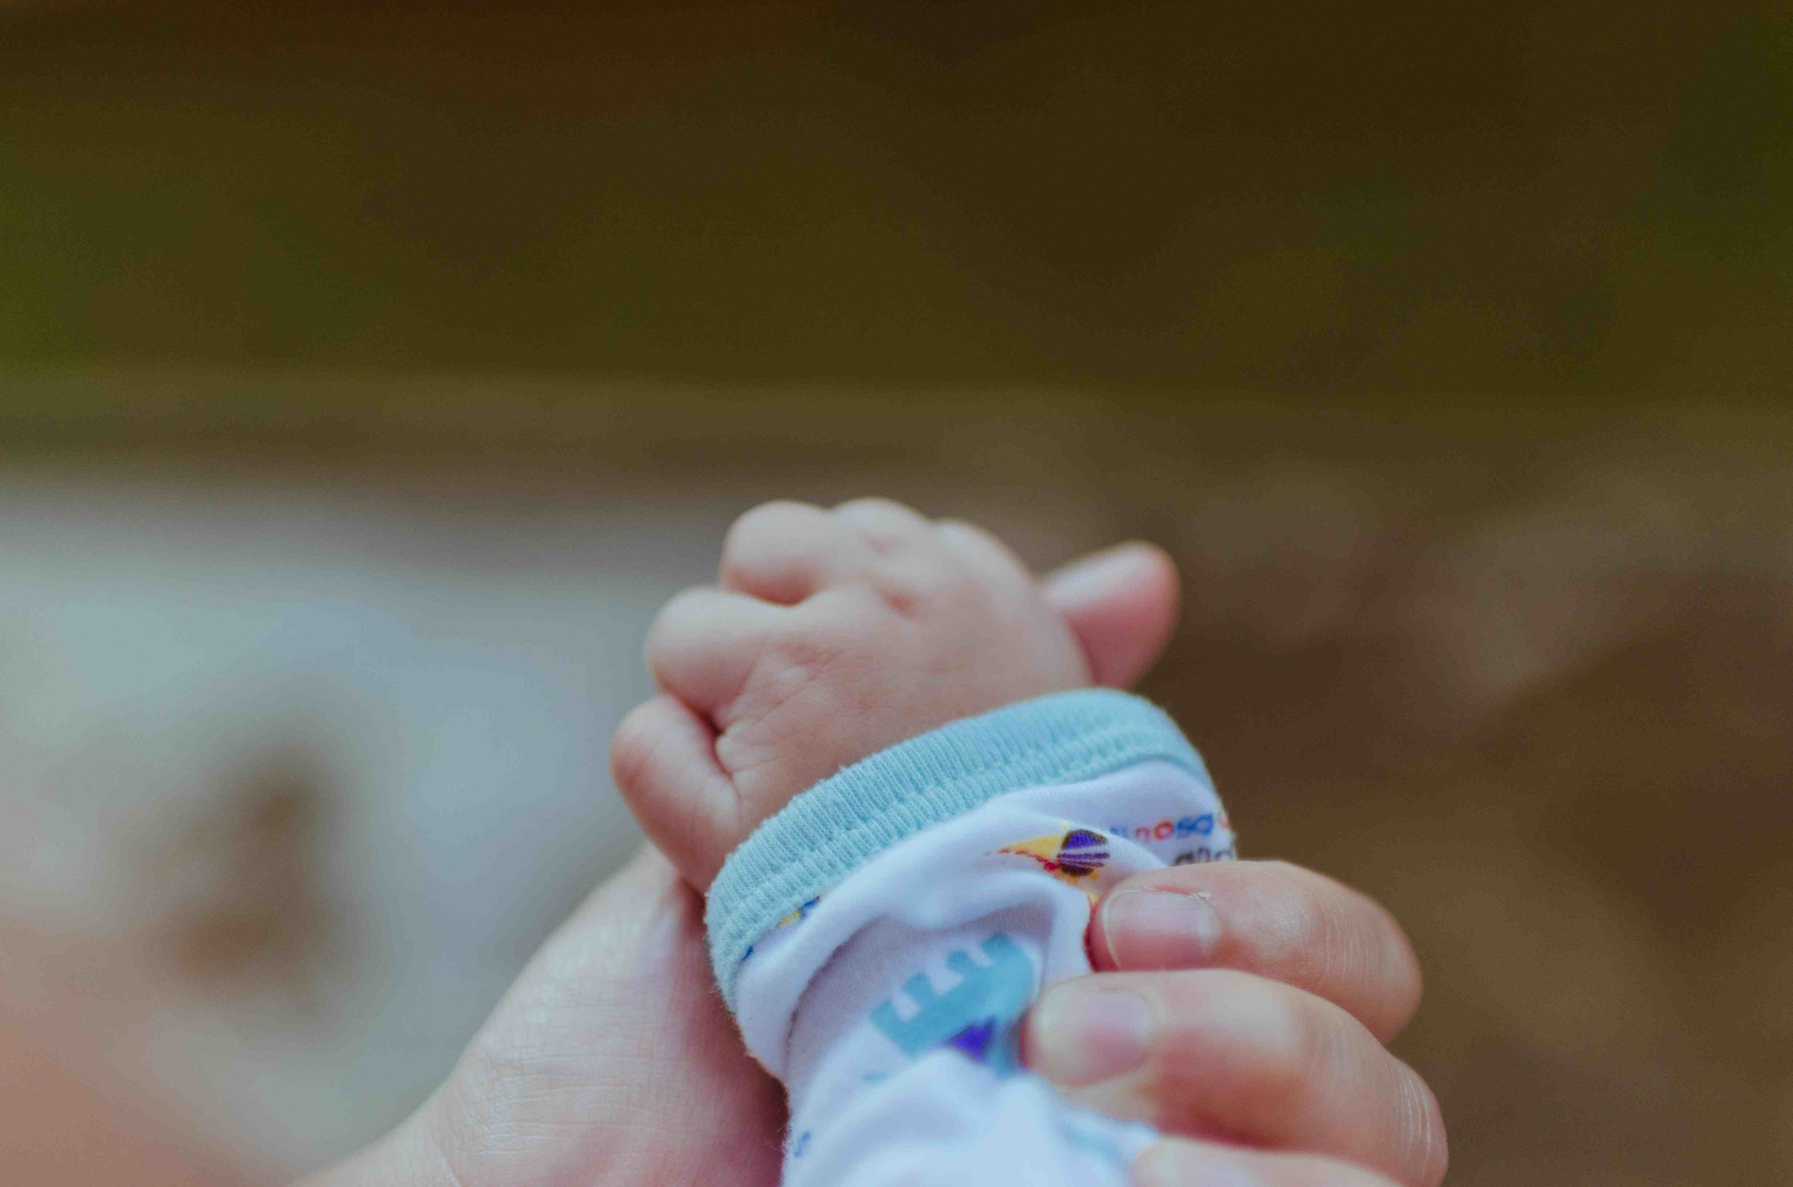
Are We Born with Sin?
Psalm 51:1-6

Slide 2
Why this matters..
This shifts the blame..
Removes ability to choose..
Our understanding of God..
We MUST Understand God

Slide 3
Options..
EITHER
We are innocent
until we sin
We are born inheriting sin
The Bible is not contradictory

Slide 4
Psalm 51..
¹ Have mercy upon me, O God, according to Your lovingkindness; According to the multitude of Your tender mercies, blot out my transgressions. ² Wash me thoroughly from my iniquity, and cleanse me from my sin.
³ For I acknowledge my transgressions, and my sin is always before me. ⁴ Against You, You only, have I sinned, And done this evil in Your sight— That You may be found just when You speak, And blameless when You judge.
A psalm of repentance, confession

Slide 5
Psalm 51..
⁵ Behold, I was brought forth in iniquity, and in sin my mother conceived me. ⁶ Behold, You desire truth in the inward parts, and in the hidden part You will make me to know wisdom.
Born guilty of sin or into a world of sin?
Psalm of repentance (for sins David has actively committed)
If sins he inherited, wouldn’t it point to Adam (why Davids’ mother?)

Slide 6
Psalm 58..
³ The wicked are estranged from the womb; They go astray as soon as they are born, speaking lies. ⁴ Their poison is like the poison of a serpent; They are like the deaf cobra that stops its ear, ⁵ Which will not heed the voice of charmers, Charming ever so skillfully. ⁶ Break their teeth in their mouth, O God! Break out the fangs of the young lions, O Lord!
Inherited sin or sin all around them?
Literally? (lies from birth, break their teeth?)
Point? (a wicked people who have chosen sin)

Slide 7
Ephesians 2..
¹And you He made alive, who were dead in trespasses and sins, , ² in which you once walked according to the course of this world, according to the prince of the power of the air, the spirit who now works in the sons of disobedience, ³ among whom also we all once conducted ourselves in the lusts of our flesh, fulfilling the desires of the flesh and of the mind, and were by nature children of wrath, just as the others.
Dead in sin (but God made them alive)
By nature children of wrath (a nature they were born with or a nature they chose?)

Slide 8
Ephesians 2..
⁴ But God, who is rich in mercy, because of His great love with which He loved us, ⁵ even when we were dead in trespasses, made us alive together with Christ (by grace you have been saved),
We chose to sin, but we have a God who still loves us ..
Vs 10 Good works we were created to walk in
We have a choice..

Slide 9
Romans 5..
¹² Therefore, just as through one man sin entered the world, and death through sin, and thus death spread to all men, because all sinned— ¹³ (For until the law sin was in the world, but sin is not imputed when there is no law. ¹⁴ Nevertheless death reigned from Adam to Moses, even over those who had not sinned according to the likeness of the transgression of Adam, who is a type of Him who was to come.

Slide 10
Romans 5..
¹⁵ But the free gift is not like the offense. For if by the one man’s offense many died, much more the grace of God and the gift by the grace of the one Man, Jesus Christ, abounded to many.
One man (Adam) brought condemnation and death to all
One Man (Jesus Christ) brought life and righteousness to all
Vs 12 – for all sinned (vs 14) not like Adam’s
Universal salvation? No.. choosing to participate brings salvation to the individual

Slide 11
Understanding sin..
1 John 3:4 sin is lawlessness
Matt 18:1-3 how Jesus dealt with children
Greatest in the kingdom like little child
Isaiah 7:16 refuse evil and choose good
Ezekiel 18:19-20 whose sin do we answer for?
We answer for our own sins

Slide 12
Things that are clear..
We answer for our own sins (2 Cor 5:10)
Are little children saved?
If born in sin, how can they be saved?
What is sin? (lawlessness)
Can I choose to obey God?
Matthew 25 God knows our ability

Slide 13
Are We Born with Sin?
Psalm 51:1-6

