Slide 1
Love the Lord Your God… With All Your Strength
Mark 12:28-34

Slide 2
Meaning of life?

Slide 3
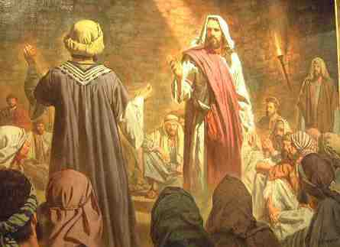
Jesus asked question..
²⁸ Then one of the scribes came, and having heard them reasoning together, perceiving that He had answered them well, asked Him, “Which is the first commandment of all?”
²⁹ Jesus answered him, “The first of all the commandments is: ‘Hear, O Israel, the Lord our God, the Lord is one. ³⁰ And you shall love the Lord your God with all your heart, with all your soul, with all your mind, and with all your strength.’ This is the first commandment.

Slide 4
Jesus debating..
³¹ And the second, like it, is this: ‘You shall love your neighbor as yourself.’ There is no other commandment greater than these.”
³² So the scribe said to Him, “Well said, Teacher. You have spoken the truth, for there is one God, and there is no other but He. ³³ And to love Him with all the heart, .. and to love one’s neighbor as oneself, is more than all the whole burnt offerings and sacrifices.”

Slide 5
Jesus debating..
³⁴ Now when Jesus saw that he answered wisely, He said to him, “You are not far from the kingdom of God.” But after that no one dared question Him.

Slide 6
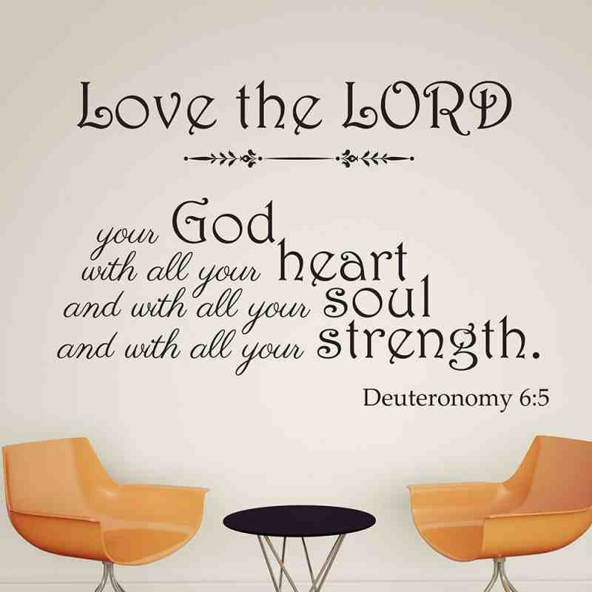

Slide 7
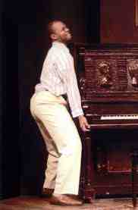
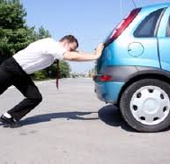
Using all your strength..
This is how we’re to love God

Slide 8
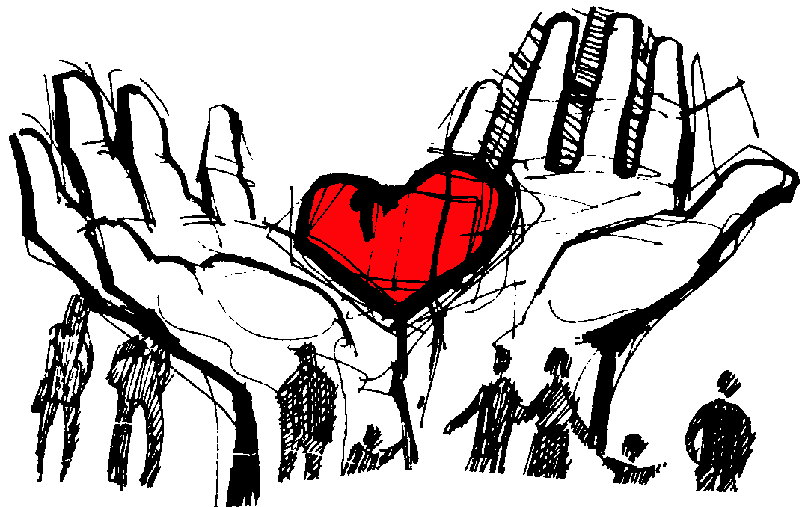
We’re made to love God
Adam and Eve in the Garden

Slide 9
Loving God is the most important thing we do..
2 Tim 3:4 last days men will be.. lovers of pleasure more than lovers of God
1 Cor 16:22 If anyone does not love the Lord Jesus Christ, let him be accursed

Slide 10
God measures our love for Him..
Deut 13:1-3 “If there arises among you a prophet or a dreamer of dreams, and he gives you a sign or a wonder, ² and the sign or the wonder comes to pass, of which he spoke to you, saying, ‘Let us go after other gods’—which you have not known—‘and let us serve them,’ ³ you shall not listen to the words of that prophet or that dreamer of dreams, for the Lord your God is testing you to know whether you love the Lord your God with all your heart and with all your soul.

Slide 11
God measures our love for Him..
John 21:15-17 Jesus said to Peter, “Do you love me more than these?... Do you love me? Do you love me?”
John 21:17 “Lord, you know all things; you know that I love you”

Slide 12
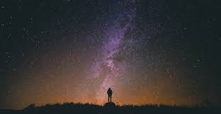
Loving someone currently invisible..
1 Peter 1:8 whom having not seen you love. Though now you do not see Him, yet believing, you rejoice with joy inexpressible and full of glory,

Slide 13
Means we can hardly wait for His return..
2 Tim 4:8 Finally, there is laid up for me the crown of righteousness, which the Lord, the righteous Judge, will give to me on that Day, and not to me only but also to all who have loved His appearing.

Slide 14
Demonstrating our love..
Rom 5:8 God demonstrates His own love for us in that He gave His own Son ..
Matt 10:37 Anyone who loves their father or mother more than me is not worthy of me; anyone who loves their son or daughter more than me is not worthy of me. Whoever does not take up their cross and follow me is not worthy of me.

Slide 15
Saying we love Him..
Psalm 18:1 I love you, Lord, my strength
“I love you, Lord. I love you with all my heart, soul, mind, and strength. I love you more than anyone or anything in this world. I love you with an imperfect love for I am an imperfect person, but nevertheless I love you, Lord, and I love you with all my strength.”

Slide 16
By acknowledging Him publicly..
“I have decided to follow Jesus”.. No turning back, no turning back
Though none go with me, I still will follow.. No turning back, no turning back
My cross I’ll carry till I see Jesus.. No turning back, I’ll follow Him..

Slide 17
By loving His word.. Psalm 119
97 Oh how I love you law! It is my meditation all the day
127 I love your commands more than gold
140 Your promise have been thoroughly tested and your servant loves them
163 I hate and detest falsehood but I love your law
165 Great peace have those who love your law and nothing can make them stumble

Slide 18
By obeying Him
John 14:15,21 If you love me, keep my commandments. Whoever has my commands and keeps them is the one who loves me.
1 John 5:2-3 This is how we know that we love the children of God: by loving God and carrying out his commands. ³ In fact, this is love for God: to keep his commands. And his commands are not burdensome.

Slide 19
By hating evil
Let those who love the Lord hate evil, for he guards the lives of his faithful ones and delivers them from the hand of the wicked.
By calling on Him in prayer
Psalm 116:1-2 I love the Lord, for he heard my voice; he heard my cry for mercy. ² Because he turned his ear to me, I will call on him as long as I live.

Slide 20
By loving God’s people
1 John 4:20-21 Whoever claims to love God yet hates a brother or sister is a liar. For whoever does not love their brother and sister, whom they have seen, cannot love God, whom they have not seen. ²¹ And he has given us this command: Anyone who loves God must also love their brother and sister.

Slide 21
How God blesses those who love Him..
He will watch over us..
The Lord is near to all who call on him, to all who call on him in truth. ¹⁹ He fulfills the desires of those who fear him; he hears their cry and saves them. ²⁰ The Lord watches over all who love him, but all the wicked he will destroy.
He will make His home with us..
John 14:21,23 The one who loves me will be loved by my Father, and I too will love them and show myself to them.” ²³ Jesus replied, “Anyone who loves me will obey my teaching. My Father will love them, and we will come to them and make our home with them.

Slide 22
How God blesses those who love Him..
He will watch over us..
Romans 8:28 And we know that all things work together for good to those who love God, to those who are the called according to His purpose.
He will bestow on us the crown of life..
Blessed is the man who endures temptation; for when he has been approved, he will receive the crown of life which the Lord has promised to those who love Him.

Slide 23
The reason why we love Him?..

Slide 24
Love the Lord Your God… With All Your Strength
Mark 12:28-34

