Slide 1
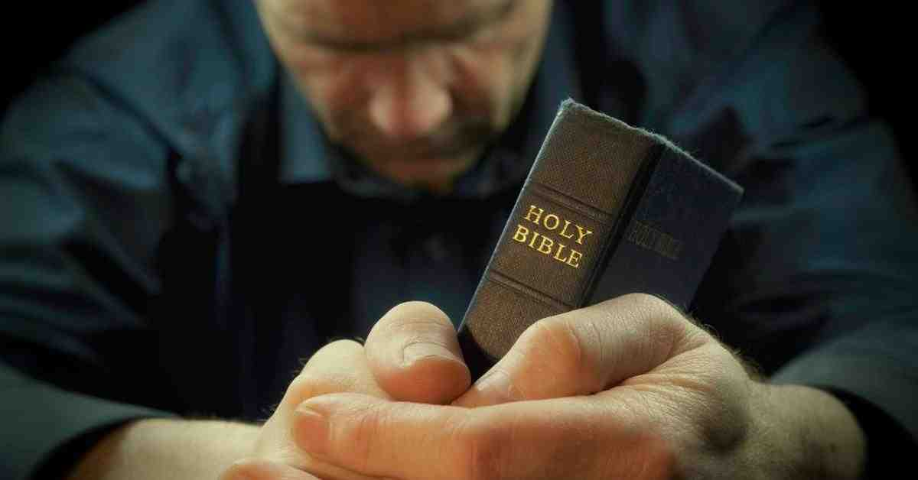
Strengthened with the Power of God
Ephesians 3:13-21

Slide 2
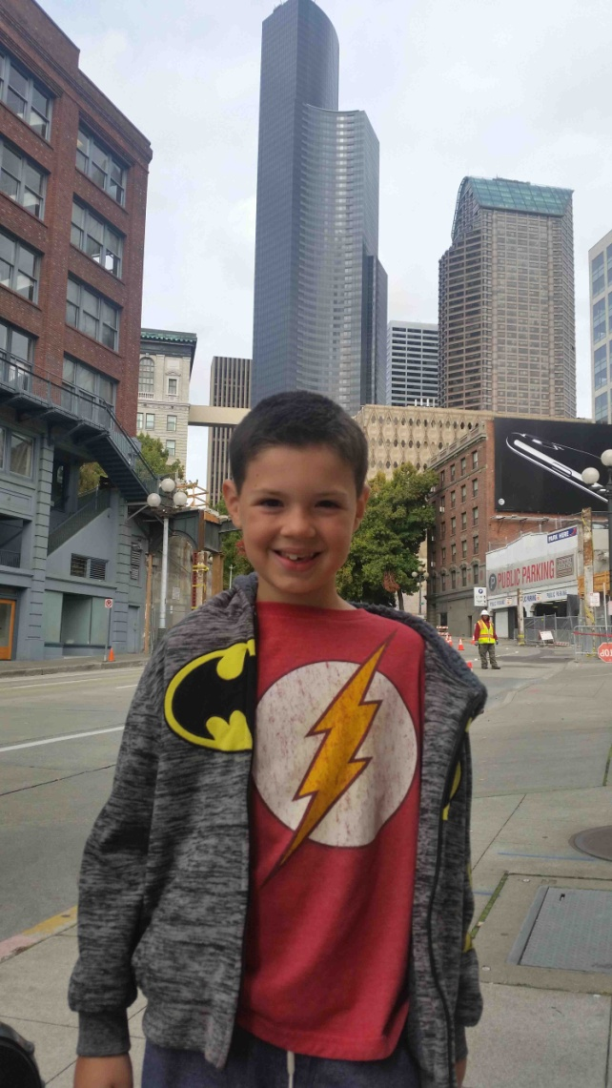
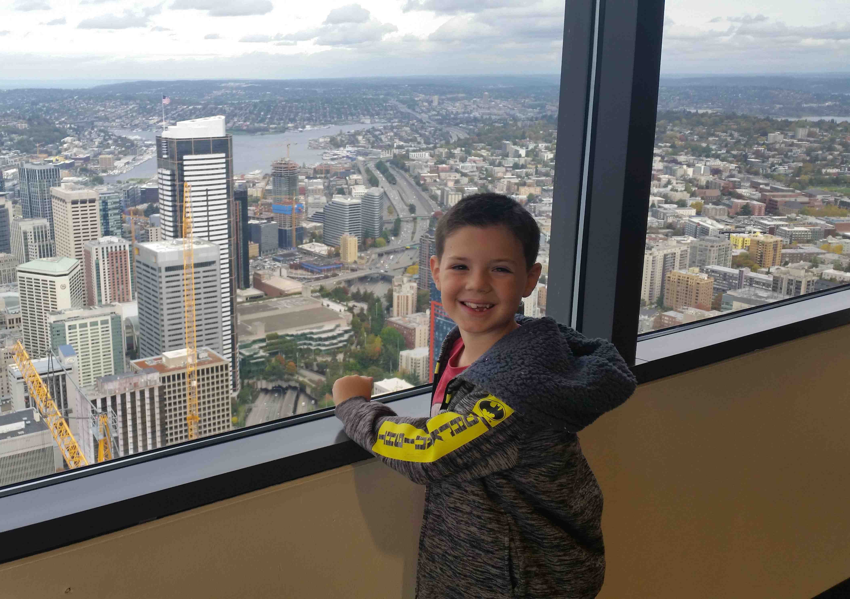
Columbia Tower (73rd Floor Observatory)
360 view of Seattle

Slide 3
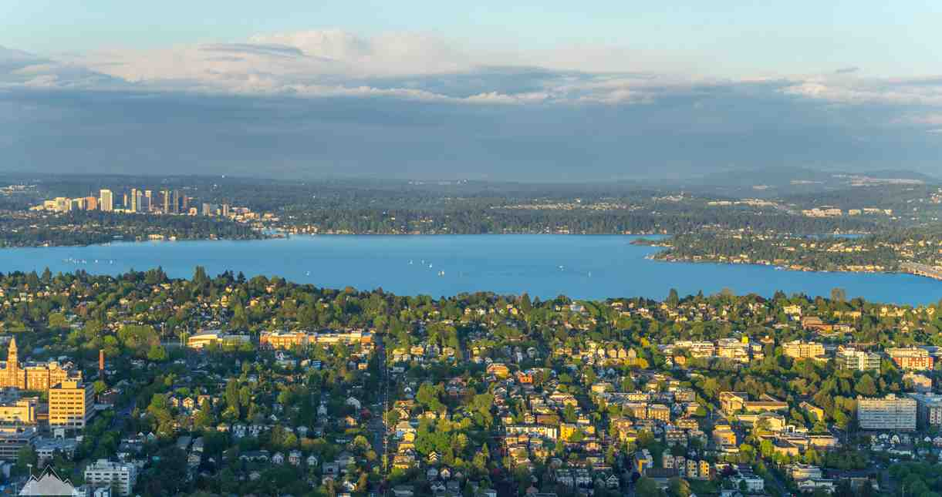
Wealth all around us..
We live in one of the most affluent areas ..

Slide 4
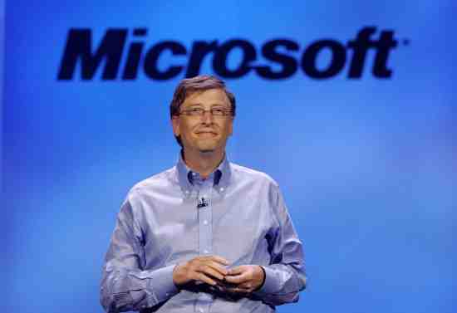
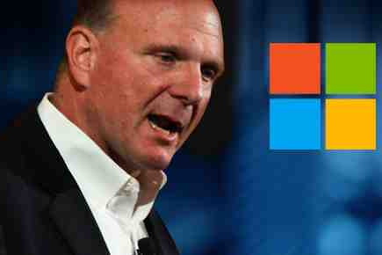
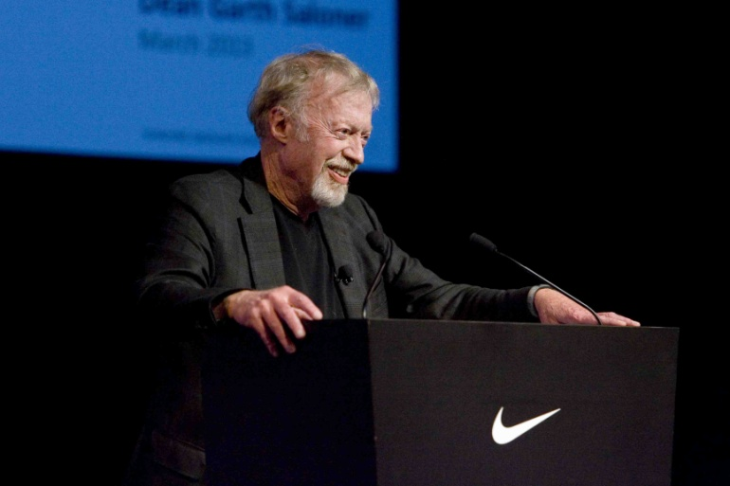
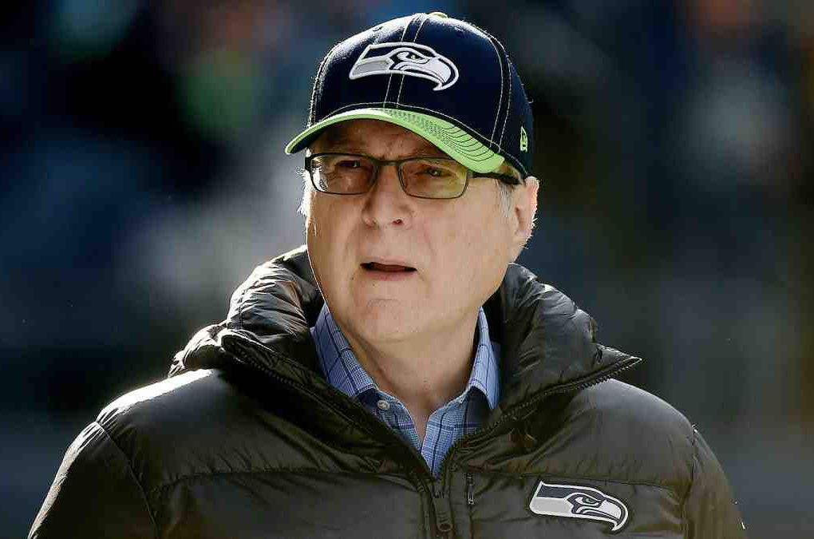
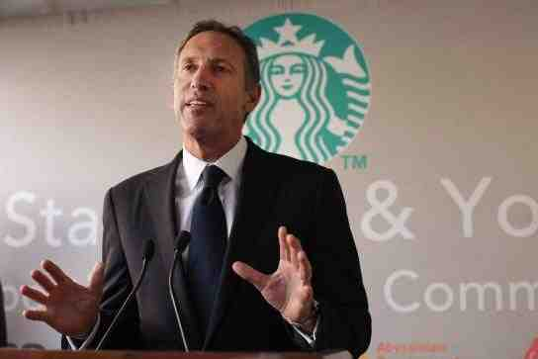
Local billionaires ..

Slide 5
Every child of God has a far greater portfolio..
Eph 3:14-16 I bow my knees to the Father of our Lord Jesus Christ.. ¹⁶ that He would grant you, according to the riches of His glory, to be strengthened with power through His Spirit in the inner man.
We are heirs of God..

Slide 6
Ch 1-3 Our riches in Christ
Eph 1:3-7 Blessed be the God and Father of our Lord Jesus Christ, who has blessed us with every spiritual blessing in the heavenly places in Christ... ⁷ In Him we have redemption through His blood, the forgive-ness of sins, according to the riches of His grace.
1:18-20 the eyes of your understanding being enlightened; that you may know what is the hope of His calling, what are the riches of the glory of His inheritance in the saints, ¹⁹ and what is the exceeding greatness of His power toward us who believe..

Slide 7
Ch 1-3 riches in Christ
2:4-7 But God, who is rich in mercy, because of His great love with which He loved us, even when we were dead in trespasses, made us alive together with Christ.. that in the ages to come He might show the exceeding riches of His grace in His kindness toward us in Christ Jesus.
3:8-10 To me, who am less than the least of all the saints, this grace was given, that I should preach among the Gentiles the unsearchable riches of Christ, that now the manifold wisdom of God might be made known by the church…

Slide 8
Paul’s own circumstances ..
Eph 3:13 Therefore I ask that you do not lose heart at my tribulations for you, which is your glory.
3:14 For this reason I bow my knees to the Father of our Lord Jesus Christ, ¹⁵ from whom the whole family in heaven and earth is named.
Paul’s desire that we apply our blessings..

Slide 9
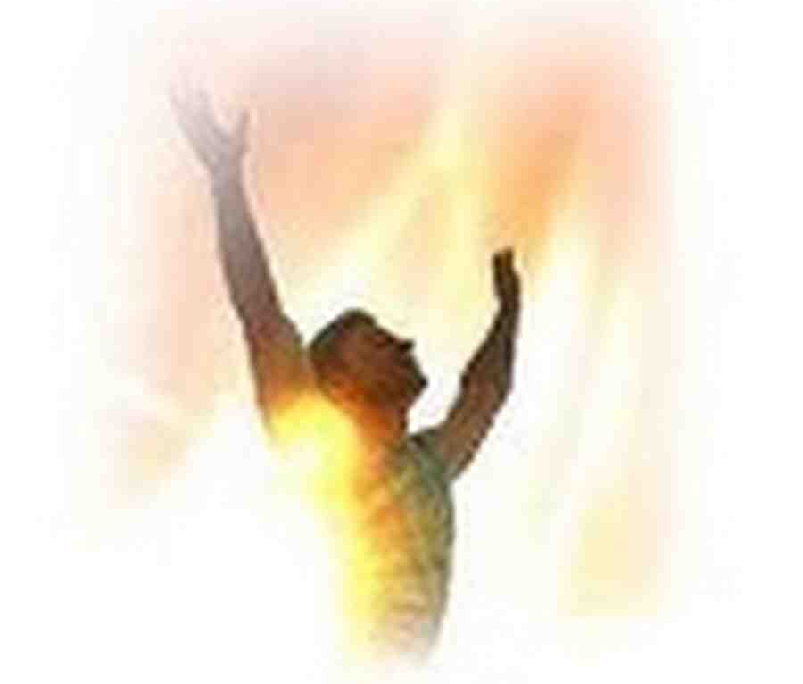
Peaks of Paul’s prayer..
Inner strength..
16 that He would grant you, according to the riches of His glory, to be strengthened with power through His Spirit in the inner man..

Slide 10
God strengthens us with power through His Spirit..
“Dunamis”(power, might, strength, ability)
Rom 1:16 the gospel the power of God unto salvation..
2 Cor 4:7 treasure in earthen vessels.. this all-surpassing power is from God
2 Tim 1:7 God has not given us a spirit of fear, but of power and of love and of a sound mind.
Col 1:10-11 bearing fruit in every good work, being strengthened with all power according to His glorious might..

Slide 11
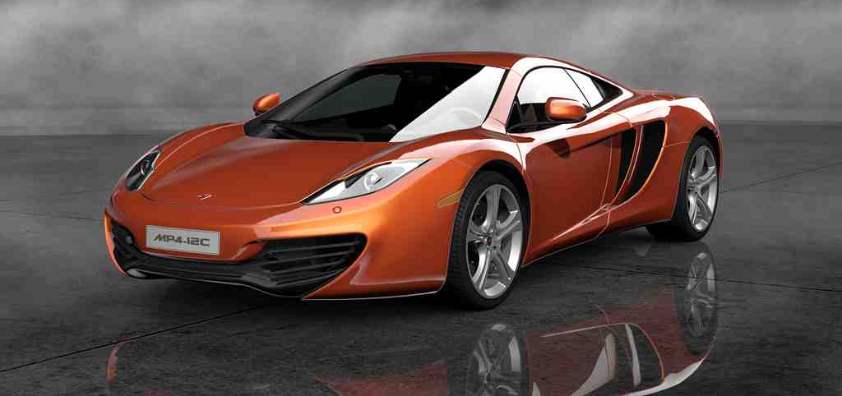
Eph 1-3 Our riches we have in Christ
All spiritual blessings
Riches of His grace
Inheritance with saints
Salvation, new life
Heavenly realm in Christ
Eph 4-6 How to apply what we have
Walk in unity
Serve in the body
Put on the new man
Marriage and family
Put on armor of God
Powerful racing engine

Slide 12
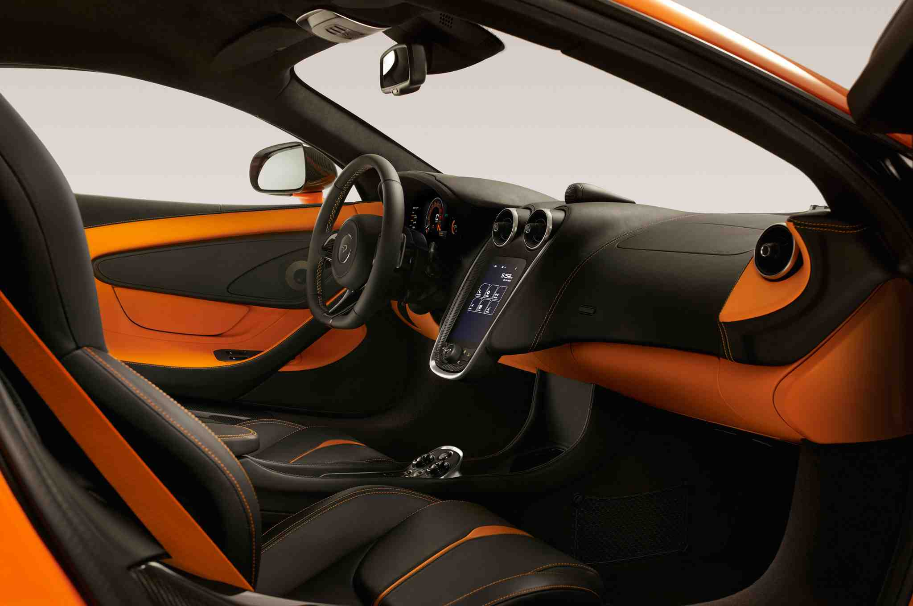
Eph 4-6 Applying what we have ..
3:16 that He would grant you, according to the riches of His glory, to be strengthened with power through His Spirit in the inner man,
3:16-21 How to Turn on the ignition

Slide 13
Strong inner man..
2 Cor 4:16 Even though our outward man is perishing, yet the inward man is being renewed day by day.
1 Thess 5:23 may your whole spirit, soul, and body be preserved blameless at the coming of our Lord Jesus Christ.
2 Cor 12:9-10 Therefore most gladly I will rather boast in my infirmities, that the power of Christ may rest upon me. Therefore I take pleasure in infirmities, in reproaches, in needs, in persecutions, in distresses, for Christ’s sake. For when I am weak, then I am strong.

Slide 14
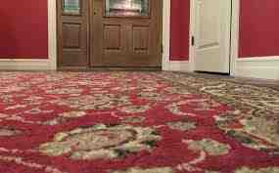
Peaks of Paul’s prayer..
Indwelling Christ..
Dwell (kata – oikeo) to live permanently, to settle down and abide, take up permanent abode
Christ will be at home in our hearts

Slide 15
Christ may dwell in your hearts through faith
Romans 8:9-10 But you are not in the flesh but in the Spirit, if indeed the Spirit of God dwells in you. Now if anyone does not have the Spirit of Christ, he is not His. And if Christ is in you, the body is dead because of sin, but the Spirit is life because of righteousness.
John 15:4 Abide in me, and I in you
1 John 4:13 By this we know that we abide in Him and He in us

Slide 16
Peaks of Paul’s prayer..
Incomprehensible love..
3:17-18 being rooted and grounded in love, may be able to comprehend with all the saints what is the width and length and depth and height— to know the love of Christ which passes knowledge..

Slide 17
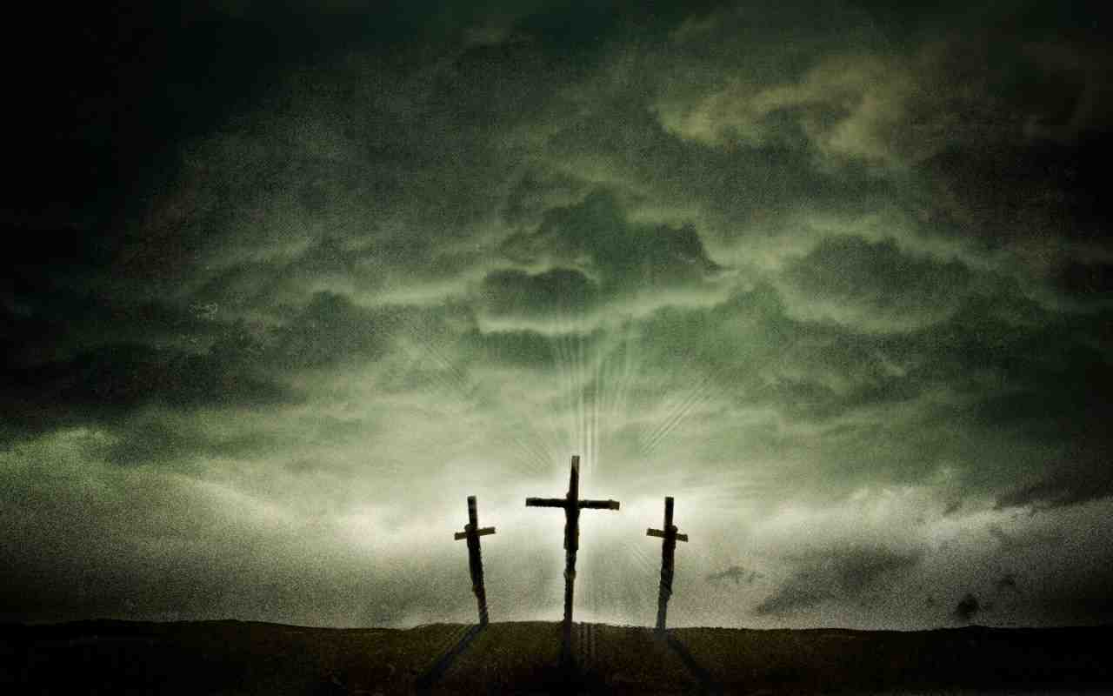
With Christ in control
Love will be characteristic of your life
You will comprehend His love because you will experience it personally
1 John 4:8; 20-21
Gal 5:22-23
John 13:34-35
1 Cor 13:4-8

Slide 18
Peaks of Paul’s prayer..
The Fullness of God..
We welcome Him so completely that He fills us and we become like Him..
Matt 5:48; 2 Cor 3:18; 1 Pet 1:15-16

Slide 19
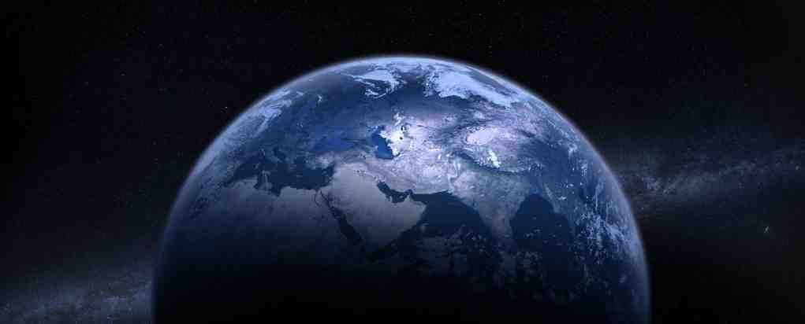
Now the Power is on..
Eph 3:20-21 Now to Him who is able to do exceedingly abundantly above all that we ask or think, according to the power that works in us, to Him be glory in the church by Christ Jesus to all generations, forever and ever. Amen.
There is no need for us to feel inadequate

Slide 20
Strengthened with the Power of God
Ephesians 3:13-21

