Slide 1
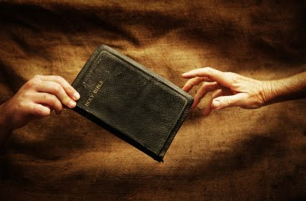
Reaching our Unsaved Friends
Romans 10:1-15

Slide 2
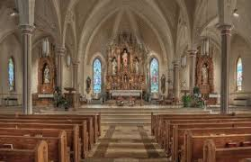
What about friends in religious error?

Slide 4
How greatly do you want them to be saved?
10:1 Brethren, my heart’s desire and prayer to God for Israel is that they may be saved.

Slide 5
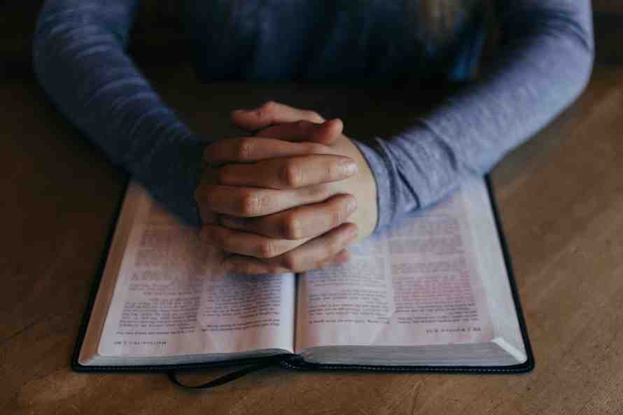
Start praying for them and for God to provide opportunities..

Slide 6
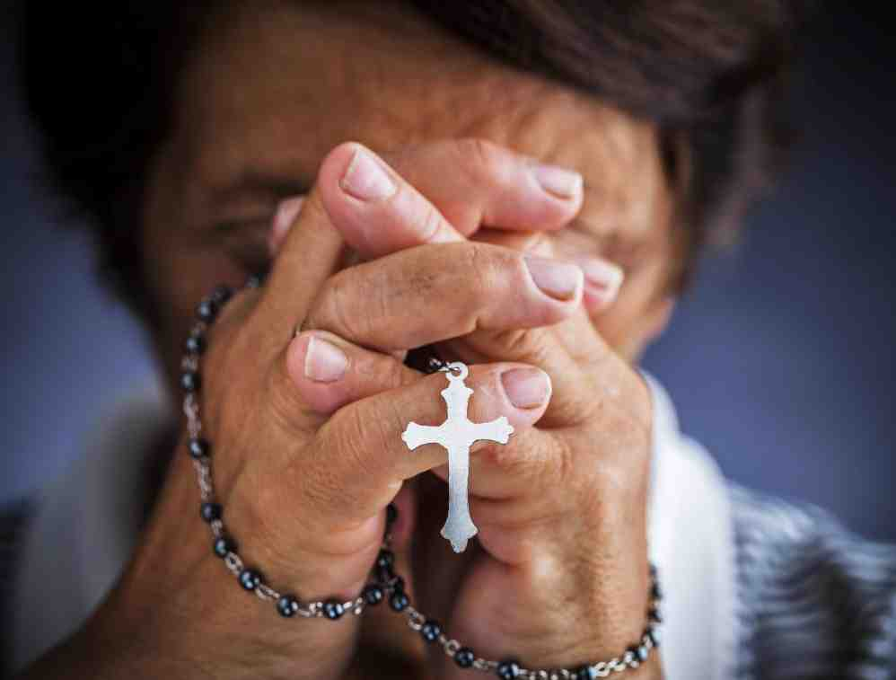
Sincerity is not enough..
² For I bear them witness that they have a zeal for God, but not according to knowledge.

Slide 7
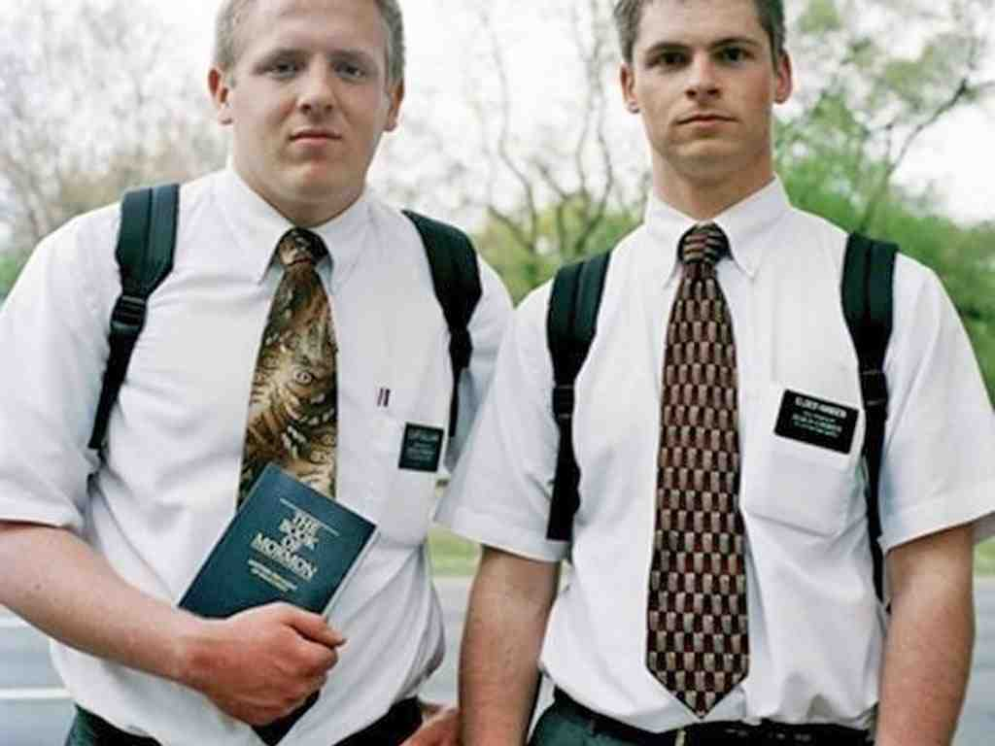
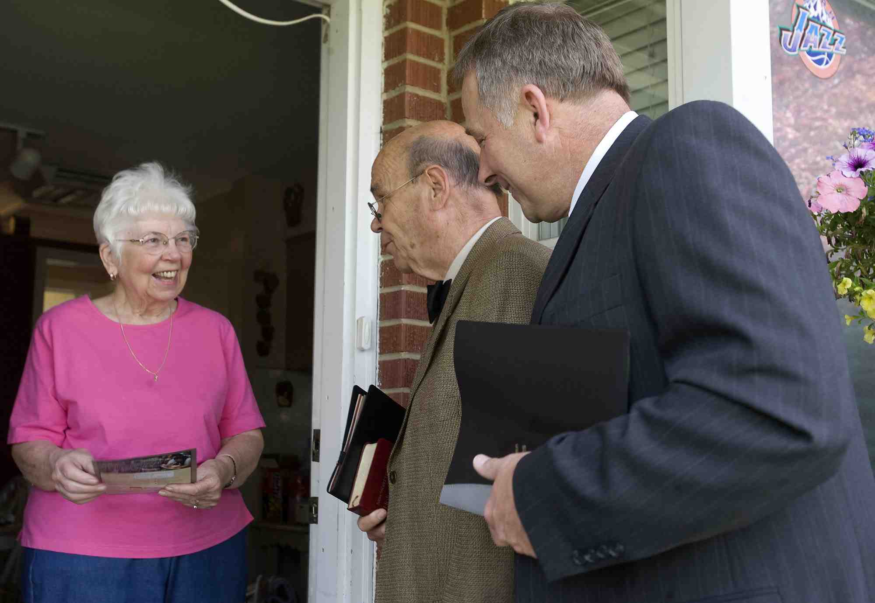
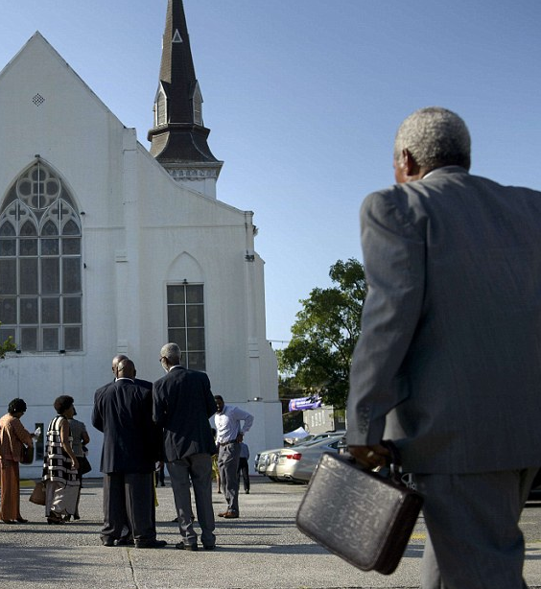
Zeal without knowledge can be harmful..
Being excited about serving God does not constitute pleasing God..

Slide 8
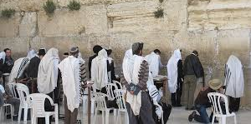
Establishing man’s own righteousness ..
³ For they being ignorant of God’s righteousness, and seeking to establish their own righteousness, have not submitted to the righteousness of God.

Slide 9
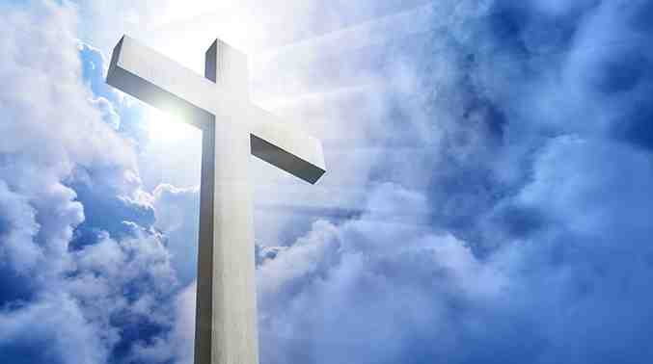
God’s righteousness..
⁴ For Christ is the end of the law for righteousness to everyone who believes.

Slide 10
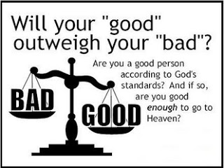
Earning our way to heaven..
⁵ For Moses writes about the righteous-ness which is of the law, “The man who does those things shall live by them.”

Slide 11
Climbing to heaven..
⁶ But the righteousness of faith speaks in this way, “Do not say in your heart, ‘Who will ascend into heaven?’” (that is, to bring Christ down from above) ⁷ or, “‘Who will descend into the abyss?’” (that is, to bring Christ up from the dead). ⁸ But what does it say? “The word is near you, in your mouth and in your heart” (that is, the word of faith which we preach):

Slide 12
Confessing Christ Lord..
⁹ that if you confess with your mouth the Lord Jesus and believe in your heart that God has raised Him from the dead, you will be saved. ¹⁰ For with the heart one believes unto righteousness, and with the mouth confession is made unto salvation.

Slide 13
One gospel for all
¹¹ For the Scripture says, “Whoever believes on Him will not be put to shame.” ¹² For there is no distinction between Jew and Greek, for the same Lord over all is rich to all who call upon Him. ¹³ For “whoever calls on the name of the Lord shall be saved.”

Slide 14
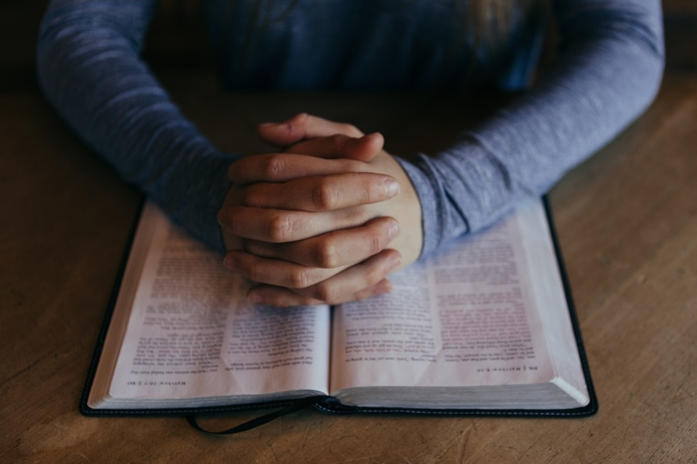
How shall they hear?
¹³ For “whoever calls on the name of the Lord shall be saved.” ¹⁴ How then shall they call on Him in whom they have not believed? And how shall they believe in Him of whom they have not heard? And how shall they hear without a preacher? ¹⁵ And how shall they preach unless they are sent? As it is written:“How beautiful are the feet of those who preach the gospel of peace, Who bring glad tidings of good things!”

Slide 15
How will they hear?
SAVED
CALL
BELIEVE
HEAR
PREACH
SENT
SENT
PREACH
HEAR
BELIEVE
CALL
SAVED

Slide 16
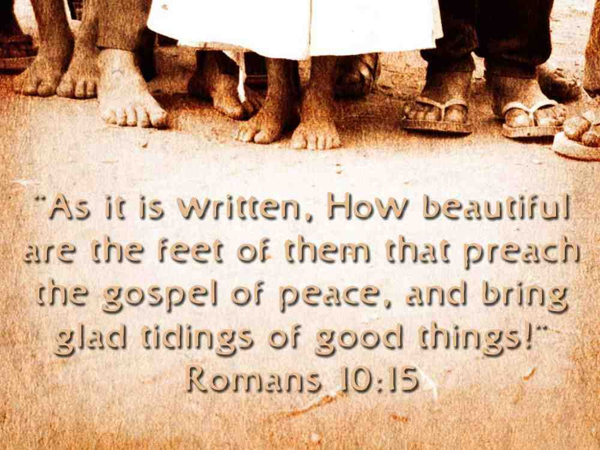

Slide 17
Reaching our Unsaved Friends
Romans 10:1-15

