Slide 1
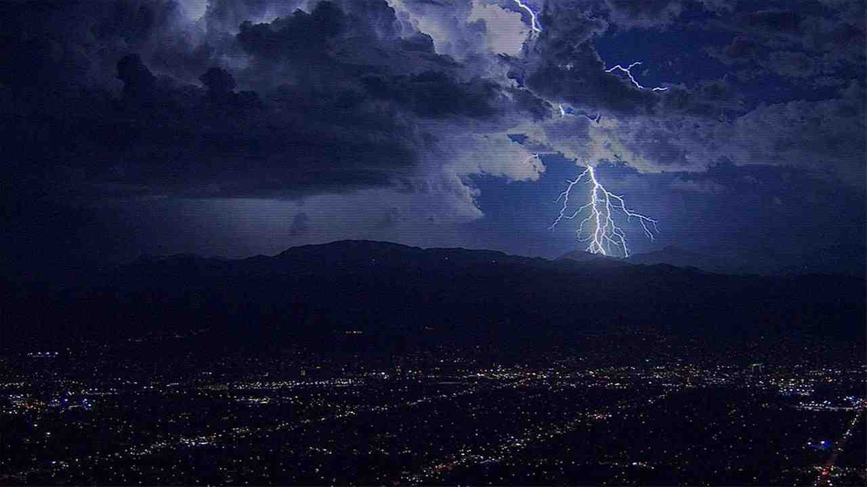
When God Has Had Enough
Romans 1:18-25

Slide 2
The Righteousness of God

Slide 3
Romans 1:18-19 For the wrath of God is revealed from heaven against all ungodliness and unrighteousness of men, who suppress the truth in unrighteousness, ¹⁹ because what may be known of God is manifest in them, for God has shown it to them.

Slide 4
“God Shed His Grace on Thee”

Slide 5
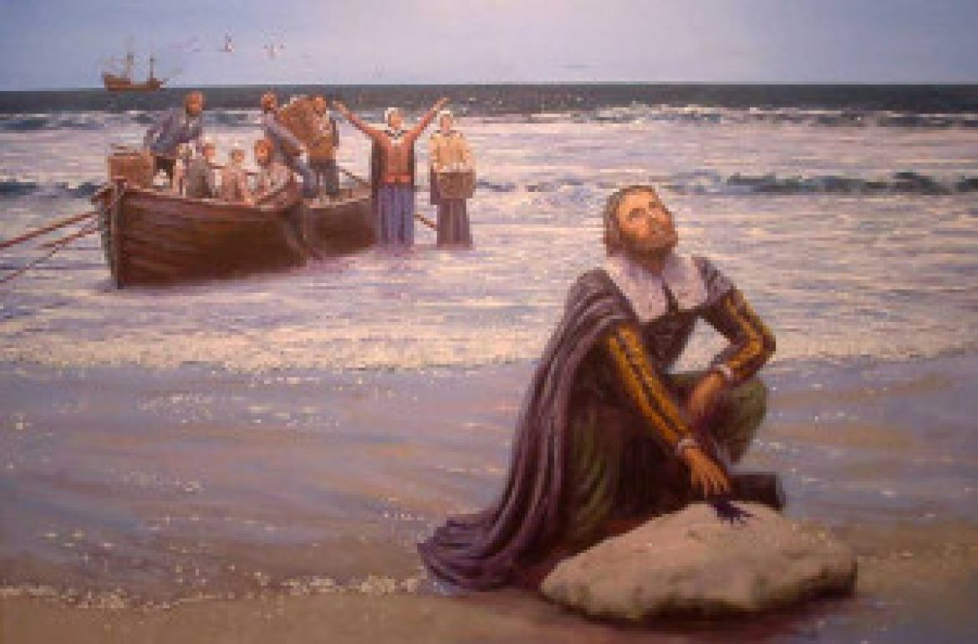
Pilgrims landing in America

Slide 6
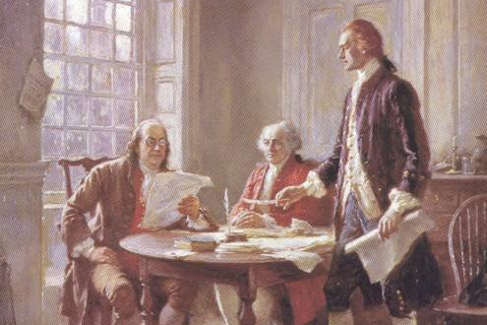
1776 Declaration of Independence

Slide 7
Romans 1:20 For since the creation of the world His invisible attributes are clearly seen, being understood by the things that are made, even His eternal power and Godhead, so that they are without excuse..

Slide 8
Search for false wisdom..
1:21-22 because, although they knew God, they did not glorify Him as God, nor were thankful, but became futile in their thoughts, and their foolish hearts were darkened. ²² Professing to be wise, they became fools…

Slide 9
Search for false worship..
1:23,25 and changed the glory of the incorruptible God into an image made like corruptible man—and birds and four-footed animals and creeping things… who exchanged the truth of God for the lie, and worshiped and served the creature rather than the Creator..

Slide 10
Search for false intimacy..
1:24,26-27 Therefore God also gave them up to uncleanness, in the lusts of their hearts, to dishonor their bodies among themselves, For this reason God gave them up to vile passions.

Slide 11
Search for false intimacy..
1:24,26-27 For even their women exchanged the natural use for what is against nature. Likewise also the men, leaving the natural use of the woman, burned in their lust for one another, men with men committing what is shameful, and receiving in themselves the penalty of their error which was due.

Slide 12
Therefore God gave them up (vs 24,26,28)
Intelligence .. they were w/o excuse (20)
Ignorance .. did not glorify Him (21-22)
Indulgence .. given to uncleanness (24)
Impenitence.. to a debased mind (28)

Slide 13
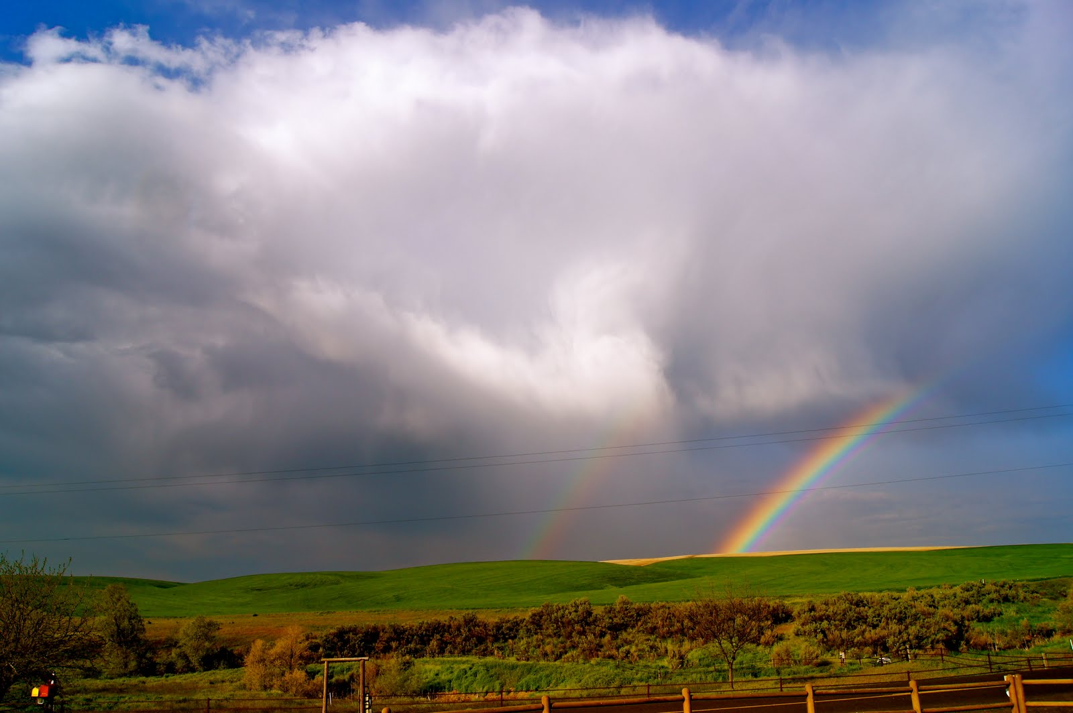
What is the good news?
1:25 who exchanged the truth of God for the lie, and worshiped and served the creature rather than the Creator, who is blessed forever. Amen.
1:16 For I am not ashamed of the gospel of Christ, for it is the power of God to salvation for everyone who believes, for the Jew first and also for the Greek. ¹⁷ For in it the righteousness of God is revealed from faith to faith; as it is written, “The just shall live by faith.

Slide 14
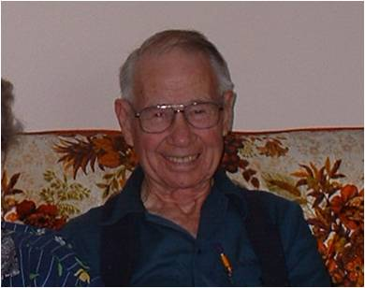
Edwin “Buddy” Kyle

Slide 15
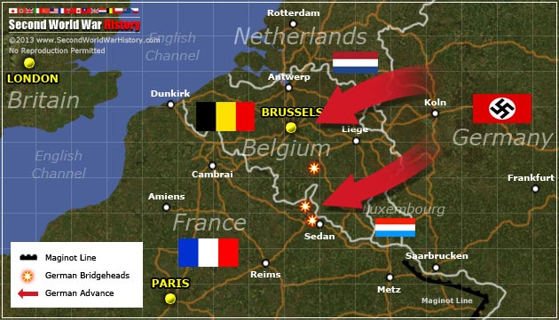
German blitzkrieg May 1940

Slide 17
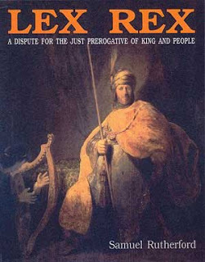
The king is not above the law..

Slide 18
Freedom from tyrannical rule..

Slide 19
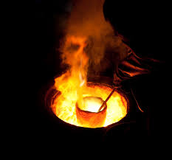
We are in the crucible..
1 Peter 1:7 that the genuineness of your faith, being much more precious than gold that perishes, though it is tested by fire, may be found to praise, honor, and glory at the revelation of Jesus Christ

Slide 20
When God Has Had Enough
Romans 1:18-25

