Slide 1
1 Thessalonians 5:13-18

Slide 2
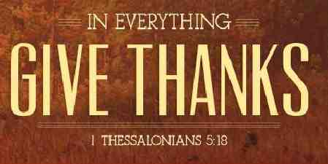
Be thankful..
1 Thessalonians 5:16-18 Rejoice always ¹⁷ pray without ceasing, ¹⁸ in everything give thanks; for this is the will of God in Christ Jesus for you.

Slide 3
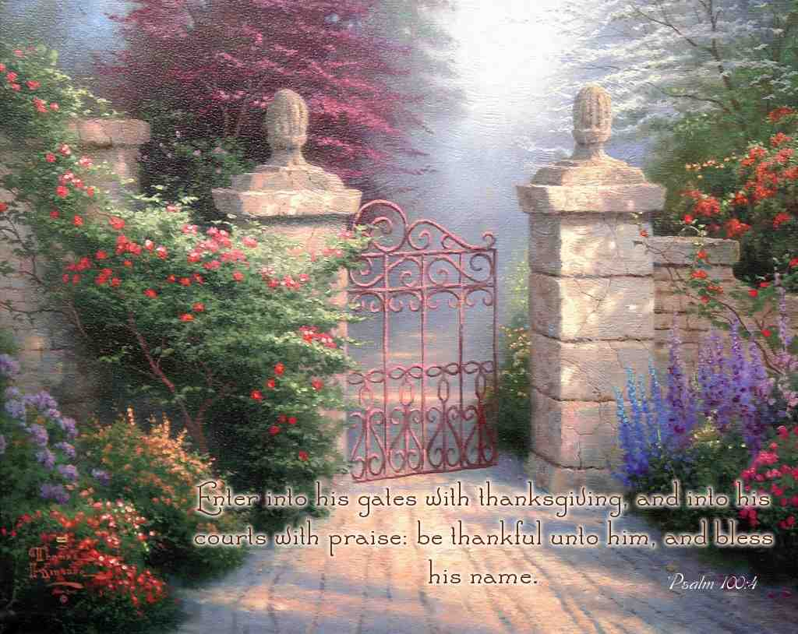
Enter with thanksgiving..
Psalm 100:4-5 Enter into His gates with thanksgiving, and into His courts with praise. Be thankful to Him, and bless His name. ⁵ For the Lord is good; His mercy is everlast-ing, and His truth endures to all generations

Slide 4
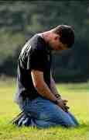
Honoring God..
Romans 1:21 because, although they knew God, they did not glorify Him as God, nor were thankful, but became futile in their thoughts, and their foolish hearts were darkened.

Slide 5
Allow God to bring good..
Romans 8:28 And we know that all things work together for good to those who love God, to those who are the called according to His purpose.

Slide 6
Make it a habit..
Daniel 6:10 Now when Daniel knew that the writing was signed, he went home. And in his upper room, with his windows open toward Jerusalem, he knelt down on his knees three times that day, and prayed and gave thanks before his God, as was his custom since early days.

Slide 7
Overflowing ..
Colossians 2:6-7 As you therefore have received Christ Jesus the Lord, so walk in Him, ⁷ rooted and built up in Him and established in the faith, as you have been taught, abounding in it with thanksgiving.
2 Cor 9:11 while you are enriched in everything for all liberality, which causes thanksgiving through us to God.

Slide 8
In everything..
Colossians 3:15-17 And let the peace of God rule in your hearts, to which also you were called in one body; and be thankful. ¹⁷ And whatever you do in word or deed, do all in the name of the Lord Jesus, giving thanks to God the Father through Him.

Slide 9
Things that hinder us..
Doubt (that God can be trusted)
Selfishness (not being content)
Worldliness (love of the world)
A critical spirit (negative sour attitude)
Impatience (I want it now)
Spiritual coldness (lack of zeal)

Slide 10
Give it to God..
Philippians 4:6-7Be anxious for nothing, but in everything by prayer and supplication, with thanksgiving, let your requests be made known to God; ⁷ and the peace of God, which surpasses all understanding, will guard your hearts and minds through Christ Jesus.

Slide 11
A thankful heart..
Rooted in Christ .. Col 2:6-7
Our effort with God .. Eph 5:20
Begin and end day with thanksgiving.. Psalm 92:1-2
List your blessings
Devote time to prayer .. Col 4:2

Slide 12
1 Thessalonians 5:13-18

