Slide 1
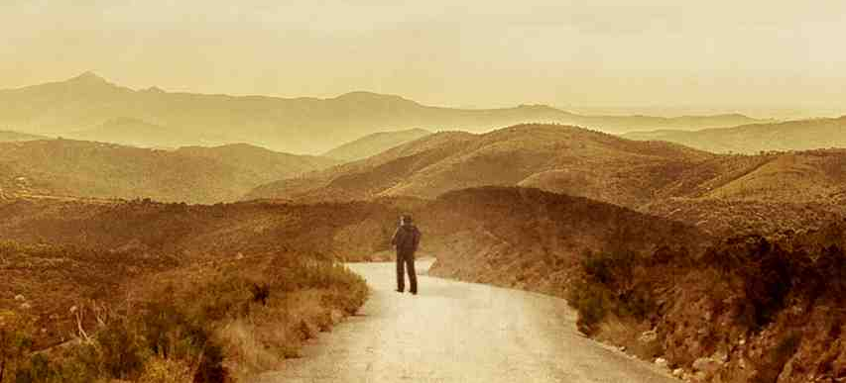
Coincidence or Godincidence
Luke 10:30-36

Slide 2
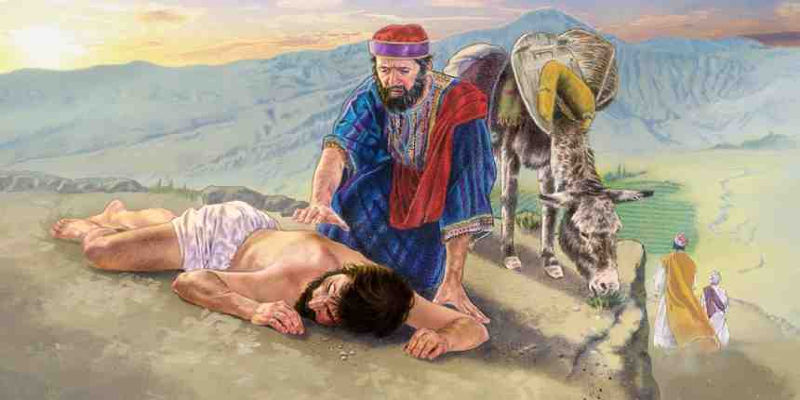
By chance..
31 Now by chance a certain priest came down that road. And when he saw him, he passed by on the other side. 32 Likewise a Levite, when he arrived at the place, came and looked, and passed by on the other side. 33 But a certain Samaritan, as he journeyed, came where he was. And when he saw him, he had compassion.

Slide 3
Coincidence
The condition of happening at the same time; exact correspondence in nature, character, result, or circumstances..

Slide 4
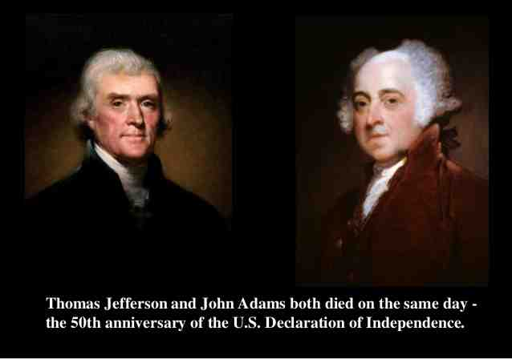
Both died July 4, 1826

Slide 5
Mark Twain
Born on the day of the appearance of Halley’s Comet in 1835 and died on the day of its next appearance in 1910..

Slide 6
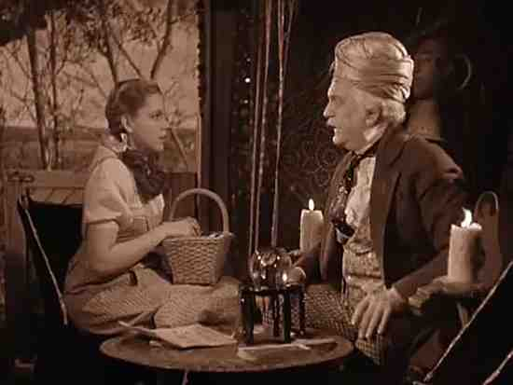
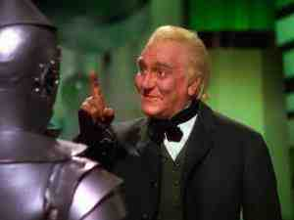
Wizard of Oz
The wizard’s coat worn by actor Frank Morgan…

Slide 7
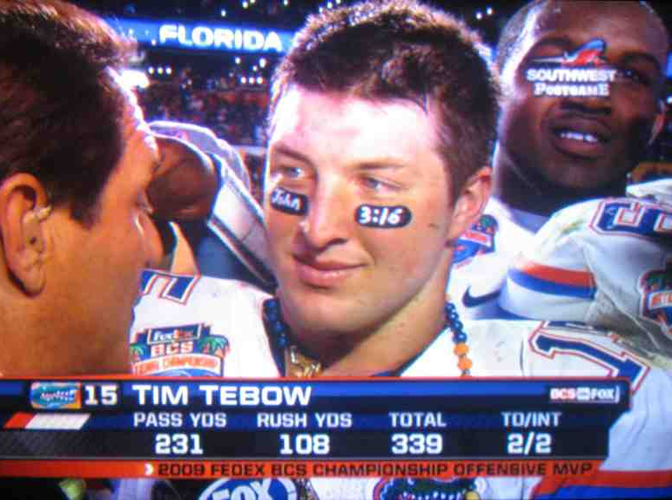
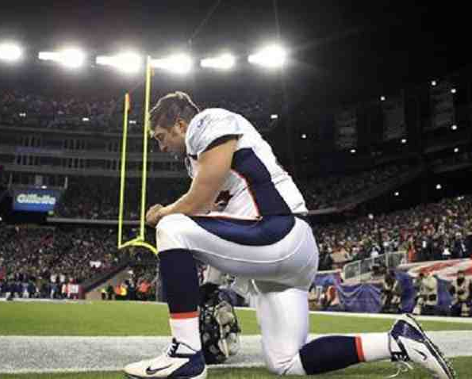
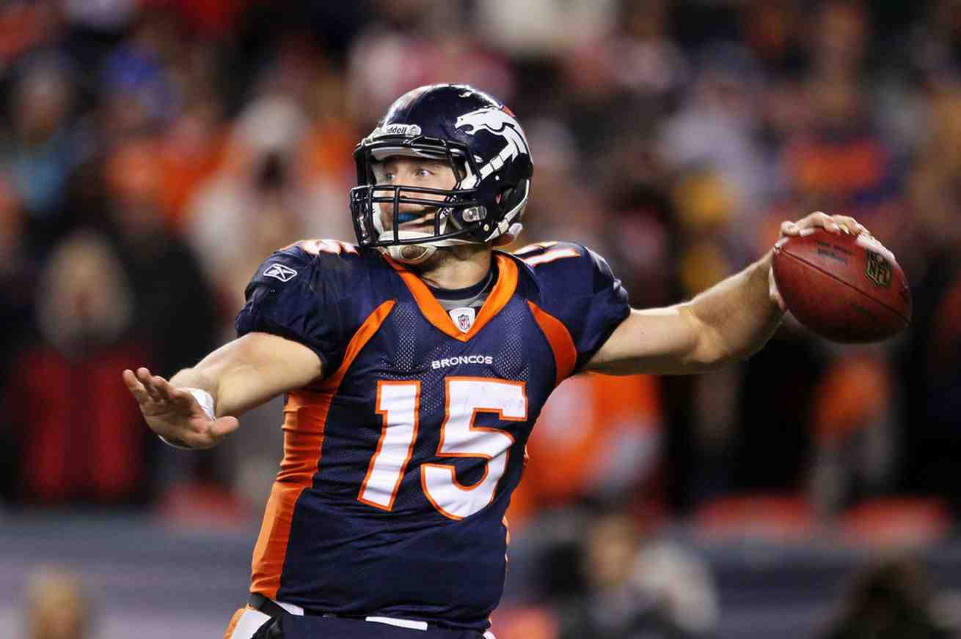
Tim Tebow
NCAA championship … Jan 9, 2009
NFL Playoff game… Jan 9, 2012

Slide 8
Is there coincidence in your life as a Christian?
Eph 1:11 In Him also we have obtained an inheritance, being predestined according to the purpose of Him who works all things according to the counsel of His will..
Psalm 33:11 The counsel of the Lord stands forever, The plans of His heart to all generations.
Rom 8:28 all things work together for good to those who love God, to those who are the called according to His purpose.

Slide 9
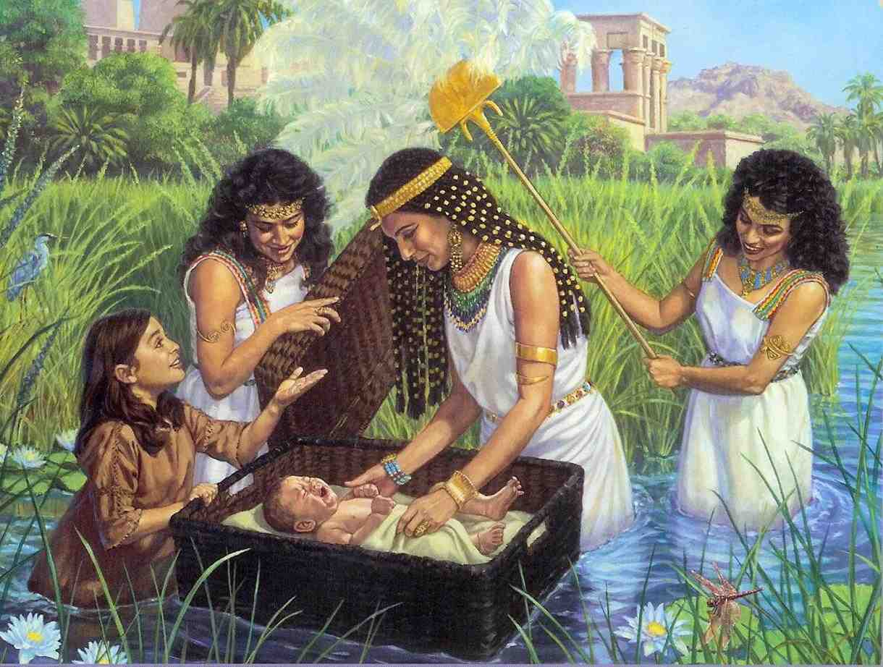
Birth of Moses
Exodus 2:5 then the daughter of Pharaoh came down to bathe at the river. And her maidens walked along the riverside; and when she saw the ark among the reeds, she sent her maid to get it.

Slide 10
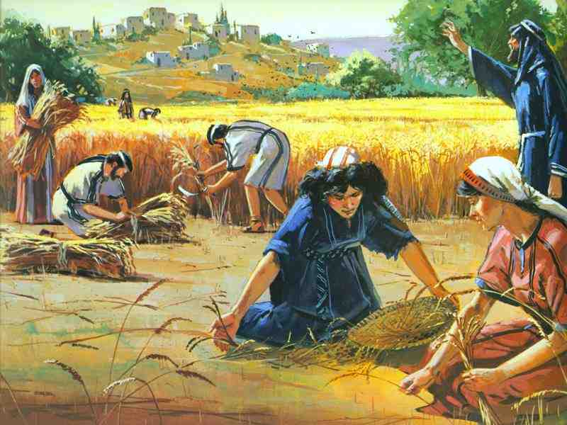
Ruth gleaning in field
Ruth 2:3 Then she left, and went and gleaned in the field after the reapers. And she happened to come to the part of the field belonging to Boaz, who was of the family of Elimelech.

Slide 11
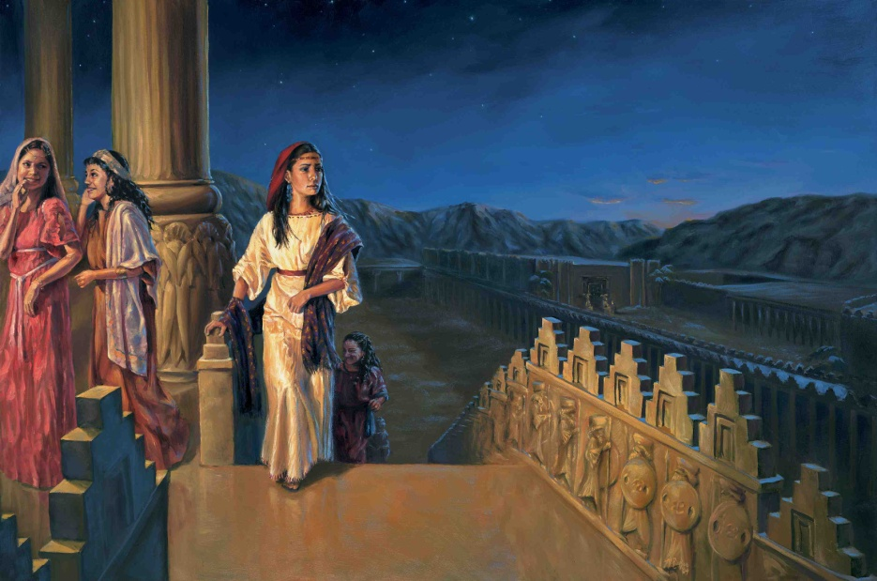
Book of Esther
Esther 4:14 if you remain completely silent at this time, relief and deliverance will arise for the Jews from another place, but you and your father’s house will perish. Yet who knows whether you have come to the kingdom for such a time as this?”

Slide 12
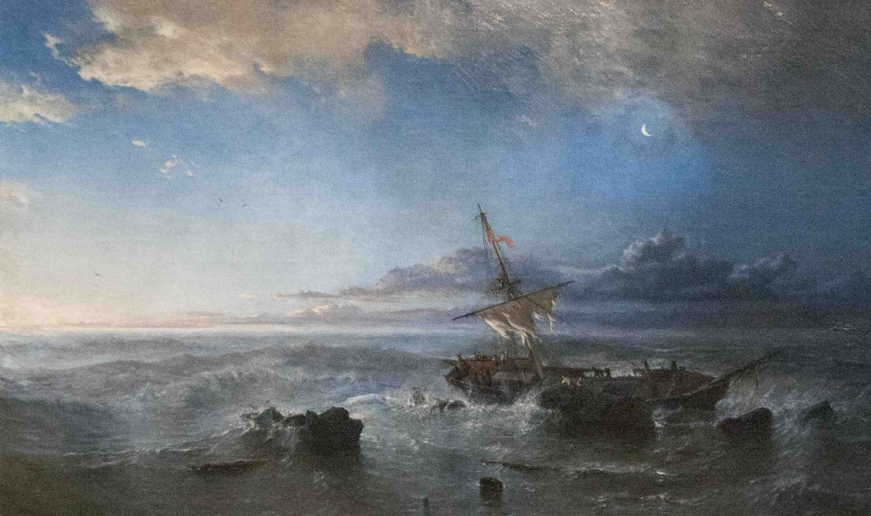
Apostle Paul
Rom 1:11 ¹¹ For I long to see you, that I may impart to you some spiritual gift, so that you may be established— ¹² that is, that I may be encouraged together with you by the mutual faith both of you and me.

Slide 13
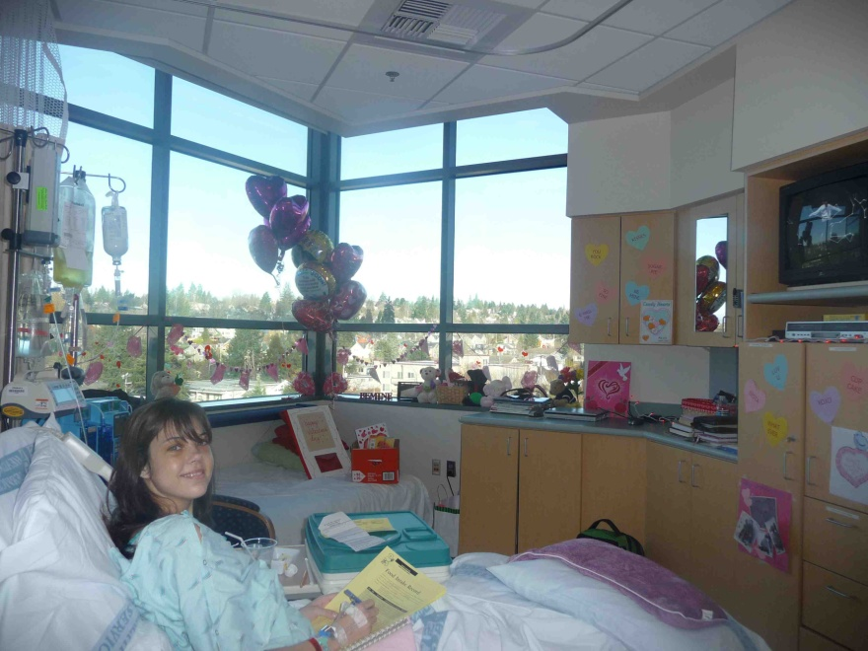
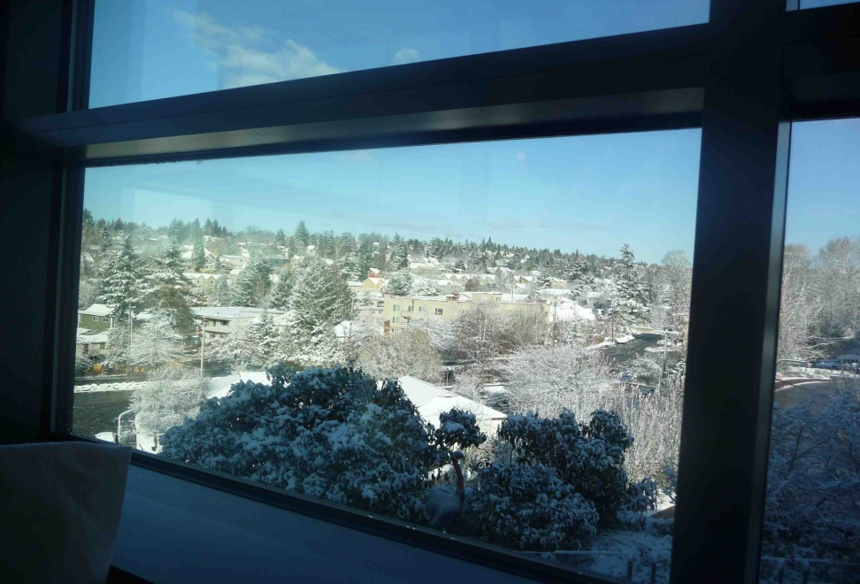
Children’s Hospital 2009

Slide 14
Coincidence or Godincidence
Luke 10:30-36

