Slide 1
Equipping the Saints
Ephesians 4:7-16

Slide 2
Walk in unity..
1 I … beseech you to walk worthy of the calling with which you were called.. 3 endeavoring to keep the unity of the Spirit in the bond of peace.

Slide 3
Gifts we each receive..
7 But to each one of us grace was given according to the measure of Christ's gift. 8 Therefore He says: "When He ascended on high, He led captivity captive, and gave gifts to men.”
Gift of His Grace Gifts of Service
All the same
1:8; 2:4-8
Diversity of gifts
Matt 25:14; Rom 12:6-8

Slide 4
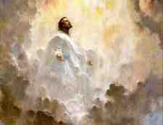
When He ascended in victory..
8 Therefore He says: "When He ascended on high, He led captivity captive, And gave gifts to men." (Psalm 68:18)
9 (Now this, "He ascended"--what does it mean but that He also first descended into the lower parts of the earth? 10 He who descended is also the One who ascended far above all the heavens, that He might fill all things.)

Slide 5
Gifts that prepare us..
11 And He Himself gave some to be apostles, some prophets, some evangelists, and some pastors and teachers, 12 for the equipping of the saints for the work of ministry, for the edifying of the body of Christ..
Apostles/Prophets Evangelists/Pastors
Not duplicated today
Acts 1:21-22; 2 Cor 12:12
Eph 2:19-22; 2 Pet 1:21
Teachers
Can qualify for these
1-2 Timothy/Titus

Slide 6
The Goal of this Process..
13 till we all come to the unity of the faith and of the knowledge of the Son of God, to a perfect man, to the measure of the stature of the fullness of Christ..
UNITY
MATURITY
KNOWLEDGE

Slide 7
Stability in the Storm
14 that we should no longer be children, tossed to and fro and carried about with every wind of doctrine, by the trickery of men, in the cunning craftiness of deceitful plotting..

Slide 8
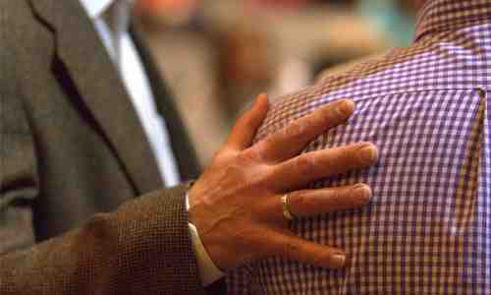
Growth of the body
15 but, speaking the truth in love, may grow up in all things into Him who is the head--Christ-- 16 from whom the whole body, joined and knit together by what every joint supplies, according to the effective working by which every part does its share, causes growth of the body for the edifying of itself in love.

Slide 9
Equipping the Saints
Ephesians 4:7-16

