Slide 1
Facing Loneliness
Ecclesiastes 4:9-12

Slide 2
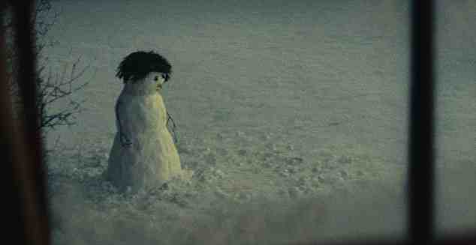
The Value of a Friend
Eccl 4:9-10 Two are better than one, Because they have a good reward for their labor. For if they fall, one will lift up his companion.
¹⁰ But woe to him who is alone when he falls, For he has no one to help him up.

Slide 3
Everyone experiences it..
Being single ..
Gen 2:18 And the Lord God said, “It is not good that man should be alone; I will make him a helper comparable to him.”
Married but lonely..
1 Pet 3:7 Husbands, likewise, dwell with them with understanding, giving honor to the wife, as to the weaker vessel, and as being heirs together of the grace of life, that your prayers may not be hindered.

Slide 4
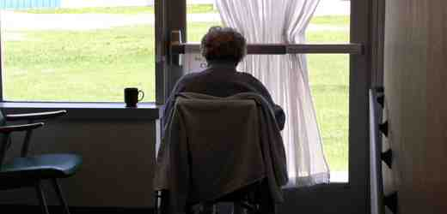
Everyone experiences it..
Losing your spouse..
James 1:27 Pure and undefiled religion before God and the Father is this: to visit orphans and widows in their trouble, and to keep oneself unspotted from the world.
The elderly who are alone..
1 Tim 5:8 But if anyone does not provide for his own, and especially for those of his household, he has denied the faith and is worse than an unbeliever.
It is not a sin to be alone

Slide 5
Those in the Bible..
King David..
Psalm 102:3 For my days are consumed like smoke, And my bones are burned like a hearth. ⁶ I am like a pelican of the wilderness; I am like an owl of the desert. ⁷ I lie awake, And am like a sparrow alone on the housetop.
Psalm 142:4 When my spirit was overwhelmed within me, Then You knew my path. In the way in which I walk They have secretly set a snare for me. ⁴ Look on my right hand and see, For there is no one who acknowledges me; Refuge has failed me; No one cares for my soul.

Slide 6
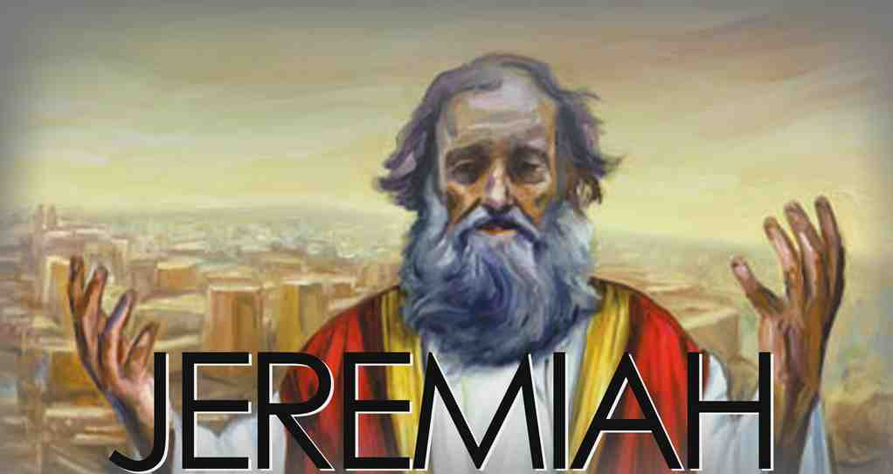
Those in the Bible..
Jeremiah ..
Jer 9:2 Oh, that I had in the wilderness a lodging place for travelers; That I might leave my people, and go from them! For they are all adulterers, an assembly of treacherous men.
Lam 1:16“For these things I weep; My eye, my eye overflows with water; Because the comforter, who should restore my life, is far from me. My children are desolate because the enemy prevailed.”

Slide 7
Those in the Bible..
The apostle Paul ..
2 Tim 4:9-16 Be diligent to come to me quickly; ¹⁰ for Demas has forsaken me, having loved this present world, and has departed for Thessalonica—Crescens for Galatia, Titus for Dalmatia. ¹⁶ At my first defense no one stood with me, but all forsook me. May it not be charged against them.

Slide 8
God’s instruction..
Acknowledge your loneliness..
Accept the help of God..
Heb 13:5-6 Let your conduct be without covetousness; be content with such things as you have. For He Himself has said, “I will never leave you nor forsake you.”
Rely upon God’s word..
Choose to be active in the church..

Slide 9
Facing Loneliness
Ecclesiastes 4:9-12

