Slide 1
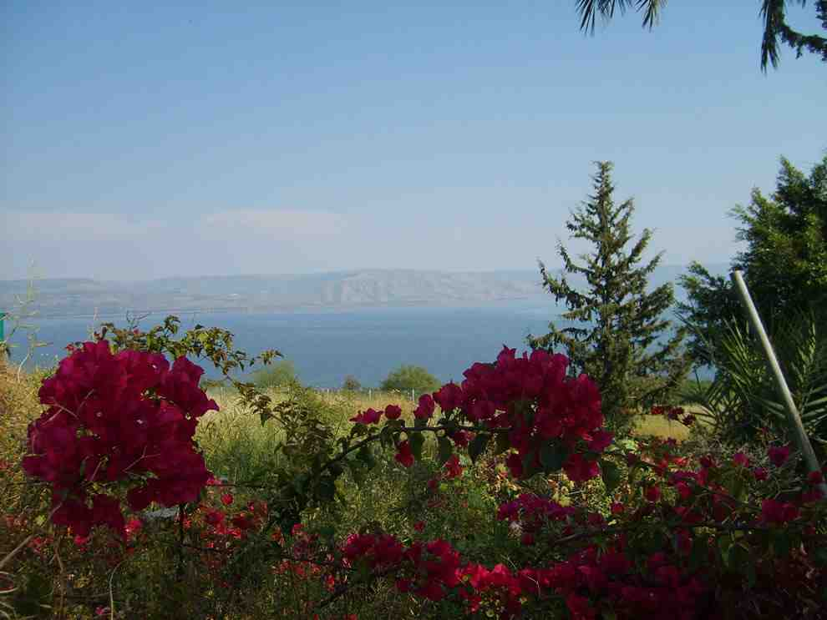
The Blessed Life
Matthew 5:1-12

Slide 2
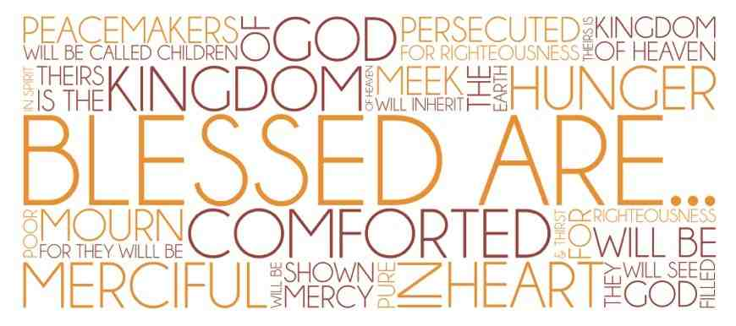
The Beatitudes..
“Blessed” (makarios) ..
Happiness (subjective)
(how they feel)
Blessed (objective)
(how they stand with God)
Character qualities of the Christian
(the blessings God has given us)

Slide 3
The Journey of Faith
The beginning of faith..
The progress of faith..
The perfection of faith..
The trial of faith

Slide 4
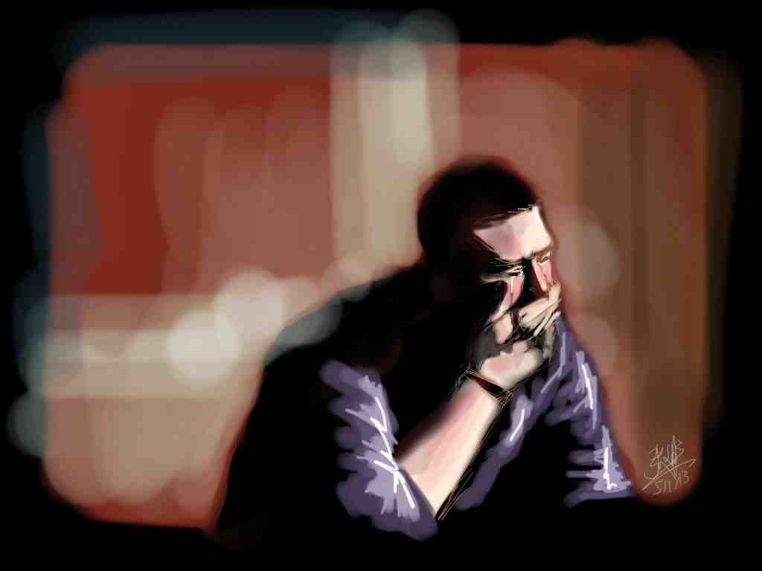
The Beginning of faith (3-4)

Slide 5
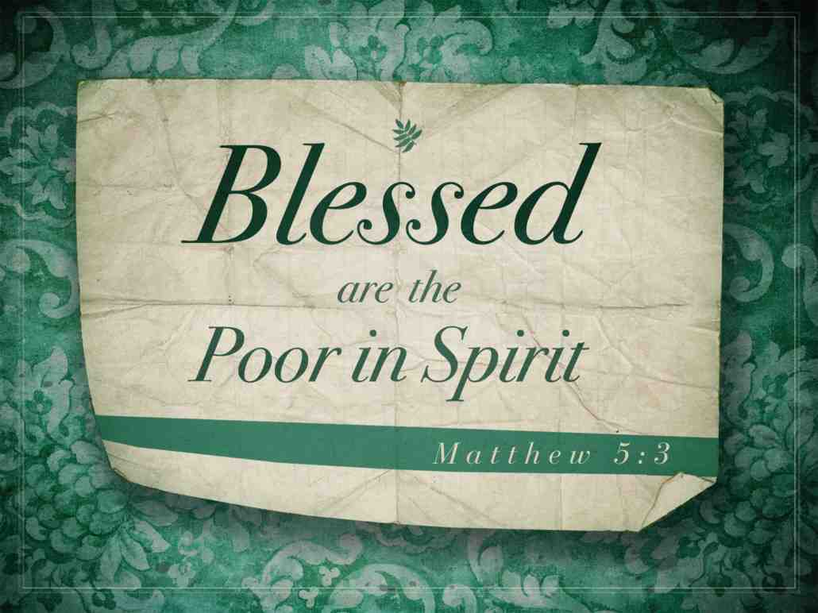
³ Blessed are the poor in spirit, For theirs is the kingdom of heaven.

Slide 6
Poor in spirit..
Destitute spiritually ..
Romans 3:23 for all have sinned and fall short of the glory of God..
1 Tim 1:15 This is a faithful saying and worthy of all acceptance, that Christ Jesus came into the world to save sinners, of whom I am chief.
1 John 1:8 If we say that we have no sin, we deceive ourselves, and the truth is not in us.

Slide 7
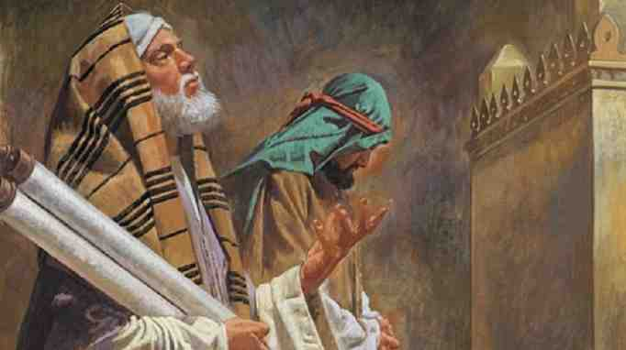
“Two men went up to the temple to pray, one a Pharisee and the other a tax collector. ¹¹ The Pharisee stood and prayed thus with himself, ‘God, I thank You that I am not like other men—extortioners, unjust, adulterers, or even as this tax collector. ¹² I fast twice a week; I give tithes of all that I possess.’ ¹³ And the tax collector, standing afar off, would not so much as raise his eyes to heaven, but beat his breast, saying, ‘God, be merciful to me a sinner!’

Slide 8
⁴ Blessed are those who mourn, For they shall be comforted.

Slide 9
They that mourn will be comforted..
Mourning because of our sin.. - Psalm 34:18 The Lord is near to those who have a broken heart, and saves such as have a contrite spirit.
- 2 Cor 7:9-10 Godly sorrow works repentance unto salvation not to be repented of, but the sorrow of the world works death..
- James 4:9.. Be afflicted and mourn.. and weep! Let your laughter be turned to mourning and your joy to heaviness.. humble yourselves in the sight of the Lord and He will life you up

Slide 10
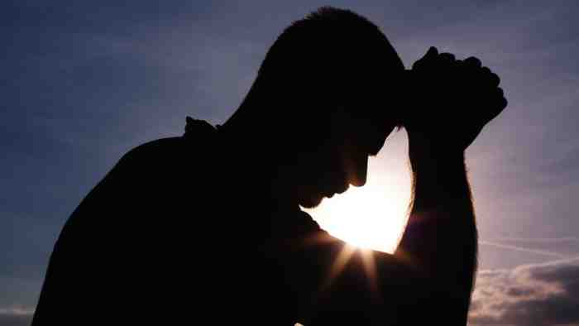
The Progress of faith (5-6)

Slide 11
⁵ Blessed are the meek, For they shall inherit the earth.

Slide 12
The meek shall inherit the earth..
Luke 15:17-18 “But when he came to himself, he said, ‘How many of my father’s hired servants have bread enough and to spare, and I perish with hunger! ¹⁸ I will arise and go to my father, and will say to him, “Father, I have sinned against heaven and before you ¹⁹ and I am no longer worthy to be called your son. Make me like one of your hired servants.”

Slide 13
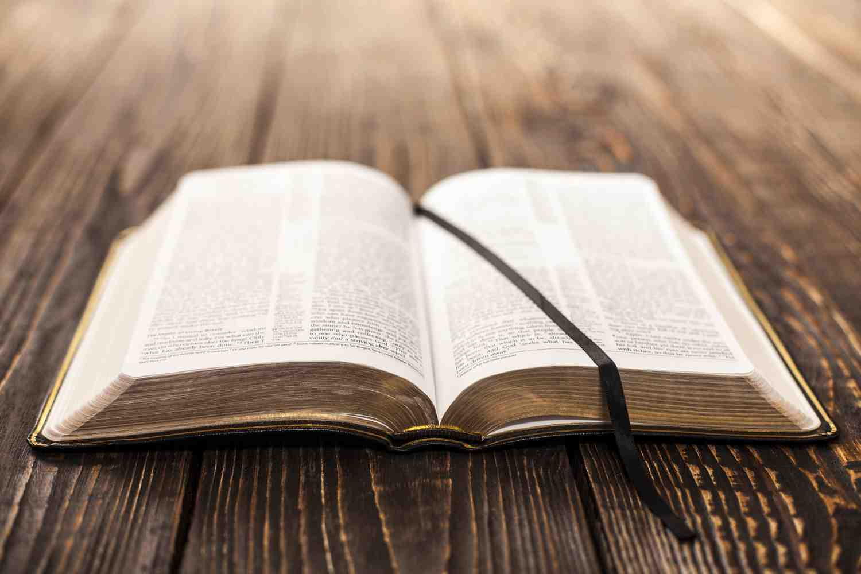
The meek shall inherit the earth..
James 1:21 Therefore lay aside all filthiness and overflow of wickedness, and receive with meekness the implanted word, which is able to save your souls.

Slide 14
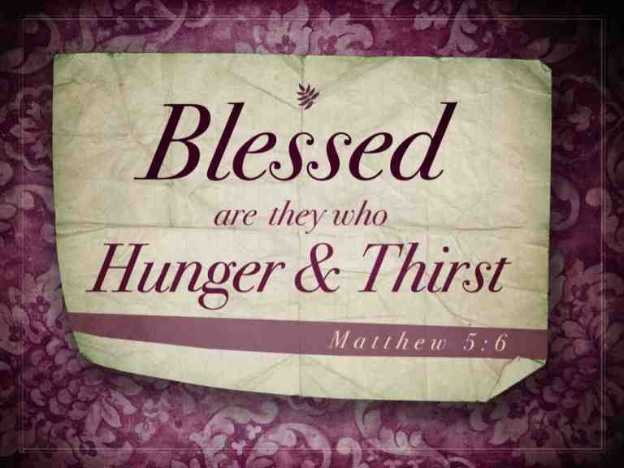
⁶ Blessed are those who hunger and thirst for righteousness, For they shall be filled.

Slide 15
Hunger and thirst for righteousness..
Matthew 7:7 Ask and it shall given, seek and you will find, knock and it will be opened to you..
John 6:35 I am the bread of life.. he that comes to me shall never hunger.. and he that believes in Me shall never thirst..

Slide 16
The Perfection of faith (7-9)

Slide 17
⁷ Blessed are the merciful, For they shall obtain mercy.

Slide 18
The merciful..
Matthew 6:14-15 For if you forgive men their trespasses, your Father will forgive you your trespasses, but if you forgive not men their trespasses, neither will your Father forgive your trespasses..
James 2:13 he shall have judgment without mercy that has showed no mercy.. for mercy rejoices against the judgment..

Slide 19
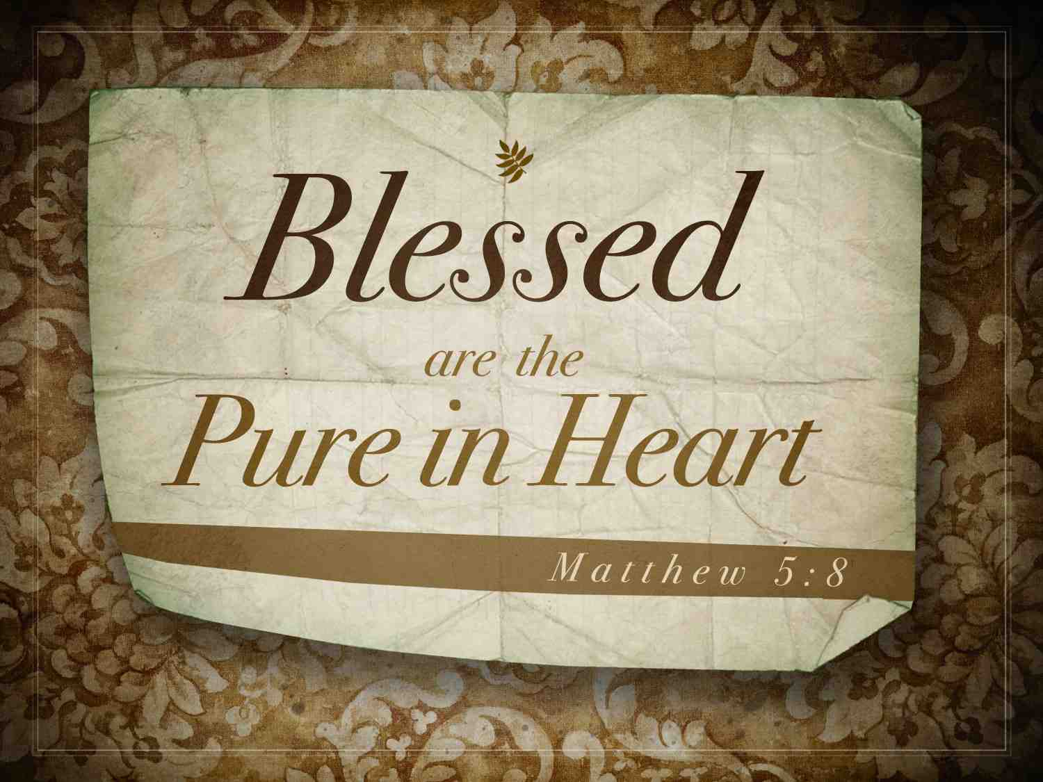
⁸ Blessed are the pure in heart, For they shall see God.

Slide 20
Pure in heart..
Psalm 24:3-5 the question is asked "Who shall ascend into the hill of the Lord..or who shall stand in His holy place?..He that has clean hands and a pure heart.. who has not lifted up his soul unto vanity nor sworn deceitfully.. he shall receive the blessing from the Lord and righteousness from the God of his salvation..

Slide 21
⁹ Blessed are the peacemakers, For they shall be called sons of God.

Slide 22
Are you a peacemaker?
Hebrews 12:14 Follow peace with all men, and holiness.. without which no one shall see the Lord..

Slide 23
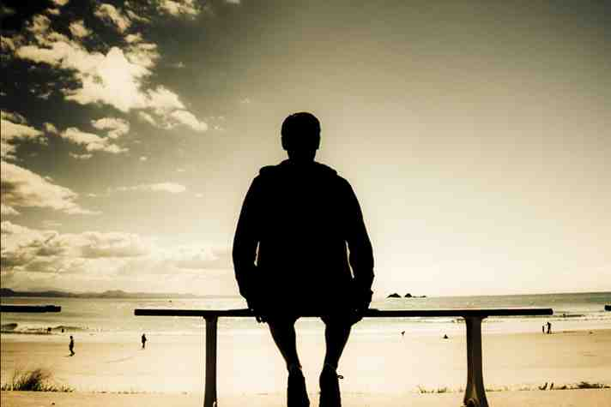
The Trial of faith (10-12)

Slide 24
¹⁰ Blessed are those who are persecuted
for righteousness’ sake,
For theirs is the kingdom of heaven.

Slide 25
Persecuted for Christ..
James 1:12 Blessed is the man that endures temptation, for when he has been tried he shall receive the crown of life which the Lord has promised to them that love Him..

Slide 26
The Blessed Life
Matthew 5:1-12

