Slide 1
Why Your Life Matters
Matthew 5:13-16

Slide 2
Our influence for good?..
Jesus says we impact the world..

Slide 3
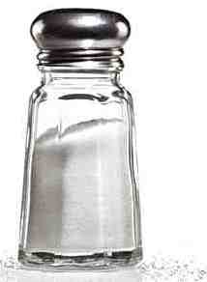
Two Items in Every Home..
SALT
LIGHT

Slide 4
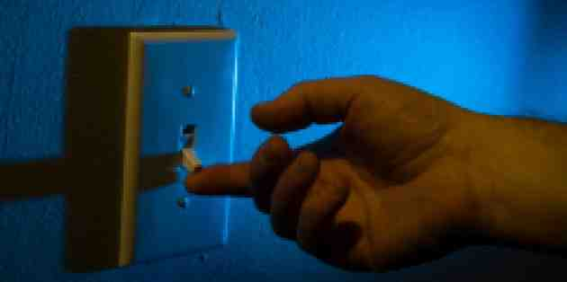
The need for light is obvious..

Slide 5
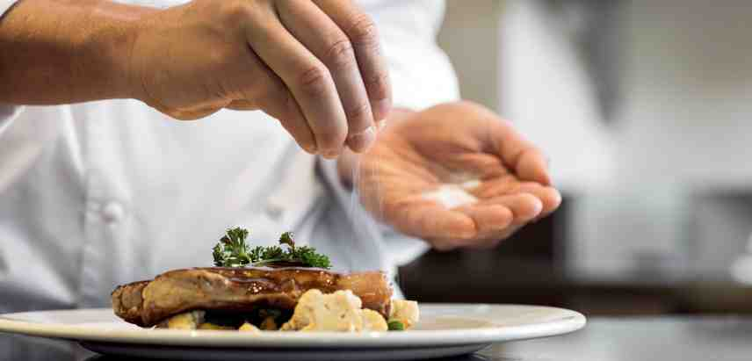
Salt had a variety of uses..
Essential to human diet as a seasoning..

Slide 6
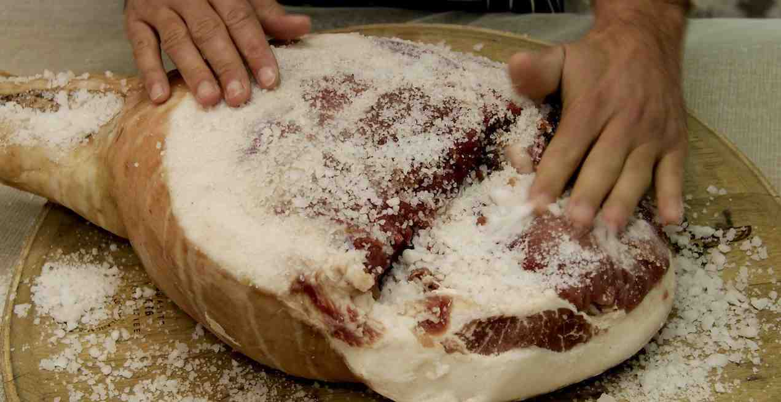
Salt had a variety of uses..
Preservative to keep meat wholesome..

Slide 7
The church and the world are distinct..
You are the earth’s salt..You are the world’s light

Slide 8
The Salt of the Earth..
13 "You are the salt of the earth; but if the salt loses its flavor, how shall it be seasoned? It is then good for nothing but to be thrown out and trampled underfoot by men.
- The world decays like rotten meat ..
- The church can hinder its decay..
- The effectiveness of salt is conditional..

Slide 9
Be the salt..
Mark 9:50 Salt is good, but if the salt loses its flavor, how will you season it? Have salt in yourselves, and have peace with one another."
Col 4:6 Let your speech always be with grace, seasoned with salt, that you may know how you ought to answer each one.

Slide 10
The light of the world..
14 You are the light of the world. A city that is set on a hill cannot be hidden. 15 Nor do they light a lamp and put it under a basket, but on a lampstand, and it gives light to all who are in the house. 16 Let your light so shine before men, that they may see your good works and glorify your Father in heaven.
- Light dispels darkness.. John 3:19-21
- How we function as light .. 1 John 1:5-7
- Must not cover our light .. 5:14-15
- Seen through our good works .. 5:16

Slide 11
Accepting our responsibility..
Salt’s responsibility to prevent decay
Light’s responsibility to illumine darkness

Slide 12
Why Your Life Matters
Matthew 5:13-16

