Slide 1
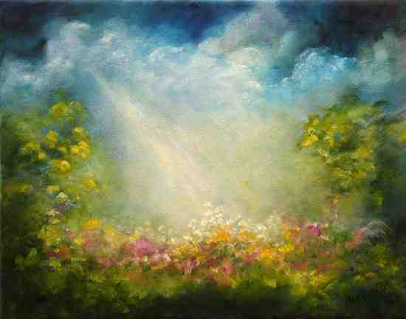
Cain and Abel
Genesis 4:1-10

Slide 2
Book of beginnings..
Gen 3:9-13 Then the Lord God called to Adam and said to him, "Where are you?" 13 And the Lord God said to the woman, "What is this you have done?“..
Num 32:23 be sure your sin will find you out.

Slide 3
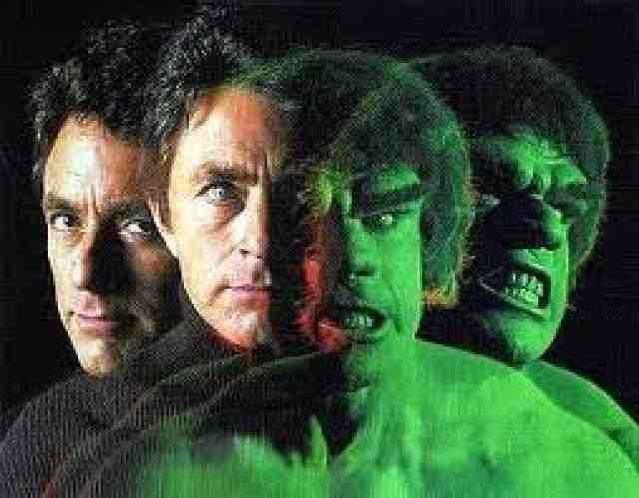
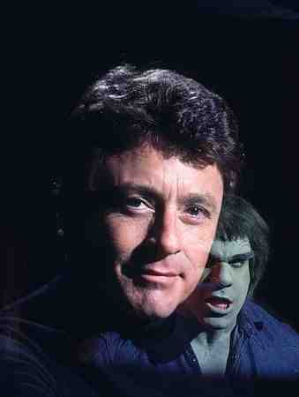
The Incredible Hulk..
If you don’t deal with your temper,
it will turn you into a monster

Slide 4
Birth of two sons (4:1-2)
1 Now Adam knew Eve his wife, and she conceived and bore Cain, and said, "I have acquired a man from the Lord." 2 Then she bore again, this time his brother Abel…

Slide 5
Worship of two brothers (4:2-5)
Now Abel was a keeper of sheep, but Cain was a tiller of the ground. 3 And in the process of time it came to pass that Cain brought an offering of the fruit of the ground to the Lord. 4 Abel also brought of the firstborn of his flock and of their fat. And the Lord respected Abel and his offering, 5 but He did not respect Cain and his offering.

Slide 6
Worship of two brothers (4:2-5)
Hebrews 11:4 By faith Abel offered to God a more excellent sacrifice than Cain, through which he obtained witness that he was righteous, God testifying of his gifts; and through it he being dead still speaks.
Matt 15:8-9 'These people draw near to Me with their mouth, And honor Me with their lips, But their heart is far from Me. 9 And in vain they worship Me, Teaching as doctrines the commandments of men.' "

Slide 7
Worship of two brothers (4:2-5)
1 John 3:11-12 For this is the message that you heard from the beginning, that we should love one another, 12 not as Cain who was of the wicked one and murdered his brother. And why did he murder him? Because his works were evil and his brother's righteous.
Jude 11 Woe to them! For they have gone in the way of Cain, have run greedily in the error of Balaam for profit, and perished in the rebellion of Korah.

Slide 8
The response of Cain (4:5-8)
.. And Cain was very angry, and his coun-tenance fell. 6 So the Lord said to Cain, "Why are you angry? And why has your countenance fallen? 7 If you do well, will you not be accepted? And if you do not do well, sin lies at the door. And its desire is for you, but you should rule over it.“
1 John 1:9-10 If we confess our sins, He is faithful and just to forgive us our sins and to cleanse us from all unrighteousness. 10 If we say that we have not sinned, we make Him a liar, and His word is not in us.

Slide 9
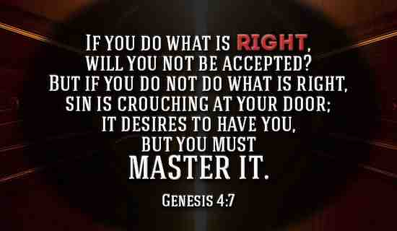
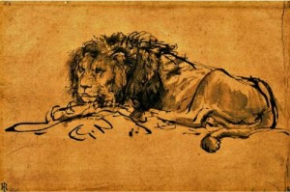

Slide 10
The response of Cain..
8 Now Cain talked with Abel his brother; and it came to pass, when they were in the field, that Cain rose up against Abel his brother and killed him.
Eph 4:26-27 "Be angry, and do not sin": do not let the sun go down on your wrath, 27 nor give place to the devil.

Slide 11
The pursuit of God (4:9-16)
9 Then the Lord said to Cain, "Where is Abel your brother?" He said, "I do not know. Am I my brother's keeper?" 10 And He said, "What have you done? The voice of your brother's blood cries out to Me from the ground.

Slide 12
Cain and Abel
Genesis 4:1-10

