Slide 1
Things God Loves
Proverbs 6:16-19

Slide 2
Things the Lord hates..
Proverbs 6:16-19 These six things the Lord hates, Yes, seven are an abomination to Him: 17 A proud look, A lying tongue, hands that shed innocent blood, 18 a heart that devises wicked plans, feet that are swift in running to evil, 19 A false witness who speaks lies, and one who sows discord among brethren.
Malachi 2:16 "For the Lord God of Israel says That He hates divorce..

Slide 3
Truth/error
Darkness/light
Hatred/Love
We should also hate what God hates..
And we should love what God loves

Slide 4
God loves..
Proverbs 15:8-9 8 The sacrifice of the wicked is an abomination to the Lord, but the prayer of the upright is His delight. 9 The way of the wicked is an abomination to the Lord, but He loves him who follows righteousness.
1 Timothy 6:11 But you, O man of God, flee these things and pursue righteousness, godliness, faith, love, patience, gentleness.

Slide 5
God loves..
3 John 4 I have no greater joy than to hear that my children walk in truth.

Slide 6
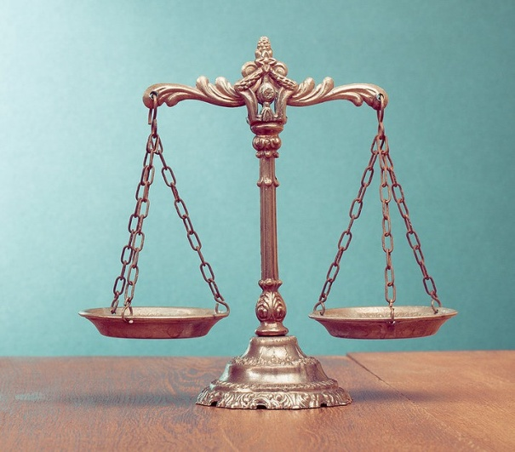
God loves..
Psalm 37:27-29 Depart from evil, and do good; And dwell forevermore. 28 For the Lord loves justice, And does not forsake His saints; They are preserved forever, But the descendants of the wicked shall be cut off.
Joseph?
Daniel?
Jesus?

Slide 7
God loves..
1 Peter 2:23 who, when He was reviled, did not revile in return; when He suffered, He did not threaten, but committed Himself to Him who judges righteously..
Phil 2:9-10 Therefore God also has highly exalted Him and given Him the name which is above every name, 10 that at the name of Jesus every knee should bow, of those in heaven, and of those on earth, and of those under the earth,

Slide 8
God loves..
2 Cor 9:6-7 But this I say: He who sows sparingly will also reap sparingly, and he who sows bountifully will also reap bountifully. 7 So let each one give as he purposes in his heart, not grudgingly or of necessity; for God loves a cheerful giver.
2 Cor 8:3-5 For I bear witness that according to their ability, yes, and beyond their ability, they were freely willing..5 And not only as we had hoped, but they first gave themselves to the Lord, and then to us by the will of God.

Slide 9
God loves..
Exodus 25:2 "Speak to the children of Israel, that they bring Me an offering. From everyone who gives it willingly with his heart you shall take My offering.

Slide 10
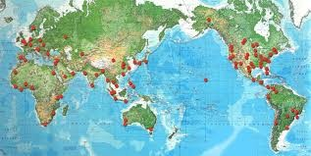
God loves..
John 3:16 For God so loved the world that He gave His only begotten Son, that whoever believes in Him should not perish but have everlasting life..
Ephesians 2:4-5 But God, who is rich in mercy, because of His great love with which He loved us, even when we were dead in trespasses and sins, made us alive together with Christ (by grace you have been saved)..

Slide 11
Things God Loves
Proverbs 6:16-19

Slide 12
Things God Loves
Proverbs 6:16-19

