Slide 1
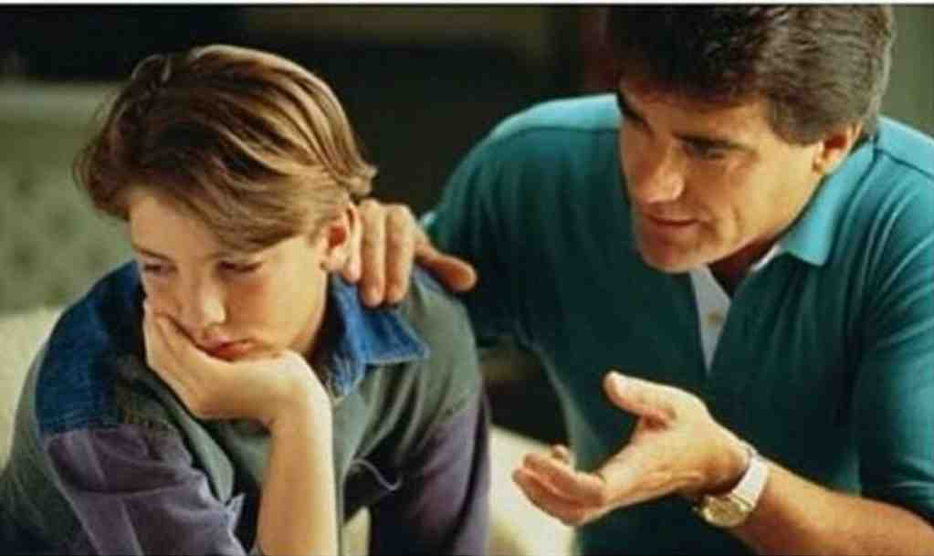
Disciplining Your Kids in Love
Psalm 78:1-8

Slide 2
Main topics..
Understand our kids will make mistakes..
Difference between Reaction and Response..
Consequences for sinful behavior..
What about my wayward child?

Slide 3
Responsibility of parents..
Col 3:18-21 Wives, submit to your own husbands, as is fitting in the Lord. 19 Husbands, love your wives and do not be bitter toward them. 20 Children, obey your parents in all things, for this is well pleasing to the Lord. 21 Fathers, do not provoke your children, lest they become discouraged.

Slide 4
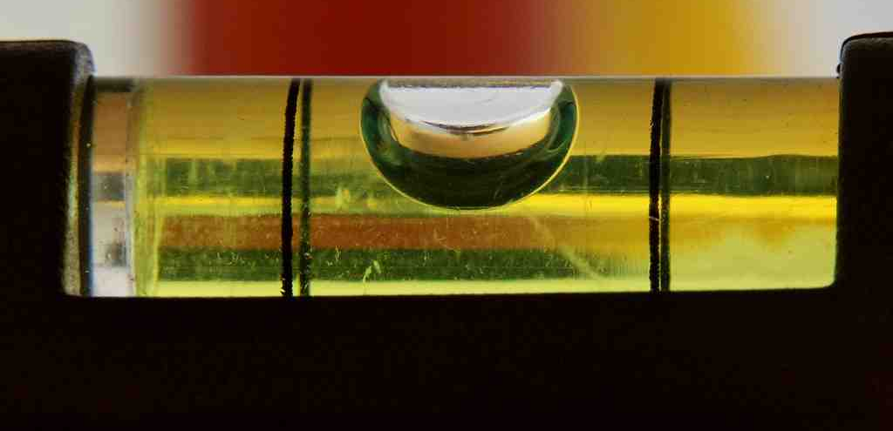
Proper balance in parenting..
Discipline is controversial..
Avoid extremes.. Seek to please God

Slide 5
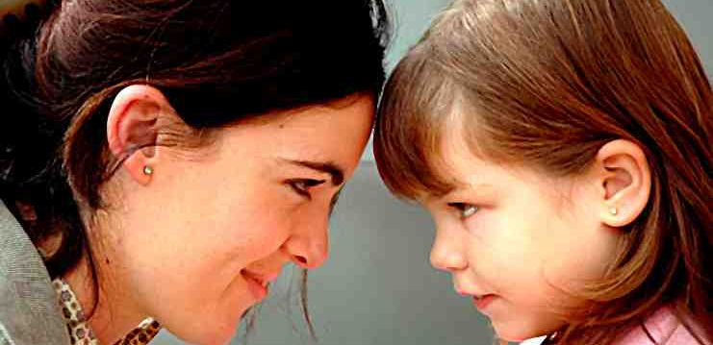
Understand they will make mistakes..
They are kids.. They will make mistakes..
Just like we aren’t perfect..

Slide 6
Response vs Reaction..
Luke 15:18-20 18 I will arise and go to my father, and will say to him, "Father, I have sinned against heaven and before you, 19 and I am no longer worthy to be called your son. Make me like one of your hired servants." '
20 And he arose and came to his father. But when he was still a great way off, his father saw him and had compassion, and ran and fell on his neck and kissed him.
Avoid condemnation..
Respond with love and grace..

Slide 7
Consequences for sinful behavior..
Heb 12:5-11 And you have forgotten the exhortation which speaks to you as to sons: "My son, do not despise the chastening of the Lord, Nor be discouraged when you are rebuked by Him; 6 For whom the Lord loves He chastens, And scourges every son whom He receives."

Slide 8
Consequences for sinful behavior..
9 Furthermore, we have had human fathers who corrected us, and we paid them respect. Shall we not much more readily be in subjection to the Father of spirits and live? 10 For they indeed for a few days chastened us as seemed best to them, but He for our profit, that we may be partakers of His holiness. 11 Now no chastening seems to be joyful for the present, but painful; nevertheless, afterward it yields the peaceable fruit of righteousness to those who have been trained by it.

Slide 9
What about corporal punishment..
Prov 22:15 Foolishness is bound up in the heart of a child; The rod of correction will drive it far from him.
Prov 29:15 The rod and rebuke give wisdom, But a child left to himself brings shame to his mother.

Slide 10
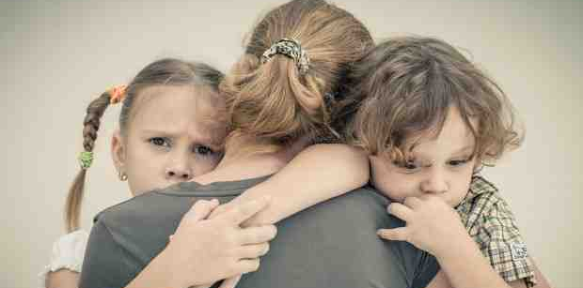
What about my wayward child?
Luke 15:17-28 ..
The father represents God
His children go astray..
We all make mistakes..
Don’t give up on them..
Be prepared to forgive (celebrate)

Slide 11
Disciplining Your Kids in Love
Psalm 78:1-8

