Slide 1
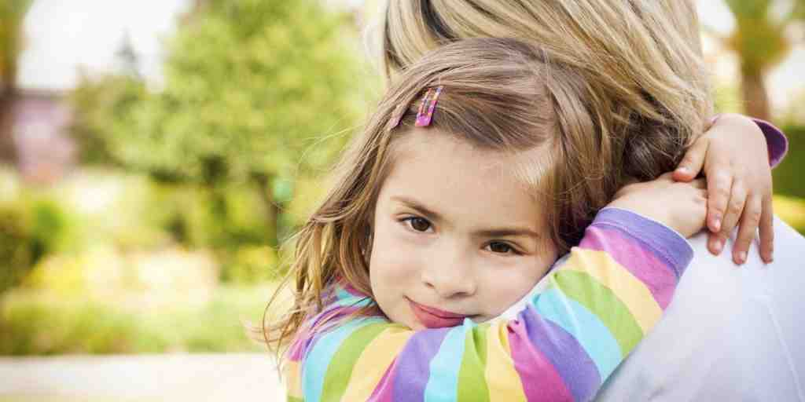
Handling Your Kids with Care
Hebrews 4:11-16

Slide 2
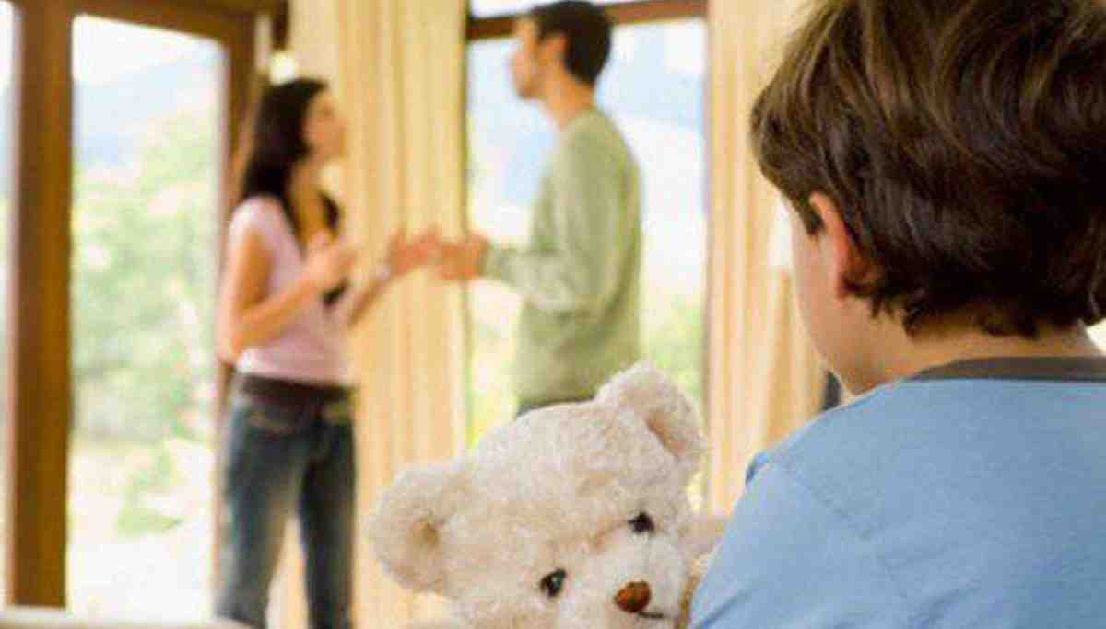
Being there for our children..
Eph 6:4 And you, fathers, do not provoke your children to wrath, but bring them up in the training and admonition of the Lord.
“Every boy or girl is in a fragile state of growth..”

Slide 3
Heb 4:14-16 Seeing then that we have a great High Priest who has passed through the heavens, Jesus the Son of God, let us hold fast our confession. 15 For we do not have a High Priest who cannot sympathize with our weaknesses, but was in all points tempted as we are, yet without sin. 16 Let us therefore come boldly to the throne of grace, that we may obtain mercy and find grace to help in time of need.

Slide 4
Treat our children the way God treats us..
1 Pet 5:6-7 Therefore humble yourselves under the mighty hand of God, that He may exalt you in due time, 7 casting all your care upon Him, for He cares for you.

Slide 5
Supreme example..
Luke 23:34 Then Jesus said, "Father, forgive them, for they do not know what they do." And they divided His garments and cast lots.

Slide 6
Treat our children the way God treats us..
1 Pet 5:6-7 Therefore humble yourselves under the mighty hand of God, that He may exalt you in due time, 7 casting all your care upon Him, for He cares for you.

Slide 7
Does not excuse bad behavior..
Titus 2:11-12 For the grace of God that brings salvation has appeared to all men, 12 teaching us that, denying ungodliness and worldly lusts, we should live soberly, righteously, and godly in the present age..

Slide 8
Learning from apostle Paul..
2 Cor 11:23-29 from the Jews five times I received forty stripes minus one. Three times I was beaten with rods; once I was stoned; three times I ws shipwrecked: a night and a day I have been in the deep: in journeys often, in perils of the Gentiles, in perils of robbers, in perils of my own countrymen, in perils in the wilderness, in perils among false brethren..

Slide 9
Learning from apostle Paul..
2 Cor 12:7-8 And lest I should be exalted above measure by the abundance of the revelations, a thorn in the flesh was given to me, a messenger of Satan to buffet me, lest I be exalted above measure. Concerning this thing I pleaded with the Lord three times that it might depart me..

Slide 10
Learning from apostle Paul..
2 Cor 12:9-10 And He said to me, “My grace is sufficient for you, for My strength is made perfect in weakness.” Therefore most gladly I will rather boast in my infirmities, that the power of Christ may rest upon me. Therefore I take pleasure in infirmities, in reproaches, in needs, in persecutions, in distresses for Christ’s sake. For when I am weak, then I am strong.”

Slide 11
Things in our children’s lives make them feel weak..
These are not liabilities..
These are opportunities..
You can have a powerful impact..
“Every boy or girl is in a fragile state of growth..”

Slide 12
Handling Your Kids with Care
Hebrews 4:11-16

