Slide 1
Raising Kids the Way God Does
Ephesians 6:1-4

Slide 2
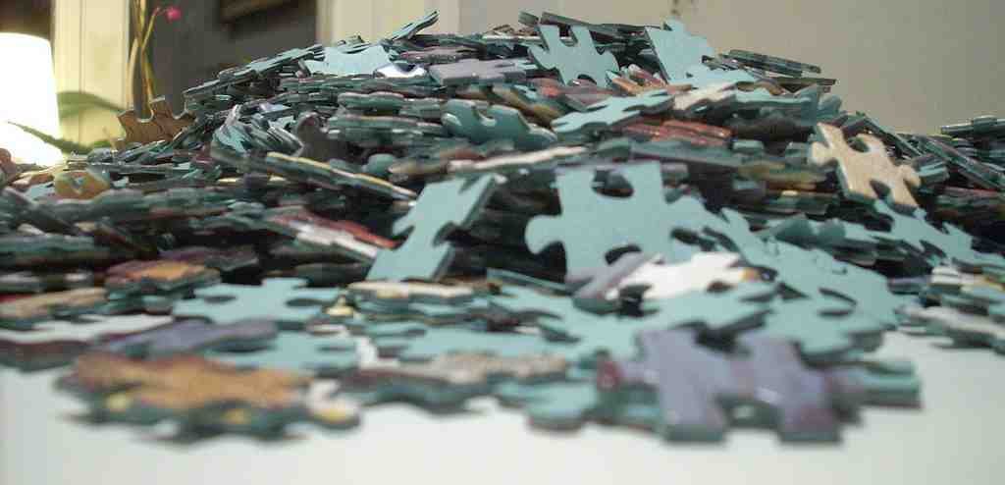
Solving the puzzle..
Welcome to parenting..

Slide 3
A great blessing..
Psalm 127:3-5 Behold, children are a heritage from the Lord, The fruit of the womb is a reward. 4 Like arrows in the hand of a warrior, So are the children of one's youth. 5 Happy is the man who has his quiver full of them.

Slide 4
We need a plan..
Eph 6:1-4 Children, obey your parents in the Lord, for this is right. 2 "Honor your father and mother," which is the first command-ment with promise: 3 "that it may be well with you and you may live long on the earth." 4 And you, fathers, do not provoke your children to wrath, but bring them up in the training and admonition of the Lord.

Slide 5
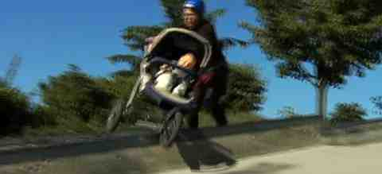
Extreme parenting..
The Everything Goes Parent..
No boundaries/No expectations
Accommodate all desires
More concerned what others think

Slide 6
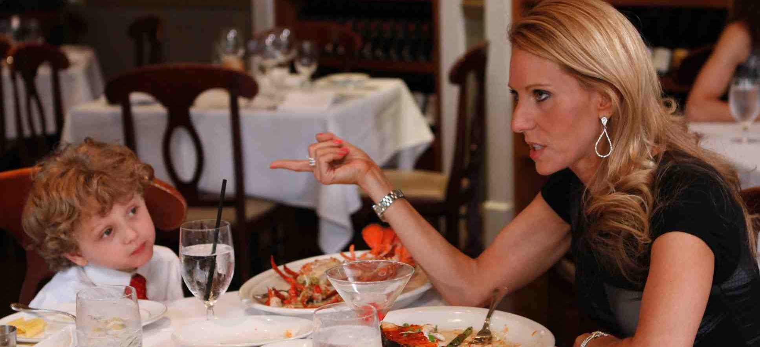
Extreme parenting..
The Over Controlling Parent..
Assumes strictness produces better behavior
Leads to fear based parenting
Control outward w/o inward attitude

Slide 7
What should be goal?
Phil 2:14-15 Do all things without complaining and disputing, 15 that you may become blameless and harmless, children of God without fault in the midst of a crooked and perverse generation, among whom you shine as lights in the world..

Slide 8
How God Raises His Children..
Titus 2:11-12 For the grace of God that brings salvation has appeared to all men, 12 teaching us that, denying ungodliness and worldly lusts, we should live soberly, righteously, and godly in the present age..

Slide 9
How God Raises His Children..
Heb 4:15-16 For we do not have a High Priest who cannot sympathize with our weaknesses, but was in all points tempted as we are, yet without sin. 16 Let us therefore come boldly to the throne of grace, that we may obtain mercy and find grace to help in time of need.

Slide 10
How God Raises His Children..
Proverbs 22:6 Train up a child in the way he should go, and when he is old he will not depart from it.

Slide 11
Grace based parenting..
Unconditional love..
Total acceptance..
Romans 15:7 Therefore receive one another, just as Christ also received us, to the glory of God.
Constant encouragement – 1 Thess 5:11
Loving discipline – Heb 12:11
Spiritual priorities – Mark 8:36
Imparting hope – 2 Thess 2:16-17

Slide 12
What will you do with your piece of history..
Psalm 127:4-5 children are a heritage from the Lord

Slide 13
Raising Kids the Way God Does
Ephesians 6:1-4

