Slide 1
The Goal of Parenting
Ephesians 6:4

Slide 2
Raising children the way God raises His..
With GRACE
Unconditional Love
Hope found only in Christ
Spiritual Reponsibilities

Slide 3
The Goal..
Eph 6:4 And you, fathers, do not provoke your children to wrath, but bring them up in the training and admonition of the Lord.
Training
Nurturing

Slide 4
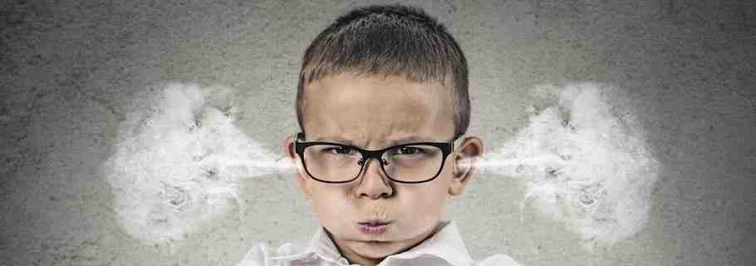
Avoiding provoking..
Harsh /overly strict..
Showing disrespect..
Comparing..
Finding fault..
Unrealistic standards..
Double standard..

Slide 5
Equipping our children for the future..
A wonderful promise..
Cannot take away free choice..
Train (“dedicate”)
“According to his way” (bending the bow)

Slide 6
Personal example and attitude..
Phil 4:9 The things which you learned and received and heard and saw in me, these do, and the God of peace will be with you.

Slide 7
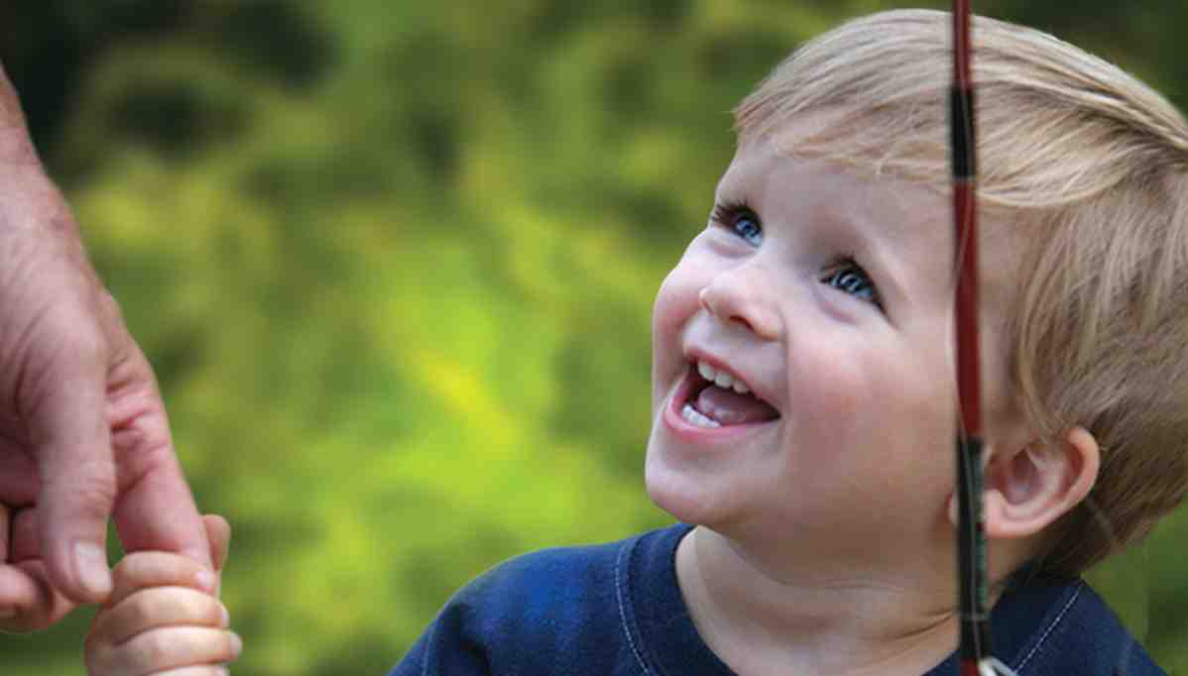
What are we to teach?
Eph 6:1-4 obey and honor parents
Rom 12:17-21 a peaceable attitude
Phil 2:4-9 a humble heart
Psa 118:24 each day with God
John 13:34-35 love for others
Luke 6:40 disciple of Jesus

Slide 8
You will never have a more important student..

Slide 9
The Goal of Parenting
Ephesians 6:4

