Slide 1
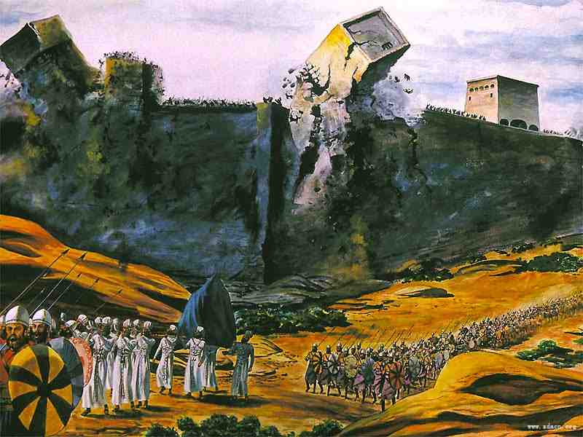
The Walls Came Down
Joshua 6:1-20

Slide 2
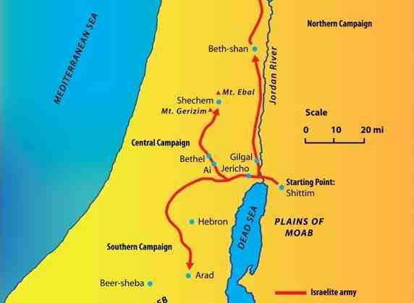
A book of conquest..
1 John 5:4-5 For whatever is born of God overcomes the world. And this is the victory that has overcome the world--our faith. 5 Who is he who overcomes the world, but he who believes that Jesus is the Son of God?

Slide 3
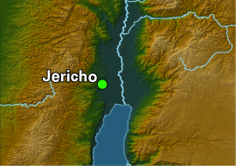
Israel’s grasshopper complex..
Numbers 13:30-33 Caleb said, "Let us go up at once and take possession, for we are well able to overcome it." 31 But the men who had gone up with him said, "We are not able to go up against the people, for they are stronger than we... There we saw the giants; and we were like grasshoppers in our own sight, and so we were in their sight."

Slide 4
Time to enter in..
Joshua 1:1-3 "Moses My servant is dead. Now therefore, arise, go over this Jordan, you and all this people, to the land which I am giving to them--the children of Israel. 3 Every place that the sole of your foot will tread upon I have given you, as I said to Moses.

Slide 5
Preparation..
Joshua 1:7-8 Only be strong and very courageous, that you may observe to do according to all the law which Moses My servant commanded you; do not turn from it to the right hand or to the left, that you may prosper wherever you go. 8 This Book of the Law shall not depart from your mouth, but you shall meditate in it day and night, that you may observe to do according to all that is written in it. For then you will make your way prosperous, and then you will have good success.

Slide 6
God’s promise..
Joshua 6:1-5 Now Jericho was securely shut up because of the children of Israel; none went out, and none came in. 2 And the Lord said to Joshua: "See! I have given Jericho into your hand, its king, and the mighty men of valor.

Slide 7
Unorthodox battle plan..
Joshua 6:3 You shall march around the city, all you men of war; you shall go all around the city once. This you shall do six days. 4 And seven priests shall bear seven trumpets of rams' horns before the ark. But the seventh day you shall march around the city seven times, and the priests shall blow the trumpets. 5 It shall come to pass, when they make a long blast with the ram's horn, and when you hear the sound of the trumpet, that all the people shall shout with a great shout; then the wall of the city will fall down flat. And the people shall go up every man straight before him."

Slide 8
Six days.. Obedient repetition..
6 Then Joshua the son of Nun called the priests and said to them, "Take up the ark of the covenant, and let seven priests bear seven trumpets of rams' horns before the ark of the Lord." 7 And he said to the people, "Proceed, and march around the city, and let him who is armed advance before the ark of the Lord."

Slide 9
Six days.. Obedient repetition..
8 So it was, when Joshua had spoken to the people, that the seven priests bearing the seven trumpets of rams' horns before the Lord advanced and blew the trumpets, and the ark of the covenant of the Lord followed them. 9 The armed men went before the priests who blew the trumpets, and the rear guard came after the ark, while the priests continued blowing the trumpets.

Slide 10
Six days.. Obedient repetition..
10 Now Joshua had commanded the people, saying, "You shall not shout or make any noise with your voice, nor shall a word proceed out of your mouth, until the day I say to you, 'Shout!' Then you shall shout." 11 So he had the ark of the Lord circle the city, going around it once. Then they came into the camp and lodged in the camp.

Slide 11
Six days.. Obedient repetition..
12 And Joshua rose early in the morning, and the priests took up the ark of the Lord. 13 Then seven priests bearing seven trumpets of rams' horns before the ark of the Lord went on continually and blew with the trumpets. And the armed men went before them. But the rear guard came after the ark of the Lord, while the priests continued blowing the trumpets.

Slide 12
Seventh day.. Climactic victory..
14 And the second day they marched around the city once and returned to the camp. So they did six days. 15 But it came to pass on the seventh day that they rose early, about the dawning of the day, and marched around the city seven times in the same manner. On that day only they marched around the city seven times.

Slide 13
Seventh day.. Climactic victory..
16 And the seventh time it happened, when the priests blew the trumpets, that Joshua said to the people: "Shout, for the Lord has given you the city! 17 Now the city shall be doomed by the Lord to destruction, it and all who are in it. Only Rahab the harlot shall live, she and all who are with her in the house, because she hid the messengers that we sent.

Slide 14
Seventh day.. Climactic victory..
18 And you, by all means abstain from the accursed things, lest you become accursed when you take of the accursed things, and make the camp of Israel a curse, and trouble it. 19 But all the silver and gold, and vessels of bronze and iron, are consecrated to the Lord; they shall come into the treasury of the Lord."

Slide 15
Seventh day.. Climactic victory..
20 So the people shouted when the priests blew the trumpets. And it happened when the people heard the sound of the trumpet, and the people shouted with a great shout, that the wall fell down flat. Then the people went up into the city, every man straight before him, and they took the city.

Slide 16
Gaining our victory..
2 Cor 10:3-5 For though we walk in the flesh, we do not war according to the flesh. 4 For the weapons of our warfare are not carnal but mighty in God for pulling down strongholds, 5 casting down arguments and every high thing that exalts itself against the knowledge of God, bringing every thought into captivity to the obedience of Christ,

Slide 17
Gaining our victory..
Hebrews 11:30 By faith the walls of Jericho fell down after they were encircled for seven days.
Psalm 46:10-11 Be still, and know that I am God; I will be exalted among the nations, I will be exalted in the earth! 11 The Lord of hosts is with us; The God of Jacob is our refuge.

Slide 18
The Walls Came Down
Joshua 6:1-20

