Slide 1
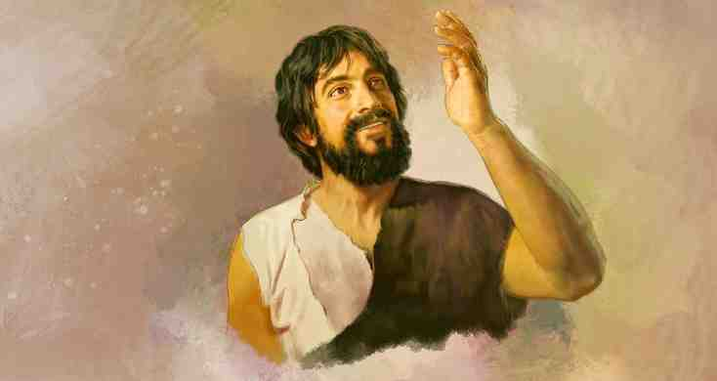
By Faith Enoch
Hebrews 11:1-6

Slide 2
Definition of Faith
Heb 11:1 Now faith is the assurance of things hoped for, a conviction of things not seen.
6 without faith it is impossible to please him, for whoever would draw near to God must believe that he exists and that he rewards those who seek him.
Faith is believing that God exists.. and that He will come through for you.. even when you give up everything for Him

Slide 3
An example of faith..
Heb 11:5 By faith Enoch was taken up so that he should not see death, and he was not found, because God had taken him. Now before he was taken he was commended as having pleased God.

Slide 4
An example of faith..
Heb 11:6 And without faith it is impossible to please him, for whoever would draw near to God must believe that he exists and that he rewards those who seek him.

Slide 5
An example of faith..
Heb 11:5 By faith Enoch was taken up so that he should not see death, and he was not found, because God had taken him. Now before he was taken he was commended as having pleased God.

Slide 6
An example of faith..
Heb 11:39-40 And all these, though commended through their faith, did not receive what was promised, 40 since God had provided something better for us, that apart from us they should not be made perfect.

Slide 7
Drawing near to God..
Genesis 5:21-24 When Enoch had lived 65 years, he fathered Methuselah. 22 Enoch walked with God after he fathered Methuselah 300 years and had other sons and daughters. 23 Thus all the days of Enoch were 365 years. 24 Enoch walked with God, and he was not,for God took him.

Slide 8
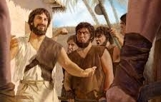
Drawing near to God ..
Jude 14-15 It was also about these that Enoch, the seventh from Adam, prophesied, saying, "Behold, the Lord comes with ten thousands of his holy ones, 15 to execute judgment on all and to convict all the ungodly of all their deeds of ungodliness that they have committed in such an ungodly way, and of all the harsh things that ungodly sinners have spoken against him."

Slide 9
Drawing near to God ..
Jude 22-23 And have mercy on those who doubt; 23 save others by snatching them out of the fire; to others show mercy with fear, hating even the garment stained by the flesh.

Slide 10
By Faith Enoch
Hebrews 11:1-6

