Slide 1
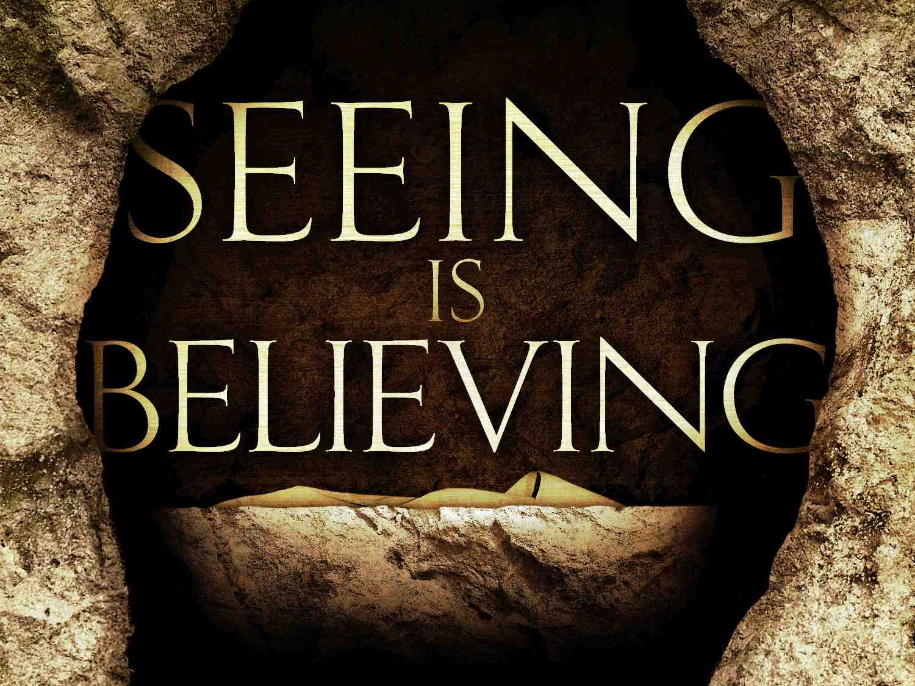
John 20:1-18

Slide 2
The key to our faith..
1 Cor 15:14 And if Christ is not risen, then our preaching is empty and your faith is also empty.. 16 For if the dead do not rise, then Christ is not risen. 17 And if Christ is not risen, your faith is futile; you are still in your sins!

Slide 3
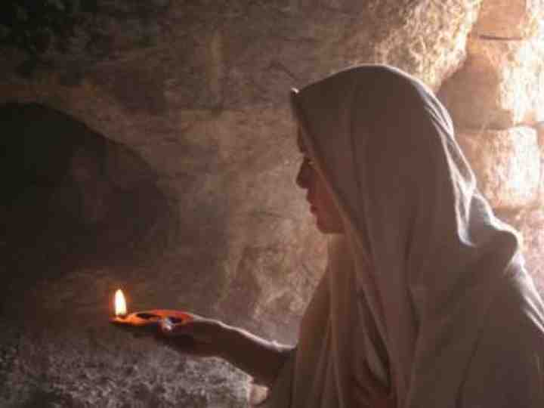
1 The Empty Tomb
John 20:1 Now on the first day of the week Mary Magdalene went to the tomb early, while it was still dark, and saw that the stone had been taken away from the tomb. 2 Then she ran and came to Simon Peter, and to the other disciple, whom Jesus loved, and said to them, "They have taken away the Lord out of the tomb, and we do not know where they have laid Him."

Slide 4
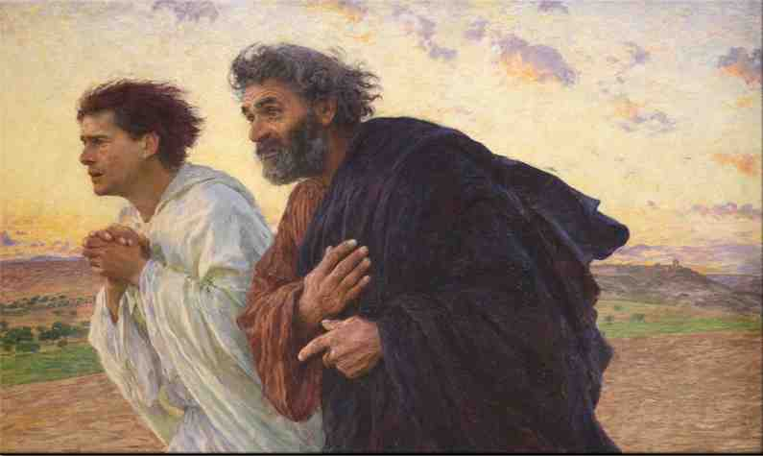
2 The Empty Graveclothes
3 Peter therefore went out, and the other disciple, and were going to the tomb. 4 So they both ran together, and the other disciple outran Peter and came to the tomb first. 5 And he, stooping down and looking in, saw the linen cloths lying there; yet he did not go in.

Slide 5
2 The Empty Graveclothes
6 Then Simon Peter came, following him, and went into the tomb; and he saw the linen cloths lying there, 7 and the handkerchief that had been around His head, not lying with the linen cloths, but folded together in a place by itself. 8 Then the other disciple, who came to the tomb first, went in also; and he saw and believed. 9 For as yet they did not know the Scripture, that He must rise again from the dead.

Slide 6
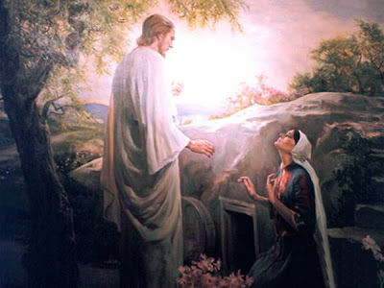
3 Eyewitness appearances
10 Then the disciples went away again to their own homes. 11 But Mary stood outside by the tomb weeping, and as she wept she stooped down and looked into the tomb. 12 And she saw two angels in white sitting, one at the head and the other at the feet, where the body of Jesus had lain. 13 Then they said to her, "Woman, why are you weeping?" She said to them, "Because they have taken away my Lord, and I do not know where they have laid Him."

Slide 7
4 Changed lives..
14 Now when she had said this, she turned around and saw Jesus standing there, and did not know that it was Jesus. 15 Jesus said to her, "Woman, why are you weeping? Whom are you seeking?" She, supposing Him to be the gardener, said to Him, "Sir, if You have carried Him away, tell me where You have laid Him, and I will take Him away." 16 Jesus said to her, "Mary!" She turned and said to Him, "Rabboni!" (which is to say, Teacher). 17 Jesus said to her, "Do not cling to Me, for I have not yet ascended to My Father; but go to My brethren and say to them, 'I am ascending to My Father and your Father, and to My God and your God.' " 18 Mary Magdalene came and told the disciples that she had seen the Lord, and that He had spoken these things to her.

Slide 8
Conclusion..
Our faith in Christ is based on solid evidence..
Our faith must include obedience to Him as Lord.
Be encouraged our Lord does not cast us off when our faith and understanding is weak.
His resurrection guarantees our future hope.

Slide 9
John 20:1-18

