Slide 1
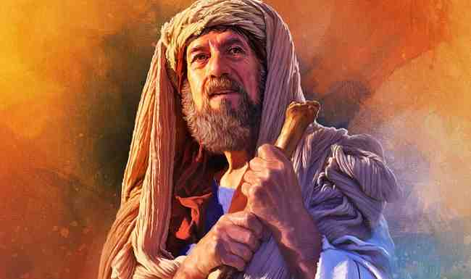
By Faith Abraham
Hebrews 11:8-10

Slide 2
1 Obeying God’s call..
Vs 8 By faith Abraham obeyed when he was called to go out to the place which he would receive as an inheritance. And he went out, not knowing where he was going.
- Faith demands decisive action..
- Always manifests itself in obedience..

Slide 3
Faith acts in response..
Genesis 12:1 Now the Lord had said to Abram: "Get out of your country, from your family and from your father's house, To a land that I will show you.

Slide 4
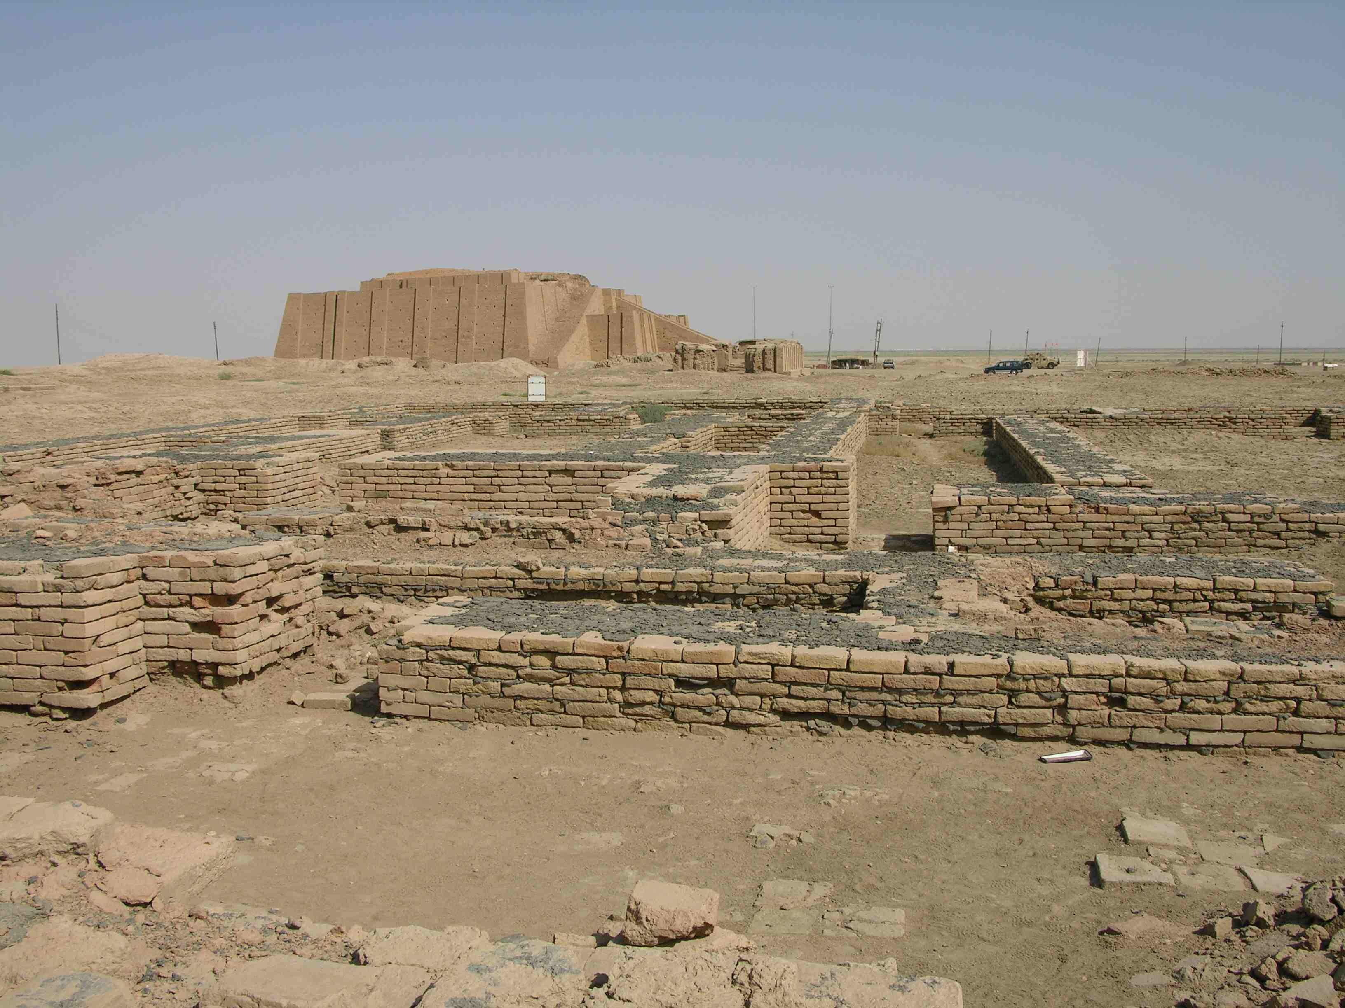
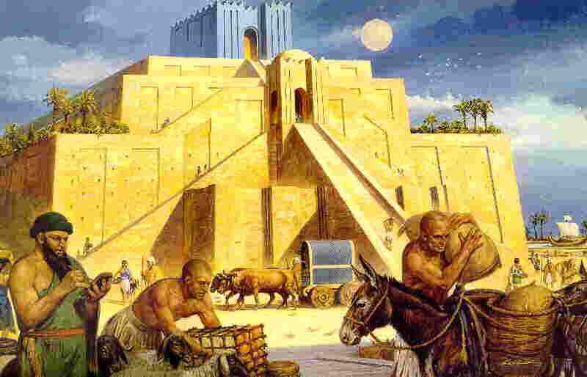
Faith requires separation..
Joshua 24:2 And Joshua said to all the people, "Thus says the Lord God of Israel: 'Your fathers, including Terah, the father of Abraham and the father of Nahor, dwelt on the other side of the River in old times; and they served other gods.

Slide 5
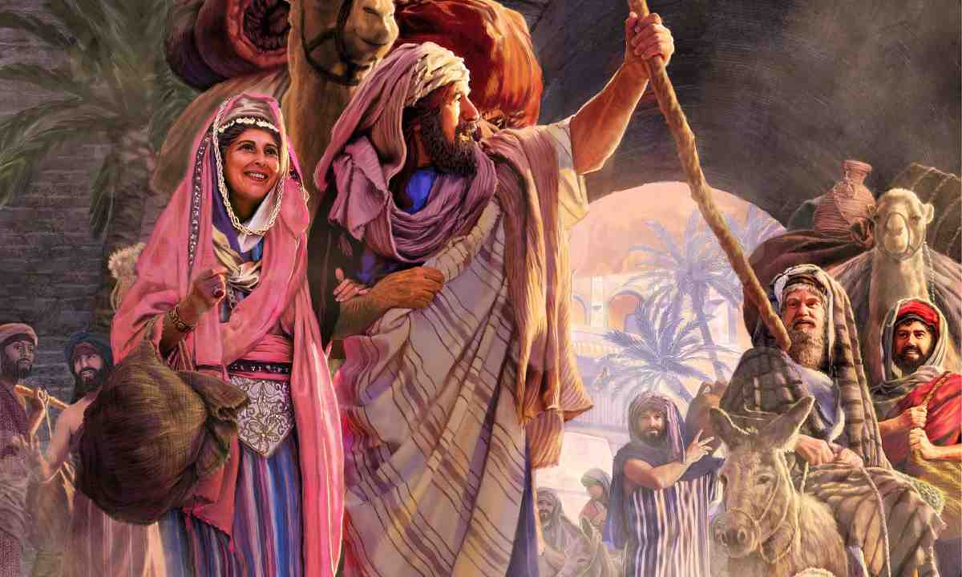
Demands decisive obedience..
Acts 7:2 "The God of glory appeared to our father Abraham when he was in Mesopotamia, before he dwelt in Haran, 3 and said to him, 'Get out of your country and from your relatives, and come to a land that I will show you.'

Slide 6
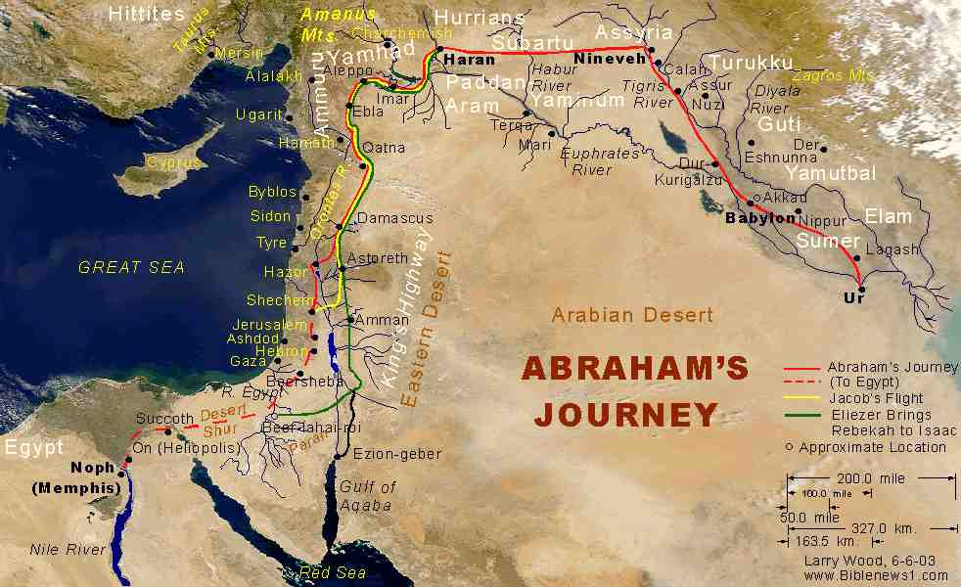
By faith Abraham obeyed..
Vs 8 By faith Abraham obeyed when he was called... And he went out, not knowing where he was going.

Slide 7
Our journey from the old life..
Matt 16:24 If any man desires to come after Me, let him deny himself, take up his cross, and follow Me.

Slide 8
2 Believing God’s promises
9 By faith he dwelt in the land of promise as in a foreign country, dwelling in tents with Isaac and Jacob, the heirs with him of the same promise..
- Faith perseveres by God’s promises..
- Willing to wait for the fulfillment..

Slide 9
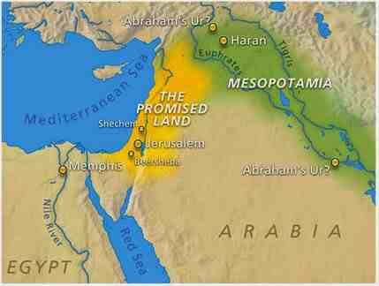
Dwelt as in a foreign country
Acts 7:5 “God gave him no inheritance in it, not even enough to set his foot on..”

Slide 10
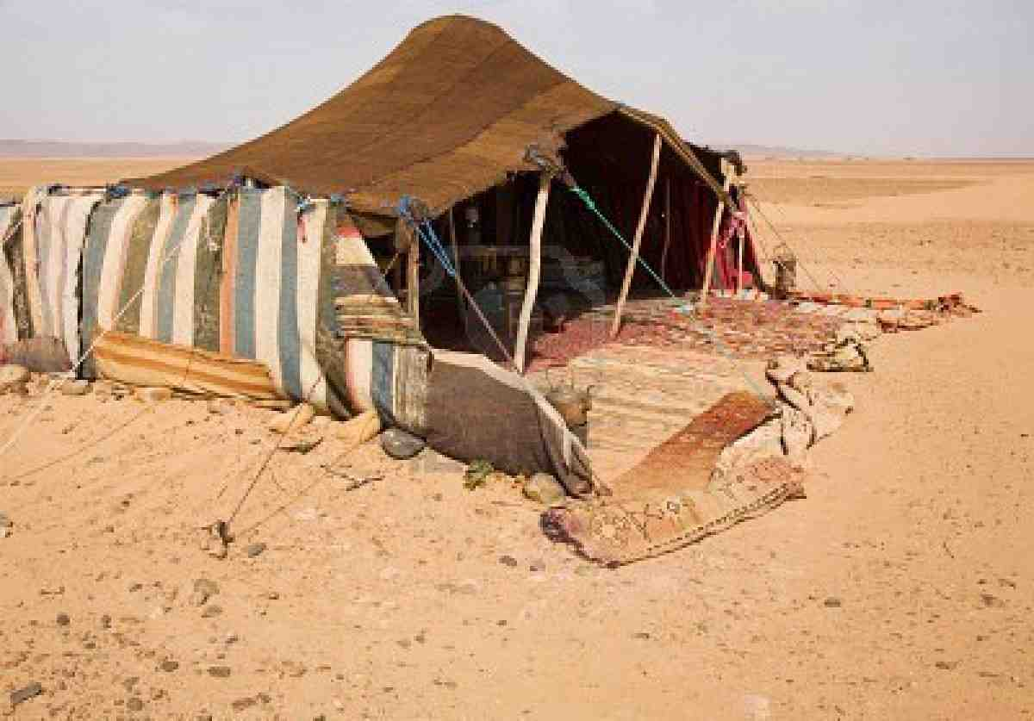
Dwelling in tents..
Abraham, Isaac, Jacob all lived as sojourners and pilgrims with no permanent home..

Slide 11
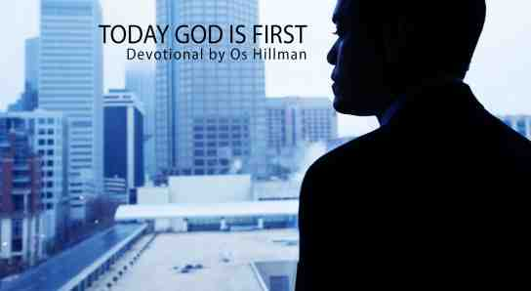
We are pilgrims in this world..
1 Peter 1:1 Peter, an apostle of Jesus Christ,To the pilgrims of the Dispersion in Pontus, Galatia, Cappadocia, Asia, and Bithynia, 2 elect according to the foreknowledge of God…

Slide 12
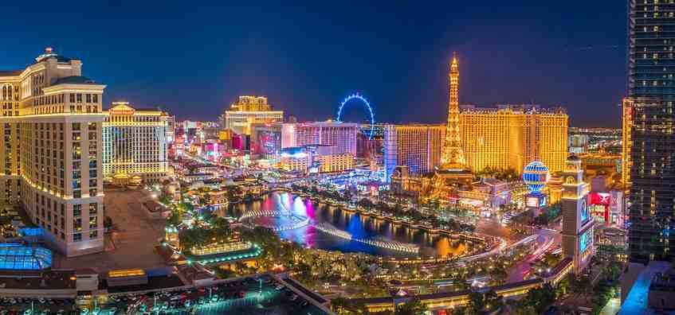
How much does the world have a grip on us?
1 John 2:15 Love not the world, neither the things that are in the world..

Slide 13
3 Looking for a city..
9-10 heirs with him of the same promise; 10 for he waited for the city which has foundations, whose builder and maker is God.
Explains what kept him going..
He looked beyond this world..

Slide 14
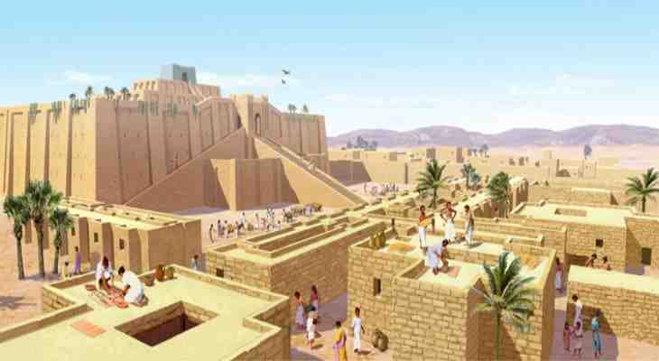
Did Abraham yearn for the comforts of this life?..
He longed to settle down and live in peace..
By faith he lifted his eyes up to better things..

Slide 15
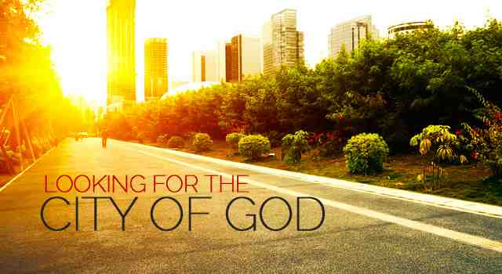
What makes us willing to sacrifice?
Romans 8:18 “I consider that the sufferings of this present time are not worthy to be compared with the glory that is to be revealed in us.”

Slide 16
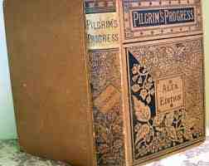
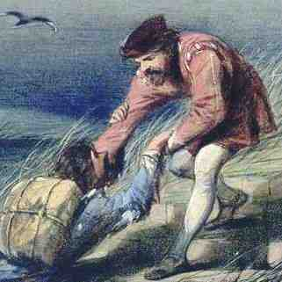
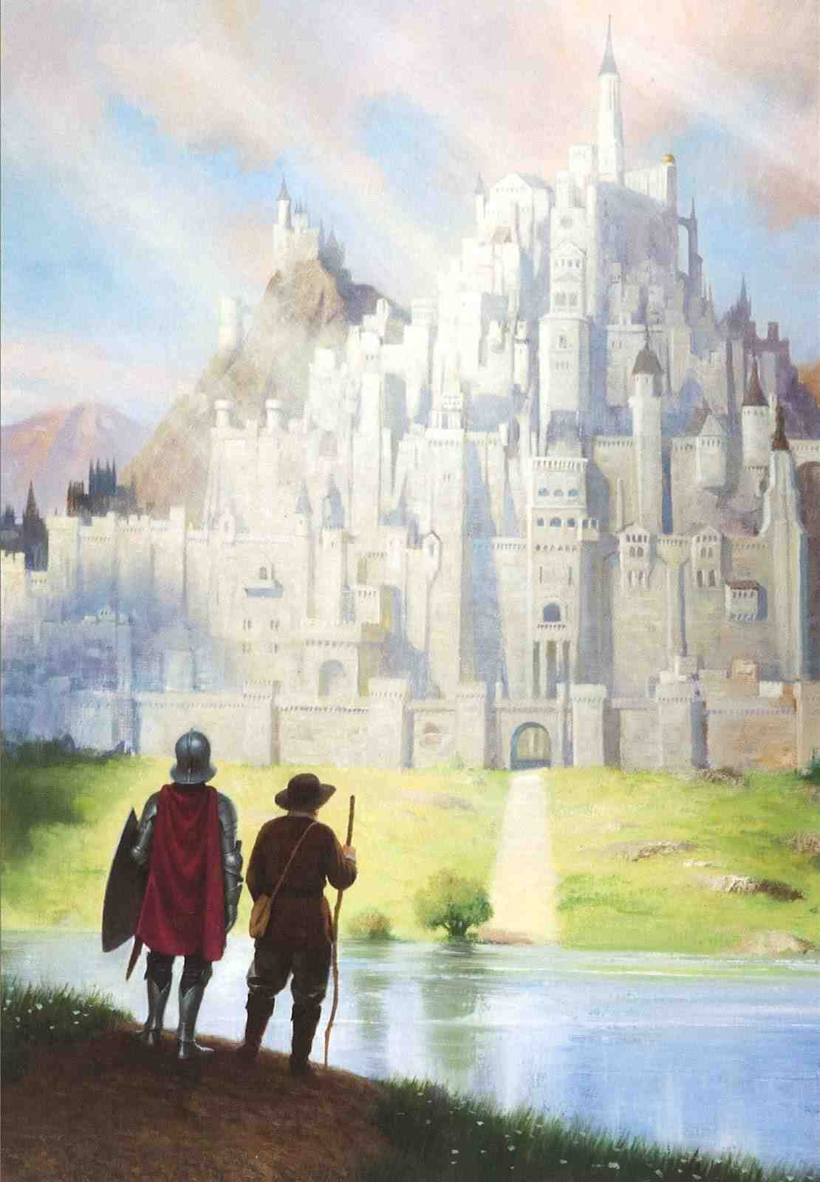
Pilgrim’s Progress..
Christian is sustained in his journey by the vision of the celestial city..

Slide 17
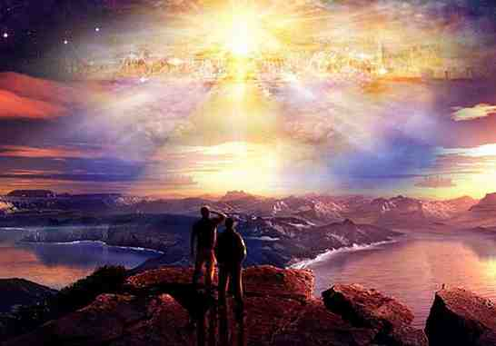
John’s vision from Patmos..
Rev 21:10-11 "mountain great and high" to see the Holy City, Jerusalem, coming down out of heaven from God and its brilliance was like that of a very precious jewel, like jasper, clear as crystal“..
21:23 "The city does not need the sun or the moon to shine on it, for the glory of God gives it light, and the Lamb is its lamp"

Slide 18
John’s vision from Patmos..
22:2-5 "The leaves of the tree are for the healing of the nations. No longer will there be any curse. The throne of God and of the Lamb will be in the city, and his servants will serve Him. They will see His face, and His name will be on their foreheads. There will be no more night. They will not need the light of a lamp or the light of the sun, for the Lord God will give them light. And they will reign for ever and ever..
22:14 Blessed are those who wash their robes, that they may have the right to the tree of life and may enter through the gates into the city

Slide 19
By Faith Abraham
Hebrews 11:8-10

