Slide 1
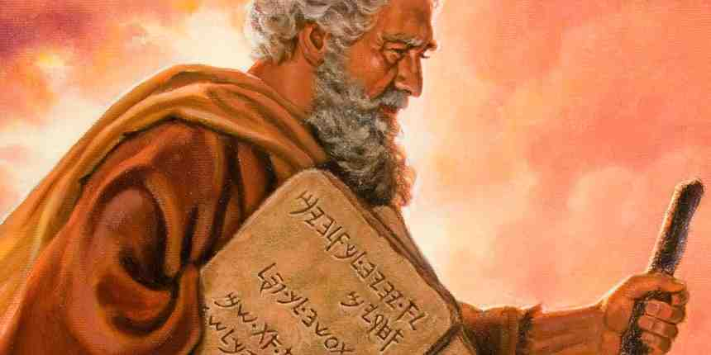
By Faith Moses
Hebrews 11:23-27

Slide 2
Moses’ Choice (vs 24-26)
24 By faith Moses, when he became of age, refused to be called the son of Pharaoh's daughter, 25 choosing rather to suffer affliction with the people of God than to enjoy the passing pleasures of sin, 26 esteeming the reproach of Christ greater riches than the treasures in Egypt; for he looked to the reward.

Slide 3
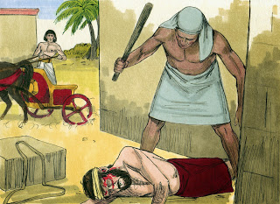
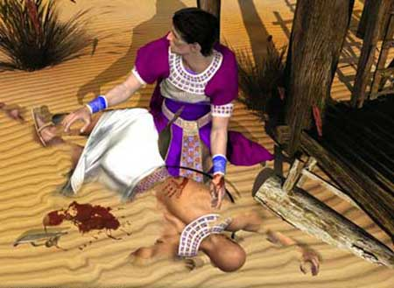
Moses’ Choice (vs 24-26)
Exod 2:11-12 One day, after Moses had grown up, he went out to where his own people were and watched them at their hard labor. He saw an Egyptian beating a Hebrew, one of his own people. 12 Looking this way and that and seeing no one, he killed the Egyptian and hid him in the sand...

Slide 4
What he gave up..
Worldly honor and power..
Pleasures of sin..
Treasures of Egypt..
What for?....
Affliction with God’s people
The reproach of Christ
Luke 14:26-33 “Any of you who do not give up everything he has cannot be my disciple”..

Slide 5
His Faith
Heb 11:24 By faith Moses chose…
He believed the Israelites were God’s people..
He believed Yahweh was the true God..
Better to be one of God’s people, even afflicted..
From his parents .. Vs 23 Exod 2:1-5
Aware of the Hebrew slaves.. Exod 1:9-10

Slide 6
Faith’s Calculation..
His faith led to works (obedience, action)
Vs 24 He chose..
Vs 25 Explains why.. He reckoned, calculated..
Vs 6 Believed God rewards those who seek Him
He chose the greater reward..
Honor in Pharoah’s house or with God’s people
Pharaoh or God
Worldly pleasure or living for God

Slide 7
Choosing reproach for Christ..
Greater value than treasures of Egypt..
Looking ahead to the reward..
Did Moses believe in Jesus?
Mistreatment with God’s people parallel with suffering of Christ
Moses knew Christ was promised..
John 1:45 we have found the one Moses wrote about, Jesus of Nazareth
John 5:46 If you believed Moses, you would believe Me, for Moses wrote about Me..

Slide 8
Choosing reproach for Christ..
Matt 5:10-12 Blessed are those who are persecuted because of righteousness, for theirs is the kingdom of heaven.
11 “Blessed are you when people insult you, persecute you and falsely say all kinds of evil against you because of me.
12 Rejoice and be glad, because great is your reward in heaven, for in the same way they persecuted the prophets who were before you.

Slide 9
By Faith Moses
Hebrews 11:23-27

