Slide 1
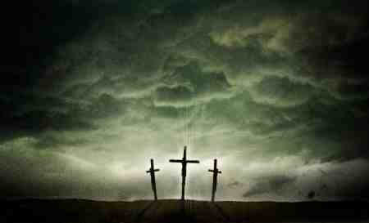
Jesus the Answer to Sin
John 8:31-36

Slide 2
Preaching Jesus..
1 Cor 2:1-2 For I determined not to know anything among you except Jesus Christ and Him crucified.
Heb 12:2 looking unto Jesus, the author and finisher of our faith, who for the joy that was set before Him endured the cross, despising the shame, and has sat down at the right hand of the throne of God.

Slide 3
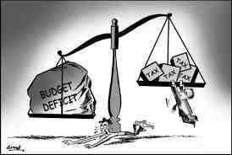
S I N
What does sin do?

Slide 4
Sin enslaves us..
2 Tim 2:24-26 And a servant of the Lord must not quarrel but be gentle to all, able to teach, patient, 25 in humility correcting those who are in opposition, if God perhaps will grant them repentance, so that they may know the truth, 26 and that they may come to their senses and escape the snare of the devil, having been taken captive by him to do his will.

Slide 5
Sin enslaves us..
John 8:34-36 Jesus answered them, "Most assuredly, I say to you, whoever commits sin is a slave of sin. 35 And a slave does not abide in the house forever, but a son abides forever. 36 Therefore if the Son makes you free, you shall be free indeed.
Rom 6:15-16 What then? Shall we sin because we are not under law but under grace? Certainly not! 16 Do you not know that to whom you present yourselves slaves to obey, you are that one's slaves whom you obey, whether of sin leading to death, or of obedience leading to righteousness?

Slide 6
Sin enslaves us..
What can we do?
By ourselves .. Nothing
1 John 5:19 We know that we are of God, and the whole world lies under the sway of the wicked one.

Slide 7
Sin leaves us unfulfilled..
Heb 11:24-26 By faith Moses, when he became of age, refused to be called the son of Pharaoh's daughter, 25 choosing rather to suffer affliction with the people of God than to enjoy the passing pleasures of sin, 26 esteeming the reproach of Christ greater riches than the treasures in Egypt; for he looked to the reward.

Slide 8
Sin leaves us unfulfilled..
Eccl 5:10-11 He who loves silver will not be satisfied with silver; Nor he who loves abundance, with increase. This also is vanity. 11 When goods increase, They increase who eat them; So what profit have the owners Except to see them with their eyes?
What can we do about it?
On our own.. nothing

Slide 9
Sin condemns our soul to eternal damnation..
Rom 6:23 For the wages of sin is death, but the gift of God is eternal life in Christ Jesus our Lord.

Slide 10
Sin condemns our soul to eternal damnation..
Mark 9:43-48 If your hand causes you to sin, cut it off. It is better for you to enter into life maimed, rather than having two hands, to go to hell, into the fire that shall never be quenched-- 44 where 'Their worm does not die, And the fire is not quenched.' 45 And if your foot causes you to sin, cut it off. It is better for you to enter life lame, rather than having two feet, to be cast into hell, into the fire that shall never be quenched-- 46 where 'Their worm does not die, And the fire is not quenched.' 47 And if your eye causes you to sin, pluck it out. It is better for you to enter the kingdom of God with one eye, rather than having two eyes, to be cast into hell fire-- 48 where 'Their worm does not die, And the fire is not quenched.'

Slide 11
Sin condemns our soul to eternal damnation..
2 Thess 1:6-9 since it is a righteous thing with God to repay with tribulation those who trouble you, 7 and to give you who are troubled rest with us when the Lord Jesus is revealed from heaven with His mighty angels, 8 in flaming fire taking vengeance on those who do not know God, and on those who do not obey the gospel of our Lord Jesus Christ. 9 These shall be punished with everlasting destruction from the presence of the Lord and from the glory of His power,
What can we do about it?
On our own.. nothing

Slide 12
Jesus is the Answer..
To Enslavement in Sin .. John 8:31-36
“If the Son sets you free you will be free indeed”
To unsatisfying life of sin .. Eph 2:1-10
“dead in sin, but God .. By grace you are saved”
To soul’s condemnation .. John 3:16-17
“should not perish but have everlasting life”

Slide 13
Is He the answer for you?
Hear and believe – Rom 10:17
Faith with obedience – Heb 11
Repent (turn from sin) – Acts 17:30
Confess faith in Jesus – Rom 10:9-10
Baptism – Acts 22:16
Peace of God – Phil 4:6-7
Life of worship – Rom 12:1-2

Slide 14
Jesus the Answer to Sin
John 8:31-36

