Slide 1
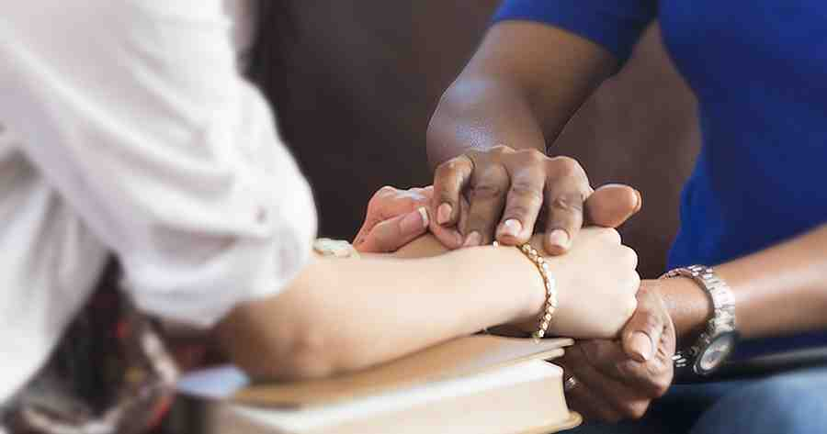
Jesus the Answer to Racism
Acts 10:24-35

Slide 2
Definition..
prejudice, discrimination, directed against someone of a different race based on the belief that one's own race is superior.
belief that members of each race possess characteristics or abilities to distinguish it as inferior or superior to another race or races.

Slide 3
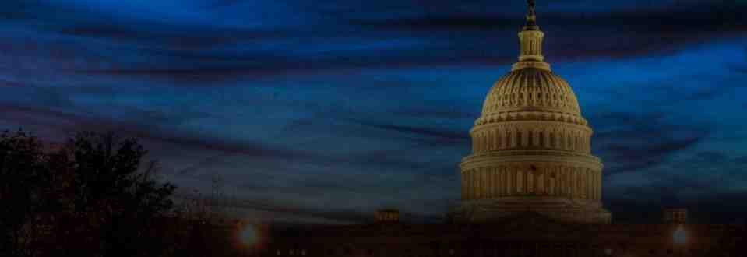
Isn’t this now behind us?..
Housing neighborhoods..
Schools..
Law enforcement..
Attitudes..
In spite of progress, serious issues still remain..

Slide 4
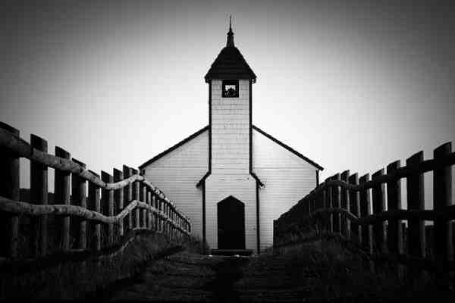
Spiritual segregation..
“11:00 Sunday .. Most segregated hour”
Some churches still segregated by choice
There is hope.. Christ is able to change heart

Slide 5
Focus on the solution..
Racism existed and is addressed in scripture..
John 4:9 Then the woman of Samaria said to Him, "How is it that You, being a Jew, ask a drink from me, a Samaritan woman?" For Jews have no dealings with Samaritans.
The Bible tells us the solution..

Slide 6
Answers to racial division..
Created in image of God.. Gen 1:26-27
Each person deserves respect Gen 9:6; Jas 3:9
Gen 3:20 Eve the mother of us all..
God made of one all nations .. Acts 17:25-26
Christ brought salvation for all ..
Peter’s vision Acts 10:28-35
Peter explains Acts 11:1-18
Good Samaritan .. Luke 10:27-28

Slide 7
Answers to racial division..
The gospel .. Matt 28:19-20 all nations
Jesus’ desire for all in heaven – John 14:1-3
Jesus removed wall of separation – Eph 2:14-16
Jesus’ prayer for unity – John 17:20-21
Unity in Christ – Eph 4:1-6
One in Christ – Gal 3:26-28

Slide 8
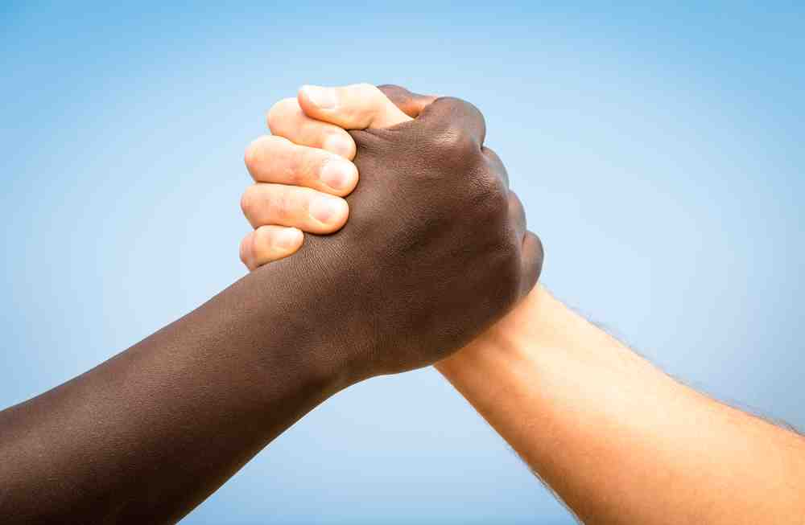
How do put this in practice?
Examine ourselves.. We all have some biases
Talk about this in a proper setting..
Be willing to open doors like Peter..
Realize people are imperfect.. Gal 2:11-15
Reach out to others.. 1 Cor 9:22-23
Begins with Christlike attitude .. Eph 4:1-3

Slide 9
Jesus the Answer to Racism
Acts 10:24-35

