Slide 1
Jesus the Answer to Relativism
John 18:33-38

Slide 2
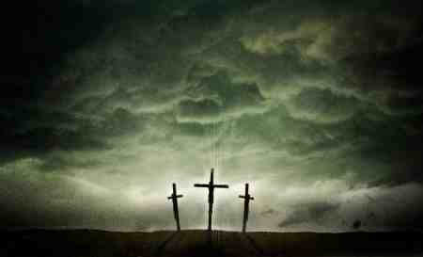
S I N
Man’s greatest problem

Slide 3
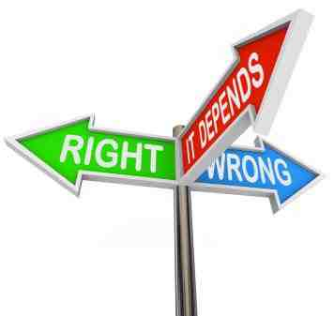

Slide 4
There is truth..
John 18:33-38 Then Pilate called Jesus and said to Him, "Are You the King of the Jews?“.. 36 Jesus answered, "My kingdom is not of this world. If My kingdom were of this world, My servants would fight, so that I should not be delivered to the Jews; but now My kingdom is not from here."

Slide 5
There is truth..
37 Pilate therefore said to Him, "Are You a king then?" Jesus answered, "You say rightly that I am a king. For this cause I was born, and for this cause I have come into the world, that I should bear witness to the truth. Everyone who is of the truth hears My voice." 38 Pilate said to Him, "What is truth?“..
Truth does exist

Slide 6
There is truth..
John 17:17 Sanctify them by Your truth. Your word is truth.
Truth does exist

Slide 7
Truth can be known..
John 8:31-32 Then Jesus said to those Jews who believed Him, "If you abide in My word, you are My disciples indeed. 32 And you shall know the truth, and the truth shall make you free."

Slide 8
Truth does not change
Hebrews 13:8 Jesus Christ is the same yesterday, today, and forever.
Jude 3 Beloved, while I was very diligent to write to you concerning our common salvation, I found it necessary to write to you exhorting you to contend earnestly for the faith which was once for all delivered to the saints.

Slide 9
Truth does not change
1 Peter 1:23 having been born again, not of corruptible seed but incorruptible, through the word of God which lives and abides forever, 24 because "All flesh is as grass, And all the glory of man as the flower of the grass. The grass withers, And its flower falls away, 25 But the word of the Lord endures forever." Now this is the word which by the gospel was preached to you.

Slide 10
We can apply truth to ourselves and other people
Matthew 7:1 "Judge not, that you be not judged. 2 For with what judgment you judge, you will be judged; and with the measure you use, it will be measured back to you.

Slide 11
We can apply truth to ourselves and other people
3 And why do you look at the speck in your brother's eye, but do not consider the plank in your own eye? 4 Or how can you say to your brother, 'Let me remove the speck from your eye'; and look, a plank is in your own eye? 5 Hypocrite! First remove the plank from your own eye, and then you will see clearly to remove the speck from your brother's eye.

Slide 12
We can apply truth to ourselves and other people
John 7:24 Do not judge according to appearance, but judge with righteous judgment."

Slide 13
Jesus the Answer to Relativism
John 18:33-38

