Slide 1
The Person God Uses
2 Timothy 2:20-22

Slide 2
2 Timothy 2:20-22
20 But in a great house there are not only vessels of gold and silver, but also of wood and clay, some for honor and some for dishonor. 21 Therefore if anyone cleanses himself from the latter, he will be a vessel for honor, sanctified and useful for the Master, prepared for every good work.

Slide 3
God desires to use each of us..
Paul arrested/his departure near..
2 Tim 1:6-8 don’t be ashamed of the gospel
God uses cleansed people..
People who flee sin
Who pursue righteousness

Slide 4
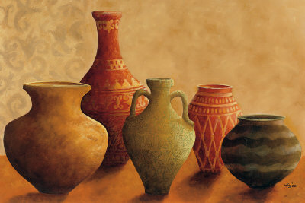
Large house: different vessels
Vessels of gold and silver for honor
Used to serve, bless, and feed
Vessels of wood and clay for dishonor
Less valuable uses, not irreplaceable
Which type do you want to be?

Slide 5
Choose to be a vessel of honor..
It is an honor for God to use you..
Isaiah 6:8 Here am I, send me..
We are clay in the potter’s hand..
Romans 9:21-23 potter has right over the clay to make a vessel of honor or another common use
Our responsibility to cleanse ourselves
2 Tim 2:20-22 we prepare ourselves to be vessels of honor

Slide 6
Cleansing is our responsibility
“If anyone cleanses himself from these things”
1 John 1:7-9 cleansed by blood of Christ, but requires a continuing walk in the light
Cleansed people are sanctified (set apart)
By obedience to the gospel 1 Cor 6:9-11
By growing in Christ 2 Cor 7:1; 1 Thess 4:3-7
Useful to Master, prepared for every good work
Willing and ready to serve

Slide 7
2 Timothy 2:22
22 Flee also youthful lusts; but pursue righteousness, faith, love, peace with those who call on the Lord out of a pure heart.
Cleansed people flee from sin..
“Flee youthful lusts”
Cleansed people pursue godliness..
“Righteousness, faith, love, peace”
“With those who call on Lord out of pure heart”

Slide 8
Useful to the Master
Choose to be a vessel of honor
Make yourself useful
Pursue righteousness, faith, love
With others who call on Lord with pure heart
Pursue peace with others (vs 24)
Be zealous in the Word (vs 15)

Slide 9
The Person God Uses
2 Timothy 2:20-22

