Slide 1
Serving the Church
1 Timothy 3:1-13

Slide 2
God’s plan for leadership..
Jesus Christ (Head) Eph 1:22-23
Apostles and prophets Eph 4:11
Elders (who oversee congregation)
Deacons (who serve special needs)
Evangelists (who proclaim the word)
Teachers (who teach, exhort, encourage)

Slide 3
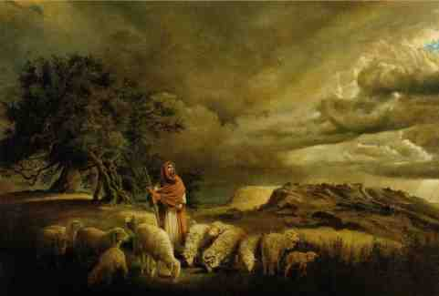
The nature of Christlike leadership..
Matt 20:25-28 But Jesus called them to Himself and said, "You know that the rulers of the Gentiles lord it over them, and those who are great exercise authority over them. 26 Yet it shall not be so among you; but whoever desires to become great among you, let him be your servant.

Slide 4
The nature of Christlike leadership..
27 And whoever desires to be first among you, let him be your slave-- 28 just as the Son of Man did not come to be served, but to serve, and to give His life a ransom for many."

Slide 5
Who is a servant?
One who freely gives himself for others like Jesus did.. Phil 2:3-4; Romans 12:10-13
One who forgives abuses to him as a leader as Jesus forgave abuses .. Eph 4:31-32
Must be willing to serve God’s people

Slide 6
Two offices of leadership
Phil 1:1-2 Paul and Timothy, bondservants of Jesus Christ, To all the saints in Christ Jesus who are in Philippi, with the bishops and deacons: 2 Grace to you and peace from God our Father and the Lord Jesus Christ.
1 Tim 3:1 This is a faithful saying: If a man desires the position of a bishop, he desires a good work.
1 Tim 3:8 Likewise deacons must be reverent, not double-tongued, not given to much wine, not greedy for money, 9 holding the mystery of the faith with a pure conscience.

Slide 9
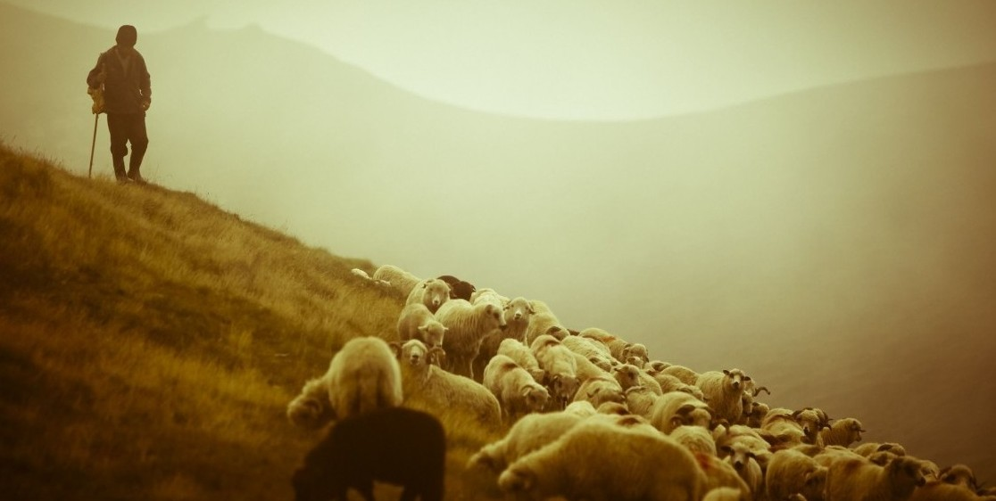
Priorities for shepherds..
Feeding the flock
Acts 20:28 Therefore take heed to yourselves and to all the flock, among which the Holy Spirit has made you overseers, to shepherd the church of God which He purchased with His own blood.
Guarding the flock
29 For I know this, that after my departure savage wolves will come in among you, not sparing the flock.
Sacrificial service
John 10:11 the good shepherd lays down his life for the sheep

Slide 10
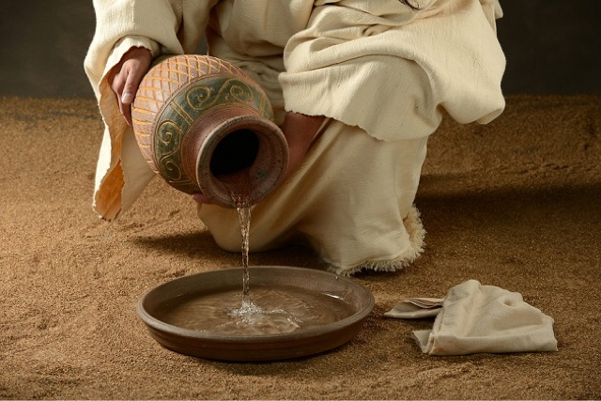
How to develop leadership
Humility is the path to greatness.. Phil 2:5-8
Follow the example of Jesus .. John 13:1-17
Grow in grace and knowledge.. 2 Pet 3:18

Slide 11
Serving the Church
1 Timothy 3:1-13

