Slide 1
Virtual Reality
Do You Want to go to Heaven?
John 14:1-3

Slide 2
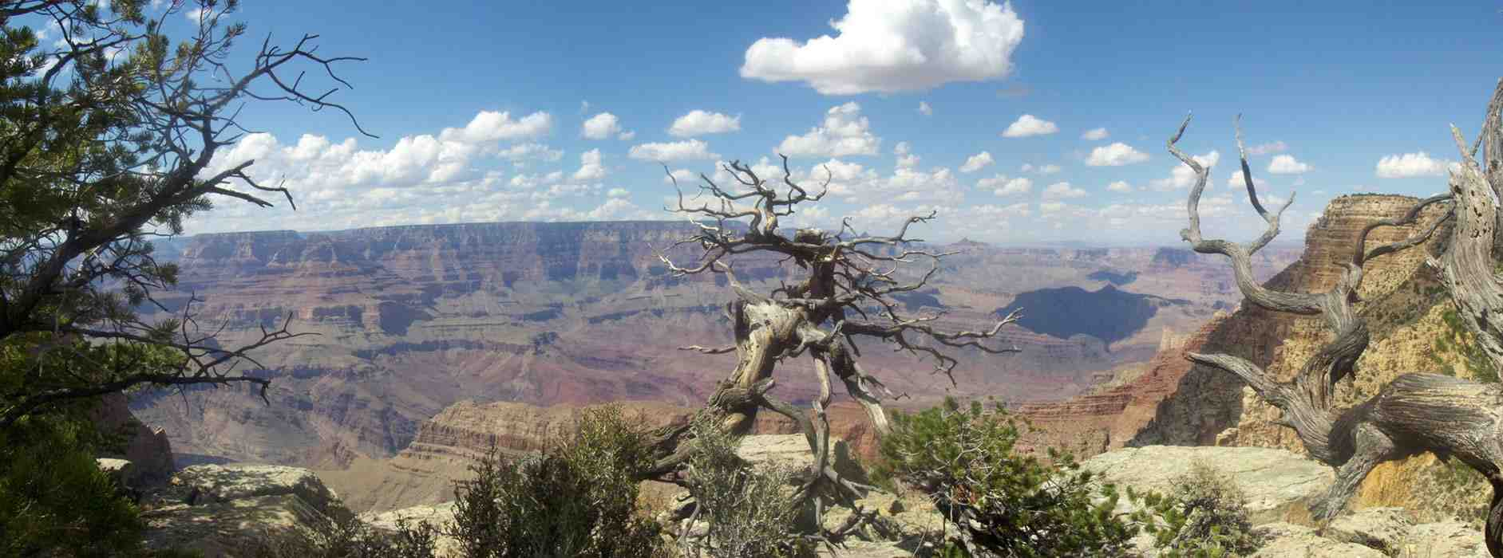
Perspective on life..

Slide 3
Going to heaven?..
We’re all going to die .. Hebrews 9:27
Jesus is coming back .. 2 Thess 1:8-9
7 and to give you who are troubled rest with us when the Lord Jesus is revealed from heaven with His mighty angels, 8 in flaming fire taking vengeance on those who do not know God, and on those who do not obey the gospel of our Lord Jesus Christ. 9 These shall be punished with everlasting destruction from the presence of the Lord and from the glory of His power.
Am I headed in the direction?

Slide 4
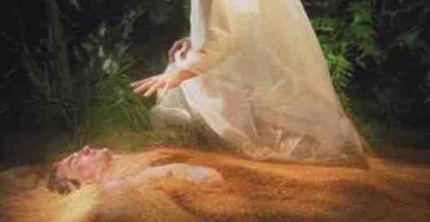
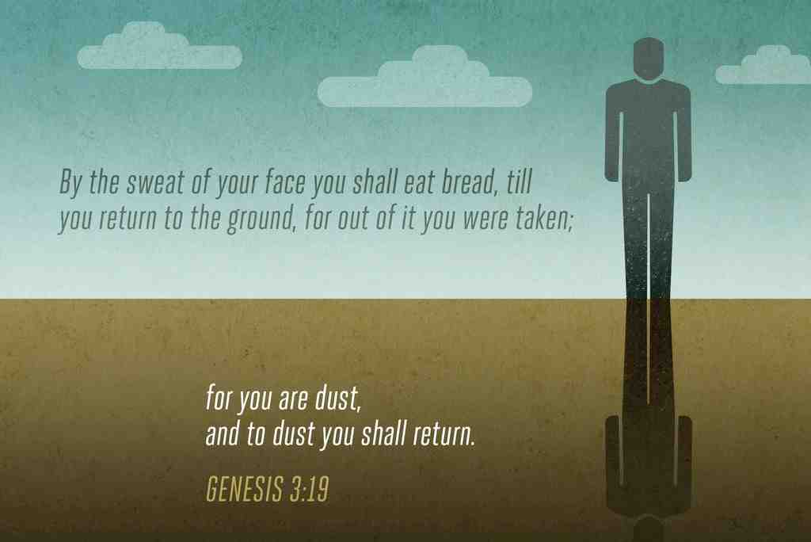
1 Reality of our identity
Gen 2:7 And the Lord God formed man of the dust of the ground, and breathed into his nostrils the breath of life; and man became a living being.
1:27 So God created man in His own image; in the image of God He created him; male and female He created them.

Slide 5
1 Reality of our identity
Eccl 3:11 He has made everything beautiful in its time. Also He has put eternity in their hearts, except that no one can find out the work that God does from beginning to end.
12:7 Then the dust will return to the earth as it was, And the spirit will return to God who gave it.

Slide 6
2 Reality of individual choice
Live with Him in Eternity
Glorify God now
Reject Him now /
Separated from Him in Eternity
Fail to glorify Him

Slide 7
2 Reality of individual choice
Matthew 25 parables of readiness
10 Virgins (five wise, five foolish)
Talents (entrusted by the Master)
King with all nations
Rom 2:8-9 but to those who are self-seeking and do not obey the truth, but obey unrighteousness--indignation and wrath, 9 tribulation and anguish, on every soul of man who does evil, of the Jew first and also of the Greek; 10 but glory, honor, and peace to everyone who works what is good, to the Jew first and also to the Greek.

Slide 8
3 Reality is deceptive
If we allow present reality to blind us to the value of eternal reality.
2 Peter 3:10-13 end of what we now see
2 Cor 4:16-18 things not seen are eternal
James 4:14 what is your life? .. Vapor
1 Peter 1:3-4 eternal inheritance fades not

Slide 9
4 Ultimate reality
Why do you want to go to heaven?
To avoid going to hell
Escape the troubles of this world
Enjoy comforts, pleasures, rewards
Be reunited with loved ones
To get answers to all our questions
There are many good reasons

Slide 10
4 Ultimate reality
There is a better reason
Psalm 73:25-26 Whom have I in heaven but You? And there is none upon earth that I desire besides You. 26 My flesh and my heart fail; But God is the strength of my heart and my portion forever.
John 14:1-3 "Let not your heart be troubled; you believe in God, believe also in Me. 2 In My Father's house are many mansions; if it were not so, I would have told you. I go to prepare a place for you. 3 And if I go and prepare a place for you, I will come again and receive you to Myself; that where I am, there you may be also.

Slide 11
Virtual Reality
Do You Want to go to Heaven?
John 14:1-3

