Slide 1
Honor One Another
Romans 12:9-16

Slide 2
One Another commands..
Rom 12:9 Let love be without hypocrisy. Abhor what is evil. Cling to what is good. 10 Be kindly affectionate to one another with brotherly love, in honor giving preference to one another..

Slide 3
What it means to honor..
Honor your father and mother – Exod 20:12
Honor all men.. Honor the king – 1 Pet 2:17
Giving honor to your wife – 1 Pet 3:7

Slide 4
Regard as valuable..
See the worth of each one..
Never consider them as valueless..
If one leaves, to act as if we don’t care..
If we refuse to consider their beliefs..

Slide 5
How this should work..
1 Cor 12:21 The eye cannot say to the hand, “I have no need of you,” nor again the head to the feet, “I have no need of you.” 22 On the contrary, the parts of the body that seem to be weaker are indispensable, 23 and on those parts of the body that we think less honorable we bestow the greater honor, and our unpresentable parts are treated with greater modesty, 24 which our more presentable parts do not require.
But God has so composed the body, giving greater honor to the part that lacked it, 25 that there may be no division in the body, but that the members may have the same care for one another. 26 If one member suffers, all suffer together; if one member is honored, all rejoice together.

Slide 6
Various translations..
NKJ/NAS – in honor giving preference
ESV – outdo one another in showing honor
NET – show eagerness to honor each other
Greek – to lead the way, go before

Slide 7
Reconsider 1 Cor 12..
12:24-26 But God has so composed the body, giving greater honor to the part that lacked it, 25 that there may be no division in the body, but that the members may have the same care for one another. 26 If one member suffers, all suffer together; if one member is honored, all rejoice together.

Slide 8
What holds us back?..
We seek our own glory and honor..
Matt 23:6 They love the best places at feasts, the best seats in the synagogues..
Mark 12:39 the best seats in the synagogues, and the best places at feasts,

Slide 9
Parable of chief seats..
Luke 14:7 So He told a parable to those who were invited, when He noted how they chose the best places, saying to them:
8 "When you are invited by anyone to a wedding feast, do not sit down in the best place, lest one more honorable than you be invited by him;
9 and he who invited you and him come and say to you, 'Give place to this man,' and then you begin with shame to take the lowest place.

Slide 10
Parable of chief seats..
10 But when you are invited, go and sit down in the lowest place, so that when he who invited you comes he may say to you, 'Friend, go up higher.' Then you will have glory in the presence of those who sit at the table with you.
11 For whoever exalts himself will be humbled, and he who humbles himself will be exalted."

Slide 11
Parable of chief seats..
12 Then He also said to him who invited Him, "When you give a dinner or a supper, do not ask your friends, your brothers, your relatives, nor rich neighbors, lest they also invite you back, and you be repaid.
13 But when you give a feast, invite the poor, the maimed, the lame, the blind.
14 And you will be blessed, because they cannot repay you; for you shall be repaid at the resurrection of the just."

Slide 12
Areas we can show honor..
Honor all people.. 1 Pet 2:17
Honor our spouses .. 1 Pet 3:7, Heb 13:4
Greeting one another.. Rom 16:16
Receiving w/o petty issues .. Rom 14
Honoring the poor equally.. James 2:1-4

Slide 13
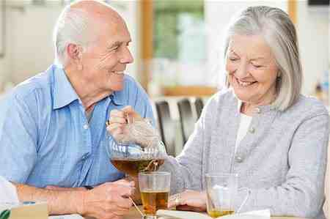
Imagine if we all practiced this..

Slide 14
Honor One Another
Romans 12:9-16

