Slide 1
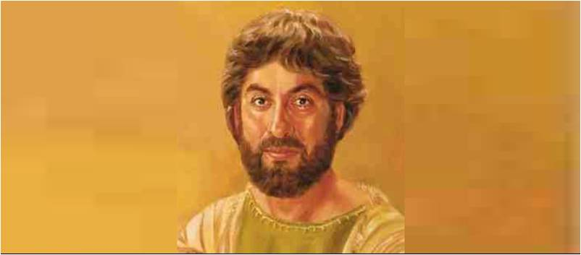
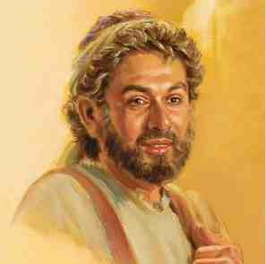
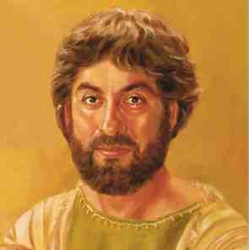
James the Son of Zebedee
Mark 10:35-45

Slide 2
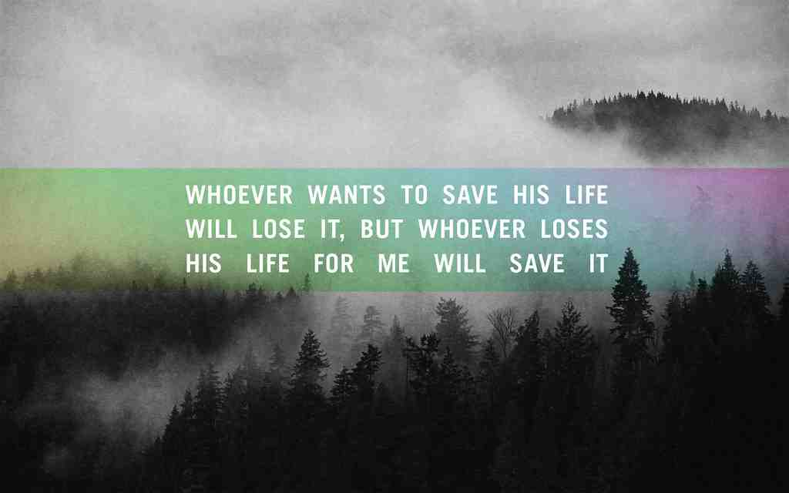
Whoever seeks to save his life will lose it, and whoever loses his life will preserve it. - Luke 17:33

Slide 3
Bold Request..
Mark 10:35-45..
“Do for us whatever we ask..”
“Right hand or left in your glory”
“Are you able to drink the cup”
“Not mine to give”
“Greatest among you.. Servant”
Did James and John get their wish?

Slide 4
Study of James..
His place in list of apostles..
Peter, James, John, Andrew
One of inner circle..
Always named with John (19 t)
Older brother… a leader
Never reached full potential
First apostle after Jesus to die..

Slide 5
Acts 12:1-2.. Death of James
Herod seeks to harass church..
Killed James with sword..
Pleased Jews.. Seized Peter..
Herod chose for most effect..
May be most underrated.. Unsung hero

Slide 6
What was James like?
From a good family.. Zebedee
His mother Salome (at the cross)
His personality .. Luke 9:53-54
Style of Elijah? 2 Kings 1:1-17
Rebuke of Jesus vs 55
Nickname Mark 3:17 Boanerges
Fiery reputation ready to defend Jesus

Slide 7
1 Zealous for the Lord..
Witnessed in Jesus .. John 2:17
Zeal for Your house consumed me
Disciples remembered saying..
James on fire for the Lord
A Fitting epitaph after Acts 12
True of James as was true of His Lord

Slide 8
2 Ambitious..
Seen in his request Mark 10:35
Ambition can be a bad thing
Driven by power, corrupted
Can also be good for noble cause
Driven by determination
James was ambitious in good sense

Slide 9
3 Ready to serve, ready to die..
“Are you able to drink the cup”?
Yes, we are able
You shall drink the cup
“We are not like the Gentiles”
We are about serving, giving life
James answered the call.. Laid down his life

Slide 10
What we learn..
Greatest servant in early church?
Following Jesus means great sacrifice
Greatest may not be most visible
Impact of strong steady presence
Herod knew how vital he was..

Slide 11
James the Son of Zebedee
Mark 10:35-45

