Slide 1
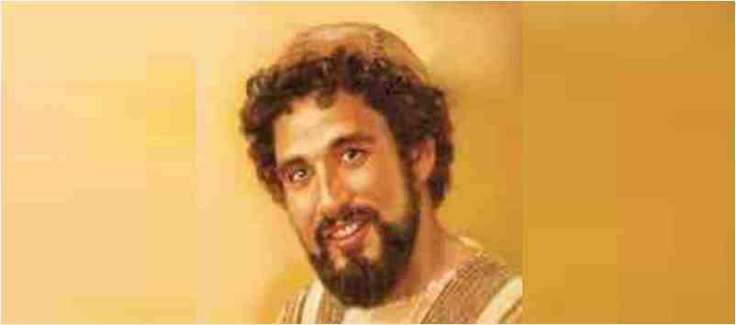
John the Beloved Disciple
John 21:20-24

Slide 2
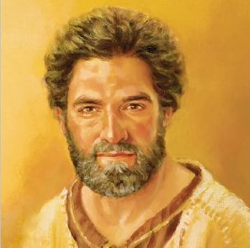
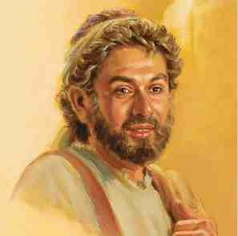
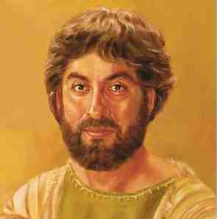
Jesus’ original followers..
Peter the Impulsive Disciple
James the son of Zebedee
Andrew the Inviter
All very close to Jesus

Slide 3
How will you be remembered..
Abraham..
David..
Job..
John the Baptist..
This disciple..
“The disciple whom Jesus loved”..

Slide 4
Identified five times..
John 13:23 leaning on Jesus
Jn 19:26 care for Jesus’ mother
Jn 20:2 first to empty tomb
Jn 21:7 “It is the Lord”
21:20-24 .. wrote these things
Jesus loved them all..13:1, 15:13
He alone is called this..

Slide 5
1 Special Relationship..
John 13:18-25..
A shocking announcement
Leaning on Jesus’ bosom
Jn 1:18 Jesus and His Father
Sense of full reliance upon
Do you lean your full weight on Him?

Slide 6
2 Because of his Character..
Started with his call ..
Jn 1:35-40 the other disciple
His spiritual perception..
Mark 9:33-38 begins to change
John 20:2-8 saw, believed
John 21:4-7 knew it was Jesus
Observing and becoming more like Jesus..

Slide 7
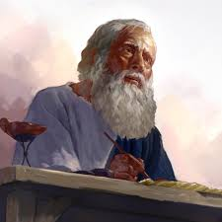
3 Shown in the things he wrote..
The nature of Jesus..
The Word, Lamb of God, God
Seven “I Am’s”
Became the apostle of love..
1 John .. 50 times
Love, but also truth.. 1 Jn 2:3-5
Visions from Patmos.. Victory in Jesus
Outlived all the others.. Aged well

Slide 8
John the Beloved Disciple
John 21:20-24

