Slide 1
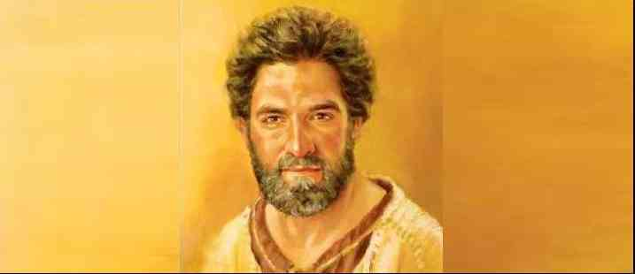
Twelve Ordinary Men
Peter the Impulsive Disciple

Slide 2
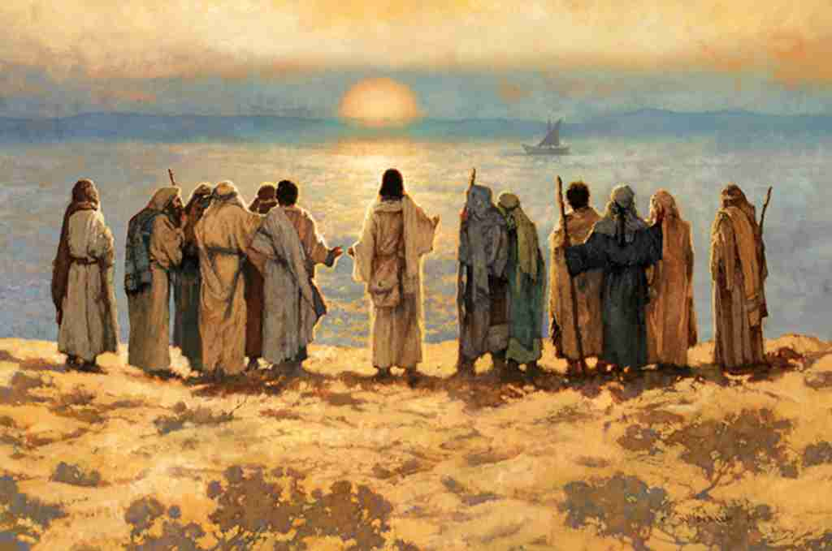
Luke 6:12 Now it came to pass in those days that He went out to the mountain to pray, and continued all night in prayer to God.
13 And when it was day, He called His disciples to Himself; and from them He chose twelve whom He also named apostles:

Slide 3
Peter’s background..
John 1:35-42..
Galilean fisherman
From Bethsaida
Living in Capernaum
Original name Simon
Jesus named him Peter
Cephas (“rock, stone”)

Slide 4
1 He was constantly impulsive
At the transfiguration – Matt 17:1-4
Jesus washing their feet – John 13:1-17
Night of Jesus’ arrest – John 18:1-11
Empty tomb – John 20:1-11
Good qualities.. Curiosity, initiative, motivated

Slide 5
2 Also consistently inconsistent
Eager to commit.. but not follow through
Matthew 16:13-15.. Who do you say I am?
Matthew 16:21-23.. Strongly rebuked
Matthew 14:22-33.. Step out of the boat
Matthew 26:31-35.. I will never deny you!
Galatians 2:11-14.. Withdrew from Gentiles
Learn to channel that energy.. Follow through

Slide 6
3 Living with failure..
What to do after worst night of your life..
Life is made up of peaks and valleys
John 21 – the restoration of Peter
Peter has gone back to fishing
21:15-21 Peter, do you love Me?
Feed my lambs..
Peter is completely restored

Slide 7
Keep your focus..
Stay fired up
Channel that energy
You can always come back
Heb 12:1-3 Keep your eyes upon Jesus

Slide 8
Twelve Ordinary Men
Peter the Impulsive Disciple

