Slide 1
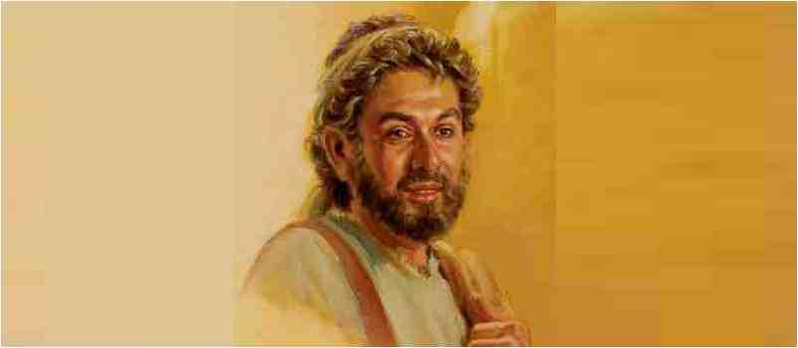
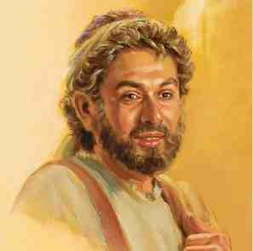
Twelve Ordinary Men
Andrew the Inviter

Slide 2
Basic profile..
Fisherman (with Peter).. (James and John)
Mentioned only 11 times (4 in lists)

Slide 3
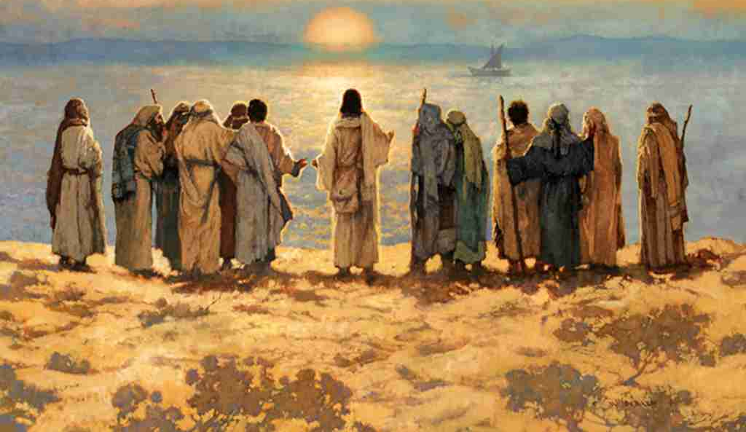
List of the Apostles..
Matthew 10:1-4 Now the names of the twelve apostles are these: first, Simon, who is called Peter, and Andrew his brother; James the son of Zebedee, and John his brother; 3 Philip and Bartholomew; Thomas and Matthew the tax collector; James the son of Alphaeus, and Lebbaeus, whose surname was Thaddaeus; 4 Simon the Cananite, and Judas Iscariot, who also betrayed Him.

Slide 4
Basic profile..
Fisherman (with Peter).. (James and John)
Mentioned only 11 times (4 in lists)
Always in Group 1 (first ones called)
Not among inner circle
(Peter, James, John)
Clear picture is seen

Slide 5
1 Spiritually motivated..
Matt 4:18-22 is not his first meeting
Matt 3:1-8 John the Baptist
John 1:35-42.. how it began
Heard John and followed
Andrew “Simon Peter’s brother”
Spiritually minded.. disciple of John

Slide 6
2 Consistently concerned..
The first thing he does..
V 41 first found his own brother
One thing on his mind
Wanted introduce others to Jesus
One talent (1 to 1 person)
Lead one person to Christ

Slide 7
3 Excited about His Jesus
John 6:5-9 finding food for multitude
Andrew finds boy with small lunch
Faith in what Jesus can accomplish
No limit with Jesus (Eph 3:20)
John 12:20-21 Greeks want to see Jesus
Philip takes them to Andrew
Takes them to Jesus
If you have a soul, you need to meet my Jesus

Slide 8
Lessons for us..
You don’t have to be highly gifted
If know Jesus you can show Jesus
If love Jesus you can share that love
Spend time with Jesus, tell someone
Magnify Jesus so others can see Him

Slide 9
Twelve Ordinary Men
Andrew the Inviter

