Slide 1
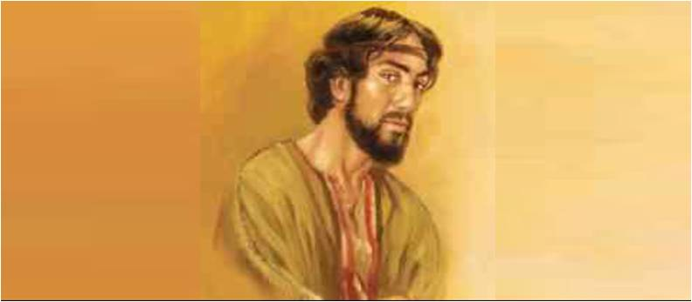
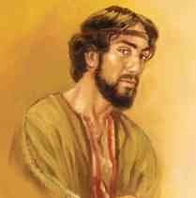
Judas Iscariot the Betrayer
John 13:18-30

Slide 2
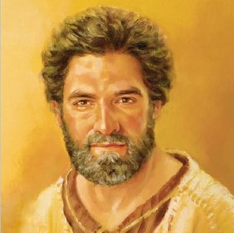
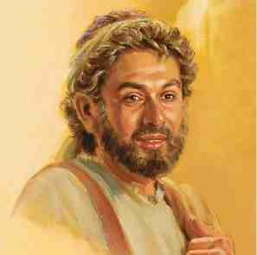
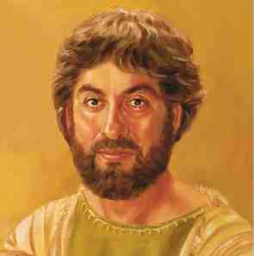
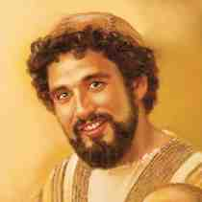
First group led by Peter..
Peter the Impulsive Disciple
Andrew the Inviter
James the son of Zebedee
John the Beloved Disciple
First true followers

Slide 3
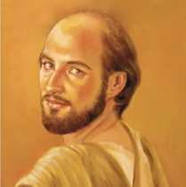
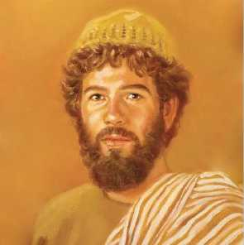
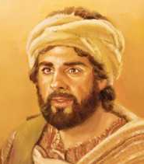
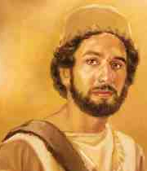
Second group led by Philip..
Philip
Nathanael Bartholomew
Matthew Levi
Thomas

Slide 4
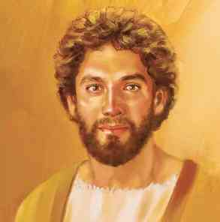
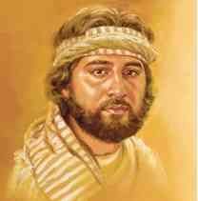
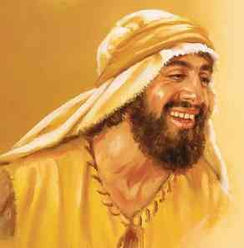
The lesser known disciples..
James son of Alphaeus
Judas Lebbeus (Thaddeus)
Simon Zelotes

Slide 5
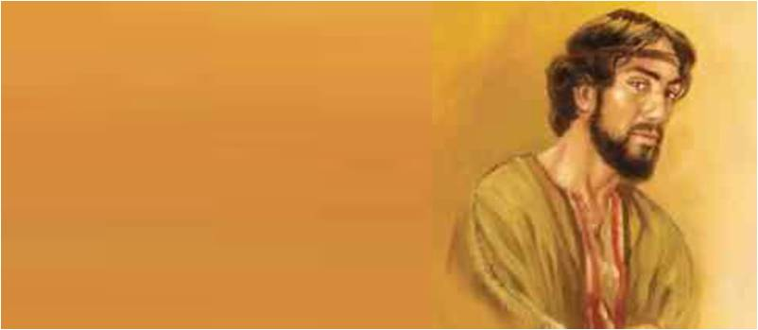
Judas Iscariot..
His name means “Jehovah leads”
Iscariot = from Kerioth in Judea
John 6:70-71 chosen but a devil
Was he a pawn or of his own will?
Psalm 41:9
Zech 11:12-13
Matt 26:14-25

Slide 6
1 Sin deceived Judas..
How it all began.. John 12:4-6
“he had the money box..took from it”
If he had known what it would lead to?
Sin seems innocent at first..
Adam taking the fruit
Cain’s jealousy
David’s love affair
Sin will take you farther than you want to go..

Slide 7
2 Sin did not let him escape..
Matt 27:3-5 filled with remorse
Led him to hang himself
Sin leaves you with no way out
He fooled some of the disciples, but knew he couldn’t fool God..

Slide 8
3 Sin left him all alone..
He had many encouraging him..
He had many with him in Gethsemane..
When they led Jesus away, he realized..
Beware of “friends” who encourage you in evil.. Proverbs 1:10-15

Slide 9
4 Sin wouldn’t let him take it back..
He tried to take the money back..
“I have betrayed an innocent man”
Some things you can’t undo
Have to live with consequences

Slide 10
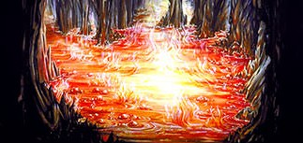
Sin is a lie from the father of lies..
John 8:44 He was a murderer from the beginning, and does not stand in the truth, because there is no truth in him. When he speaks a lie, he speaks from his own resources, for he is a liar and the father of it.

Slide 11
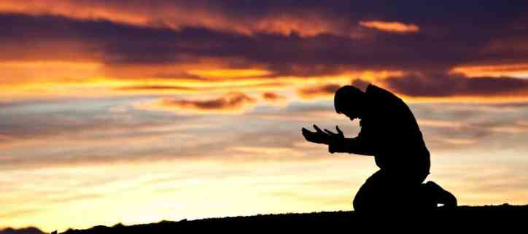
A better way out..
Sin cannot be undone, but it can be forgiven
Can’t be taken back, but it can be removed
Day of Pentecost.. 3000 forgiven
Forgiveness for the Christian.. 1 John 1:9
Turn to God and seek His forgiveness

Slide 12
Judas Iscariot the Betrayer
John 13:18-30

