Slide 1
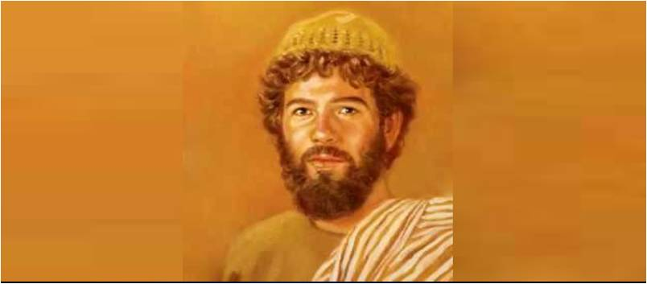
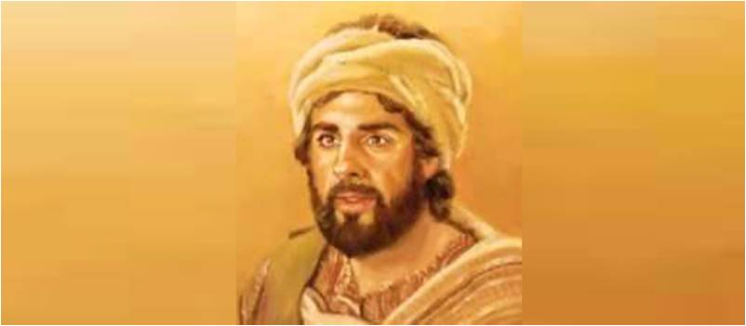
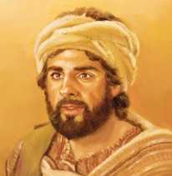
Matthew Levi the Tax Collector
Luke 5:27-32

Slide 2
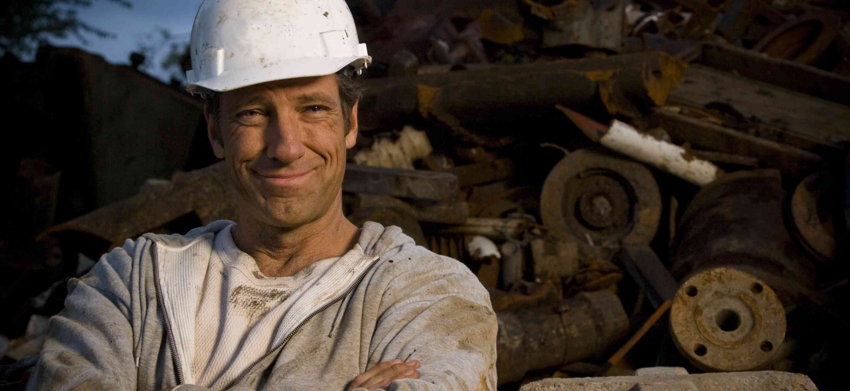
Mike Rowe.. “Dirty Jobs”

Slide 3
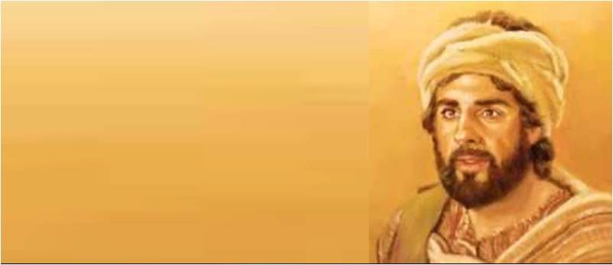
Tax collectors among the Jews..
Matthew 18:17 And if he refuses to hear them, tell it to the church. But if he refuses even to hear the church, let him be to you like a heathen and a tax collector.
Luke 18:11 The Pharisee stood and prayed thus with himself, 'God, I thank You that I am not like other men--extortioners, unjust, adulterers, or even as this tax collector.

Slide 4
Why so despised?
Hired by the Romans
Allowed to collect excess
Wealthy at expense of own people
Luke 3:12-13 “don’t collect more”

Slide 5
1 A Radical Calling..
His own account.. Matt 9:9
As Jesus passed on from there, He saw a man named Matthew sitting at the tax office. And He said to him, "Follow Me." So he arose and followed Him.
Luke’s account .. Luke 5:17-32
Healing of paralytic.. 17-26
After this.. Jesus saw Levi at his tax office.. Said to him “Follow Me.”
An unlikely candidate..

Slide 6
2 A radical response..
Luke 5:27 left all, rose up, and followed..
Matt 16:24 first deny himself
Matthew saw the treasure .. Matt 13:45-46
He left a lot behind and could not return
His immediate certain response

Slide 7
3 A Radical change..
Matt 9:9-13; Luke 5:29-32
Levi gave Him a great feast in his own house.. A great number of tax collectors
Showed his full repentance
His excitement at his choice
We need His excitement for Jesus..

Slide 8
Silent sermons..
Jesus is a friend to all..
Following Jesus is a cause to rejoice..
No matter where you are Jesus says “Come follow Me”..

Slide 9
Matthew Levi the Tax Collector
Luke 5:27-32

Slide 10
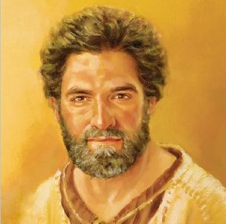
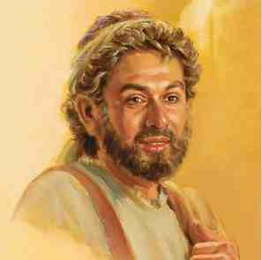
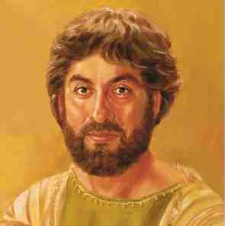
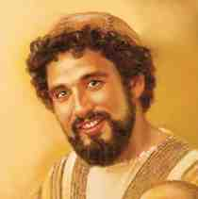
First group led by Peter..
Peter the Impulsive Disciple
Andrew the Inviter
James the son of Zebedee
John the Beloved Disciple
First true followers

Slide 11
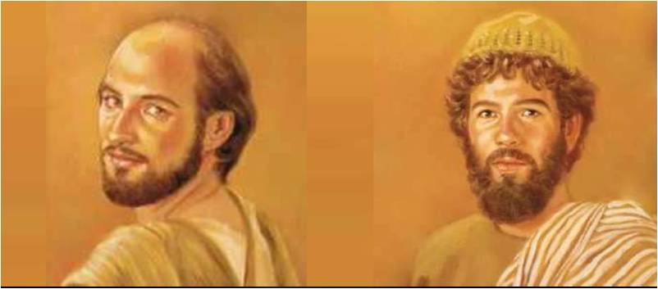
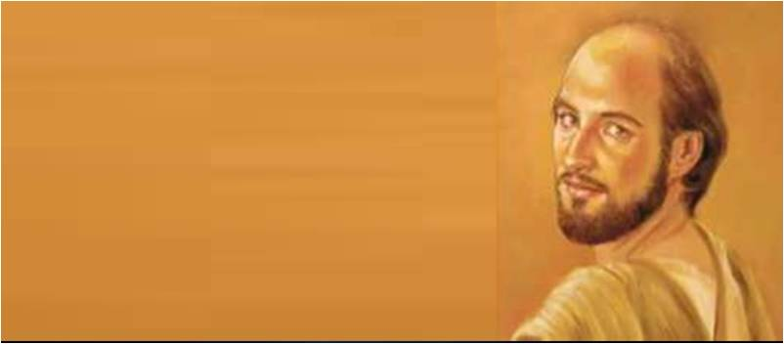
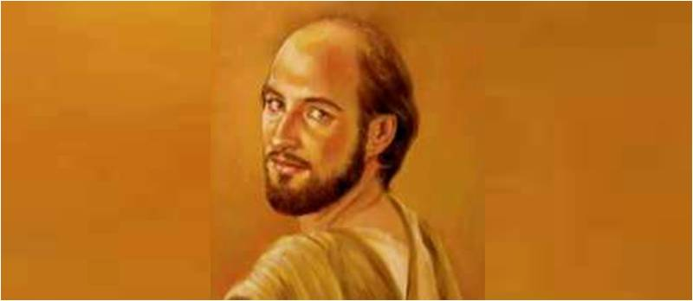
Philip.. Leader of Second Group
Natural tendencies Jesus saw..

