Slide 1
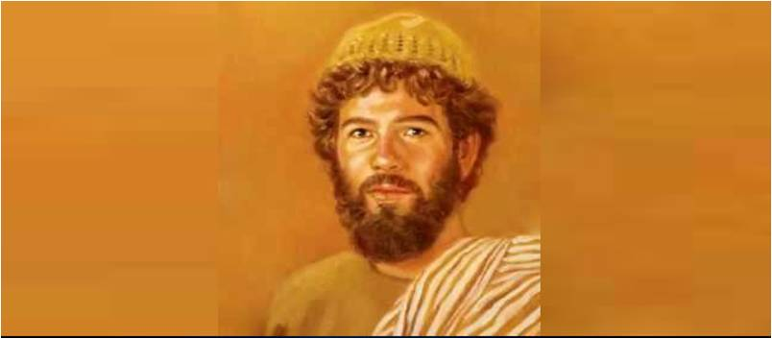
Nathanael the Guileless
John 1:43-49

Slide 2
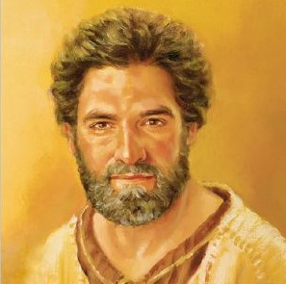
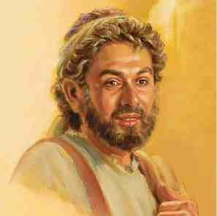
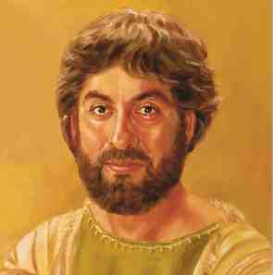
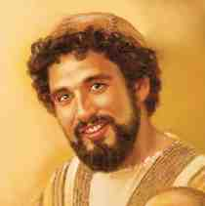
First group led by Peter..
Peter the Impulsive Disciple
Andrew the Inviter
James the son of Zebedee
John the Beloved Disciple
First true followers

Slide 3
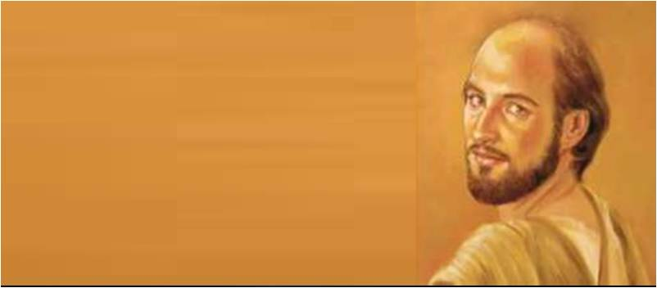
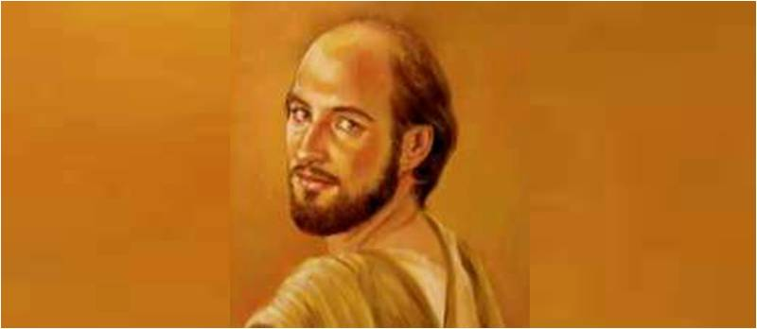
Philip.. Leader of Second Group
Natural tendencies Jesus saw..

Slide 4
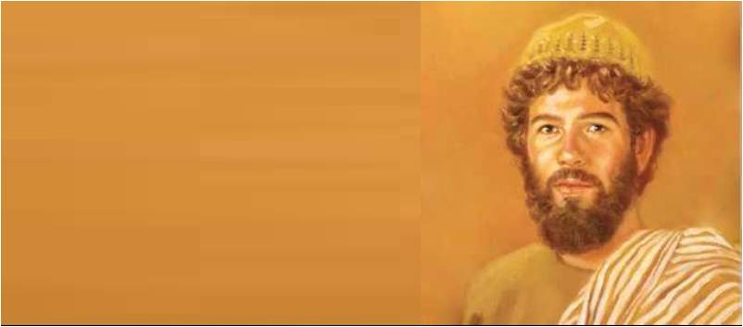
Nathanael’s name..
Nathanael
Bartholomew
“gift of God”
“bar-Tolmai”
Gospel of
John
All four lists of apostles
From Cana of Galilee (John 21:2)

Slide 5
John 1:43-45..
43 The following day Jesus wanted to go to Galilee, and He found Philip and said to him, "Follow Me." 44 Now Philip was from Bethsaida, the city of Andrew and Peter.
45 Philip found Nathanael and said to him, "We have found Him of whom Moses in the law, and also the prophets, wrote--Jesus of Nazareth, the son of Joseph."
Philip and Nathanael were friends

Slide 6
1 His Love of Scripture..
John 1:45.. "We have found Him of whom Moses in the law, and also the prophets, wrote--Jesus of Nazareth, the son of Joseph."
Students of the OT
A seeker after divine truth
Searching for the Messiah
Philip knew Nathanael’s scriptural view..

Slide 7
2 His Natural Prejudice
John 1:46 “Nazareth! Can anything good come from there?” Nathanael asked. “Come and see,” said Philip.
His contempt for Nazareth
Prejudice caused many to reject Jesus
Prejudice based on emotion, not facts
Nathanael was spiritual but also human..

Slide 8
3 His Sincerity..
John 1:47 When Jesus saw Nathanael approaching, he said of him, “Here truly is an Israelite in whom there is no deceit.”
A true Israelite – Rom 2:28-29
Not inwardly hypocritical
A true disciple – John 8:31-32

Slide 9
4 His Eager Faith..
John 1:48-49 “How do you know me?” Nathanael asked. Jesus answered, “I saw you while you were still under the fig tree before Philip called you.” 49 Then Nathanael declared, “Rabbi, you are the Son of God; you are the king of Israel.”

Slide 10
4 His Eager Faith..
John 1:50-51 Jesus said, “You believebecause I told you I saw you under the fig tree. You will see greater things than that.” 51 He then added, “Very truly I tell you,youwill see ‘heaven open, and the angels of God ascending and descending on the Son of Man.”

Slide 11
Nathanael the Guileless
John 1:43-49

