Slide 1
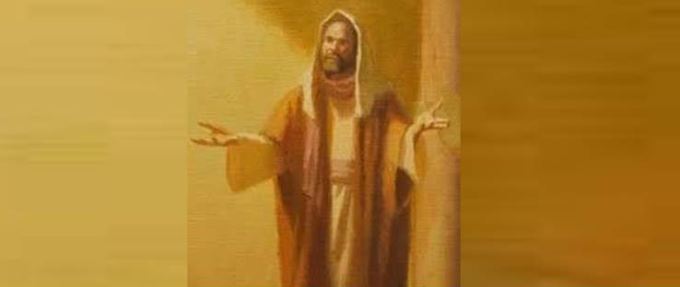
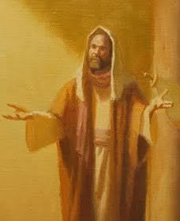
Paul the Apostle for All
1 Corinthians 15:3-10

Slide 2
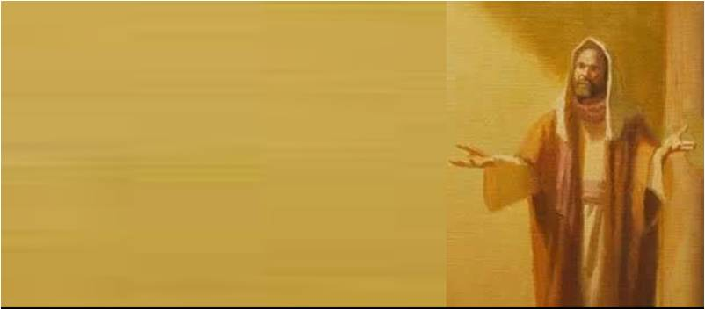
Christ’s chosen vessel..
8 Then last of all He was seen by me also, as by one born out of due time.
9 For I am the least of the apostles, who am not worthy to be called an apostle, because I persecuted the church of God.
10 But by the grace of God I am what I am, and His grace toward me was not in vain; but I labored more abundantly than they all, yet not I, but the grace of God which was with me.

Slide 3
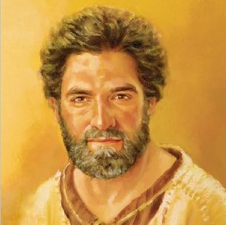
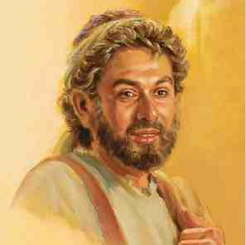
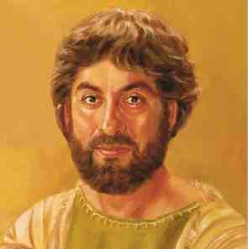
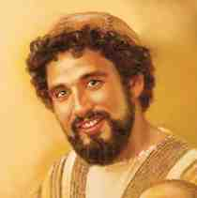
First group led by Peter..
Peter the Impulsive Disciple
Andrew the Inviter
James the son of Zebedee
John the Beloved Disciple
First true followers

Slide 4
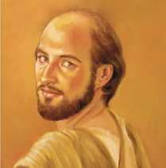
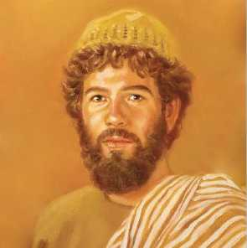
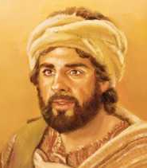
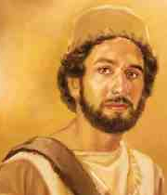
Second group led by Philip..
Philip
Nathanael Bartholomew
Matthew Levi
Thomas

Slide 5
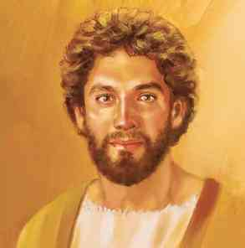
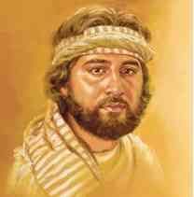
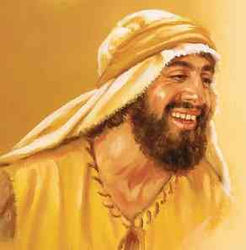
The lesser known disciples..
James son of Alphaeus
Judas Lebbeus (Thaddeus)
Simon Zelotes

Slide 6
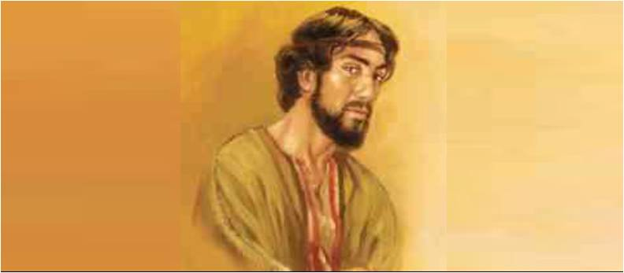
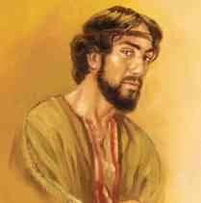
Judas Iscariot the Betrayer
John 13:18-30

Slide 7
1 His Conversion
From Persecutor to Evangelist
Conversion accounts
Acts 9 original record
Acts 22 Defense to the Jews
Acts 26 Before King Agrippa
Gal 1:11-24 Origin of his gospel
Conversion = complete change

Slide 8
1 His Conversion -
His life before conversion
Acts 8:1-3 ; 9:1-2 ; 22:3-5; 26:9-11
His conversion
Acts 22:6-16 Gal 1:15-16
His life after conversion
Gal 1:16-21 Acts 9:20-27

Slide 9
2 His Work –
His three journeys..
1st journey 13-14
2nd -3rd journeys 16-19
His churches.. Acts 20:4-7; 17-28
Philippi .. Thessalonica.. Berea
Corinth.. Ephesus .. Colossae
His letters and legacy.. 2 Tim 1:13-14

Slide 10
3 His Example -
1 Cor 11:1 imitate me, as I imitate Christ..
Gal 2:20 Christ lives in me
Phil 1:20 Christ will be magnified
Phil 3:7 counted loss to gain Christ
Phil 3:10 that I may know Him
Phil 4:4-7 rejoice in the Lord always
Phil 4:11 in whatever state to be content

Slide 11
3 His Example -
His humility in view of Christ
1 Cor 15:9 least of all the apostles
Eph 3:8 least of all the saints
1 Tim 1:15 chief of sinners
By the grace of God I am what I am..

Slide 12
Paul the Apostle for All
1 Corinthians 15:3-10

