Slide 1
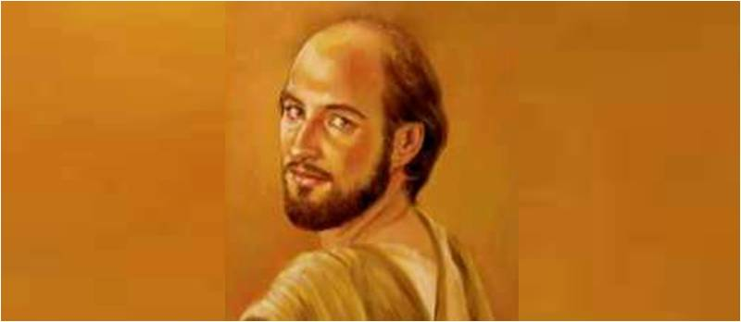
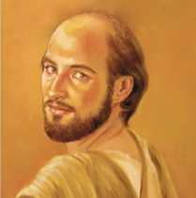
Philip the Analyzing Disciple
John 6:1-7

Slide 2
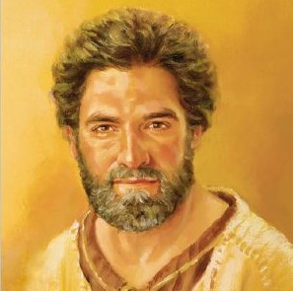
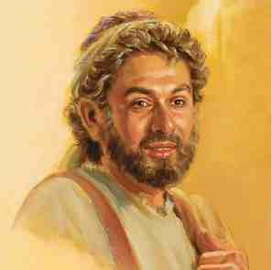
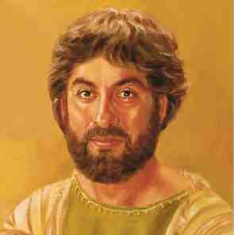
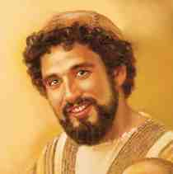
Jesus’ front four..
Peter the Impulsive Disciple
Andrew the Inviter
James the son of Zebedee
John the Beloved Disciple
All very close to Jesus

Slide 3
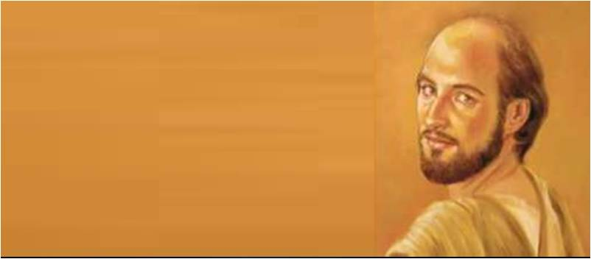
Philip’s background..
Always 5th in lists of apostles..
Greek name (Greek influence)
Hebrew name is never given
Not same Philip of Acts 6,8
From Bethsaida (John 1:44)
Fisherman (Jn 21:2..?)
Close friend of Nathanael (Bartholomew)

Slide 4
1 His spiritual side..
John 1:43-46..
Jesus found Philip.. “Follow Me”
A seeking heart (v 45)
“We have found Him..”
His 1st thought to find Nathanael
Jesus of Nazareth, son of Joseph
He was prepared, ready to follow..

Slide 5
2 His natural tendencies..
John 6:1-7 at feeding of 5000..
Great multitude (v 10)
Evening approaching
Jesus tests Philip (v 5-6)
“Where shall we buy bread?”
Philip calculates by numbers..
It can’t be done..
Jesus was testing his faith..

Slide 6
2 Tendency to overanalyze..
John 12:20-22..Visit of the Greeks
Certain Greeks at Passover feast
“Sir, we wish to see Jesus”..
Came to Philip to arrange meeting
Philip seems unsure, holds back
Matt 10:5-7; 15:24..
Passes ball to Andrew..
Philip knew in his heart, but held back..

Slide 7
3 One final glimpse of Philip..
John 14:1-11 in upper room..
Jesus’ last night.. Faith still weak
Jesus’ heart heavy.. John 14:1-4
Go to prepare.. you know the way
Thomas’ response v 5
Jesus’ clearest statements v 6-7
Philip v8 “Show us the Father”
Jesus’ disappointment vs 9-11
Philip failed all three tests..

Slide 8
Does Jesus reject him?
Jesus: He is exactly what I’m looking for..
I’ll send him to preach..
I’ll give him a throne
A home in heaven
History: Stoned in Heliopolis, Phrygia
Jesus uses the weak.. 1 Cor 1:26
The power of God..

Slide 9
Philip the Analyzing Disciple
John 6:1-7

