Slide 1
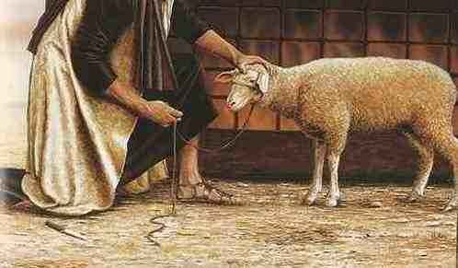
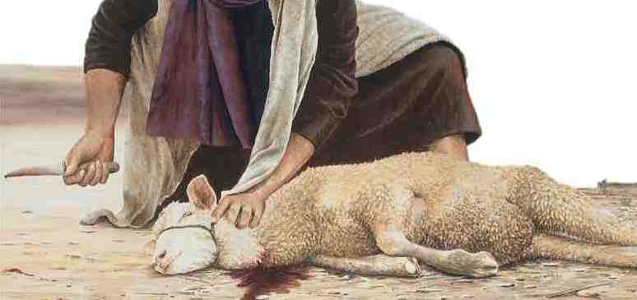
Sacrifice and Salvation
Leviticus 1:1-9

Slide 2
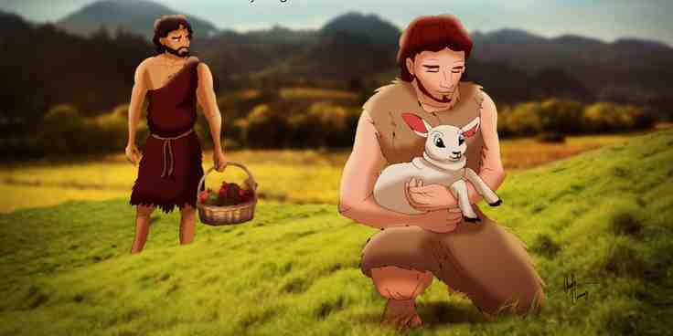
Sacrifices from the beginning
Cain and Abel
Abraham
Isaac

Slide 3
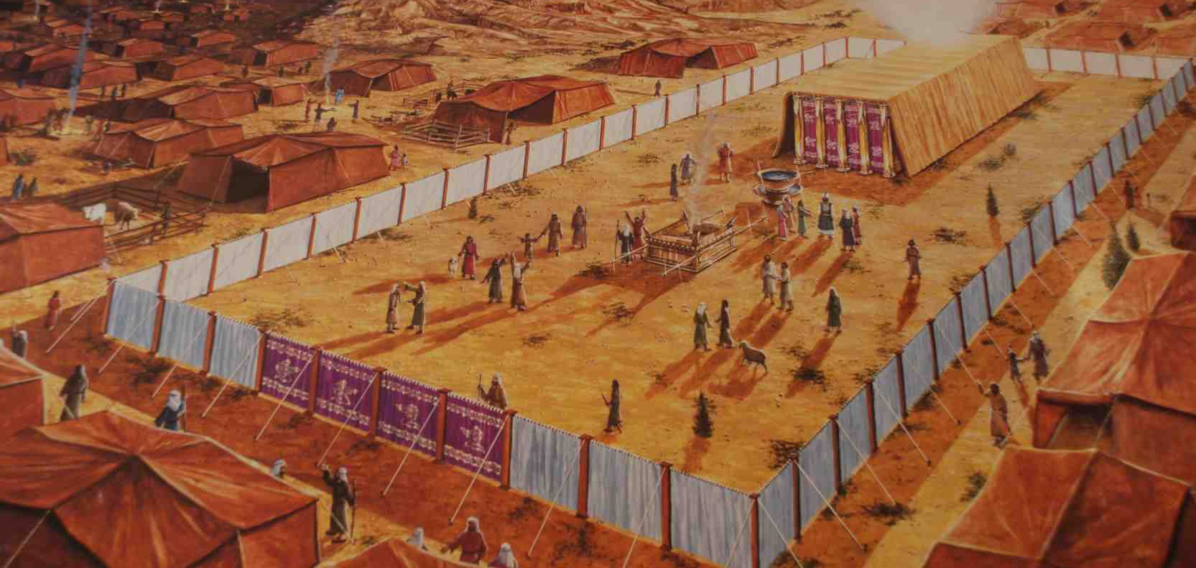
Mosaic Law..
Law Exod 20
Tabernacle
Levitical system
Why important?
Rom 15:4
Hebrews 8:5
Heb 9:9; 10:1

Slide 4
1 Sin means something must die
Romans 6:23 wages of sin is death
Separated from “LIFE”
John 11:25 Jesus is source of life
John 1:4-5
Isaiah 59:1-2

Slide 5
1 Sin means something must die
We all deserved to die
God allowed a substitute
Leviticus 1:4-5
Lev 4:4-5, 13, 22, 35
Lay hand on head of animal
Isaiah 53:3-7 Christ bore our sins

Slide 6
1 Sin means something must die

Slide 7
2 The power of the blood of Jesus
Thousands of sacrifices offered
2-3 million Israelites
1400 years daily
Heb 10:3-4 reminder every year
Incentive for us .. Heb 10:26-31

Slide 8
3 Obedience is very specific..
Lev 4:4-13 notice the detail
Different kinds of sacrifice
Atonement based on obedience
Lev 22 only the best allowed
Lev 10 Nadab and Abihu an example
Rom 12:1-2 a living sacrifice

Slide 9
4 Don’t be weary of repetition..
Isa 1:10-15
"I have had enough of burnt offerings of rams And the fat of fed cattle. I do not delight in the blood of bulls, Or of lambs or goats.
12 "When you come to appear before Me, Who has required this from your hand, To trample My courts?
13 Bring no more futile sacrifices; Incense is an abomination to Me. The New Moons, the Sabbaths, and the calling of assemblies-- I cannot endure iniquity and the sacred meeting.
14 Your New Moons and your appointed feasts My soul hates; They are a trouble to Me, I am weary of bearing them.
15 When you spread out your hands, I will hide My eyes from you; Even though you make many prayers, I will not hear. Your hands are full of blood.

Slide 10
Sacrifices instruct us..
When someone sins, something has to die
All their sacrifices could not do what Jesus’ one sacrifice has accomplished
God requires specific obedience by faith
Constant repetition means we must be careful not to lose appreciation

Slide 11
Sacrifice and Salvation
Leviticus 1:1-9

