Slide 1
Sin and Salvation
Romans 3:19-26

Slide 2
God and Salvation..
Planned from eternity .. Eph 1:3-7
Provided for all men .. 1 Tim 2:1-6
Requiring man’s response .. John 1:10-13

Slide 3
Sin is Universal.. All have sinned
Confirmed by the OT..
King Solomon .. 1 Kings 8:46; Eccl 7:20
The Psalmist David .. Psalm 14
The Prophet Isaiah .. Isaiah 53
Confirmed by the NT..
The apostle Paul .. Romans 1-3 (3:9-23)
The apostle John .. 1 John 1:8,10

Slide 4
The nature of sin .. What is sin?
Transgression of the law – 1 John 3:4
Offense against God himself – Gen 39:9
Failure to do what God requires – James 4:17
All wrongdoing, unrighteousness – 1 Jn 5:16

Slide 5
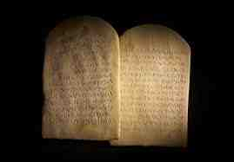
God’s moral code..
1 No other gods before Me..
2 No graven image..
3 Not take His name in vain..
4 Remember sabbath..
5 Honor father and mother..

Slide 6
God’s moral code..
6 Shall not kill
7 Shall not commit adultery
8 Shall not steal
9 Shall not bear false witness
10 Shall not covet

Slide 7
Consequences of sin..
Alienation from God – Hab 1:13; 1 John 1:5-6
Separation – Isa 59:1-2; 2 Cor 6:14-16
Bondage to self – John 8:30-34; Rom 6:16
Conflict with others – Matt 22:37-39

Slide 8
Salvation..
God has come to our rescue..

Slide 9
Sin and Salvation
Romans 3:19-26

