Slide 1
A Good Name
Proverbs 22:1-5

Slide 2
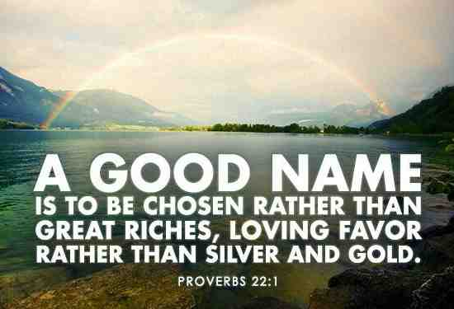

Slide 3
What is your reputation?
Should we be concerned..
What non believers think about us?
What our fellow Christians think?
What God thinks about us?

Slide 4
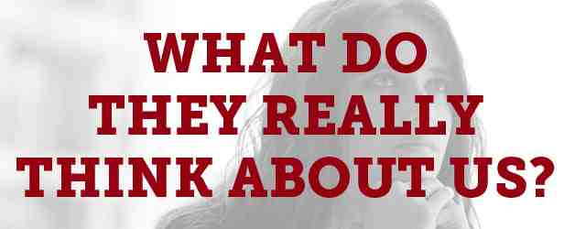
1 What non believers think..
Matt 5:16 Let your light so shine before men that they may see your good works and glorify your Father in heaven..

Slide 5
1 What non believers think..
1 Tim 3:1-7 A bishop must be blameless, the husband of one wife, of good behavior.. 7 Moreover he must have a good testimony among those who are outside, lest he fall into reproach and the snare of the devil.
Titus 2:6-8 Likewise exhort the young men to be sober-minded, 7 in all things showing yourself to be a pattern of good works; in doctrine showing integrity, reverence, incorruptibility, 8 sound speech that cannot be condemned, that one who is an opponent may be ashamed, having nothing evil to say of you.

Slide 6
1 Is there a limitation..
Acts 4:19 But Peter and John answered and said to them, "Whether it is right in the sight of God to listen to you more than to God, you judge.
Acts 5:29 But Peter and the other apostles answered and said: "We ought to obey God rather than men.
Gal 1:10 For do I now persuade men, or God? Or do I seek to please men? For if I still pleased men, I would not be a bondservant of Christ.

Slide 7
2 What fellow Christians think
Acts 16:1-3 Paul came to Derbe and then to Lystra, where a disciple named Timothy lived, whose mother was Jewish and a believer but whose father was a Greek. 2 The believers at Lystra and Iconium spoke well of him. 3 Paul wanted to take him along on the journey, so he circumcised him because of the Jews who lived in that area, for they all knew that his father was a Greek.

Slide 8
2 What fellow Christians think
Romans 1:8 First, I thank my God through Jesus Christ for all of you, because your faith is being reported all over the world.
1 Cor 1:11-13 My brothers and sisters, some from Chloe’s household have informed me that there are quarrels among you.

Slide 9
2 Is there a limitation?
1 Thess 2:3-4 For the appeal we make does not spring from error or impure motives, nor are we trying to trick you. 4 On the contrary, we speak as those approved by God to be entrusted with the gospel. We are not trying to please people but God, who tests our hearts.

Slide 10
3 What does the Lord think?
1 Cor 4:3-4 I care very little if I am judged by you or by any human court; indeed, I do not even judge myself. 4 My conscience is clear, but that does not make me innocent. It is the Lord who judges me.
Rev 20:12 And I saw the dead, great and small, standing before the throne, and books were opened. Another book was opened, which is the book of life. The dead were judged according to what they had done as recorded in the books.

Slide 11
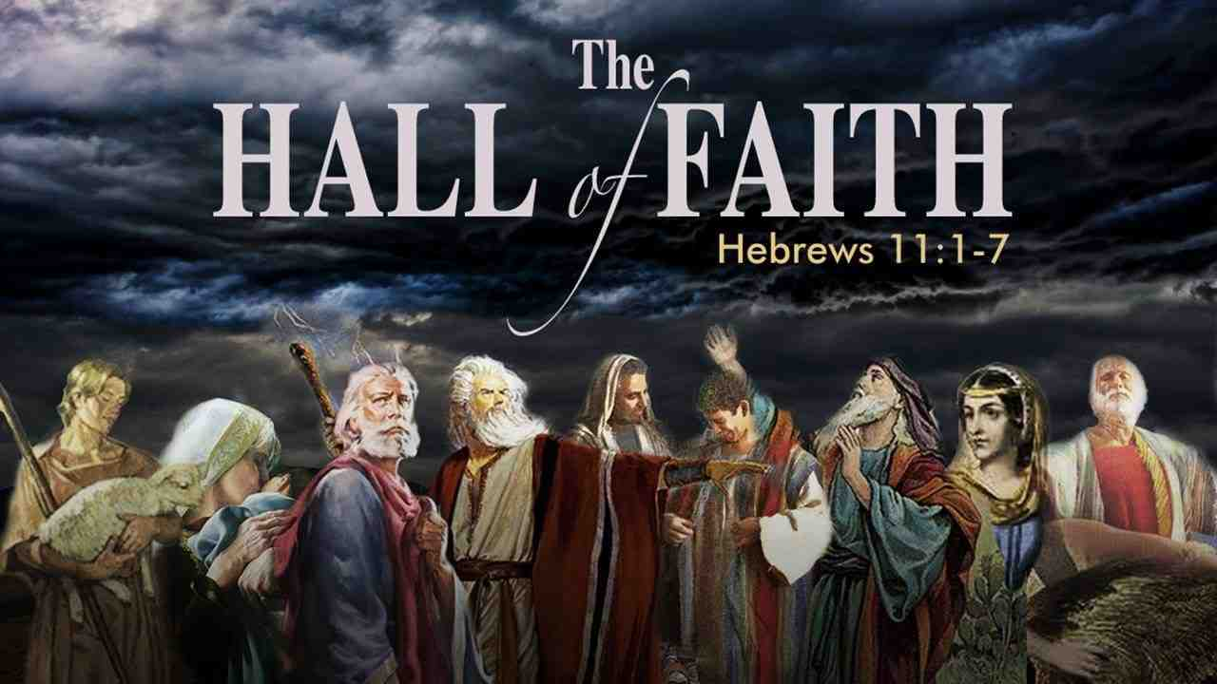
4 How is our reputation formed?
Living by faith

Slide 12
A Good Name
Proverbs 22:1-5

