Slide 1
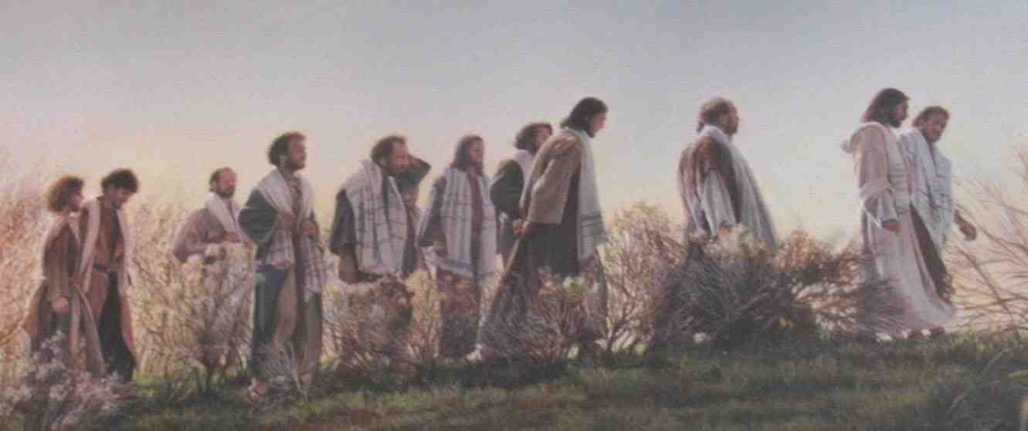
Jesus and Salvation
Hebrews 2:1-4

Slide 2
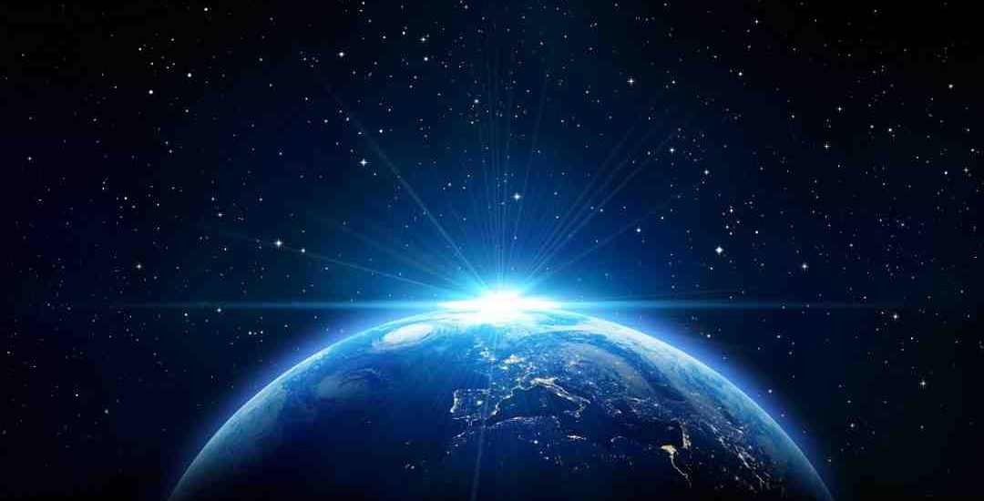
Jesus from eternity
Heb 1:1-2 God, who at various times and in various ways spoke in time past to the fathers by the prophets, 2 has in these last days spoken to us by His Son, whom He has appointed heir of all things, through whom also He made the worlds..
Mark
Luke
Matthew
John
Creation
Judgment

Slide 3
1 His Mission: the Will of God
Not my will but your will be done..
Mark 14:36 John 4:34 5:19, 31 6:38
Pleasing the Father Matt 11:27 Luke 2:49
God’s will “must” be done
It is written..

Slide 4
2 His Titles: Son of man/Servant
His favorite designation: Son of man
Far more than Son of God Mark 2:10
OT meaning Psalm 8:3-5 Dan 7:13-14
Servant of the Lord
Fulfilling Isaiah’s servant Isaiah 42:1-4
Bring justice on earth, light to Gentiles
Suffering servant Isaiah 53

Slide 5
2 His Titles: Son of man/Servant
Mark 10:44-45 And whoever of you desires to be first shall be slave of all. 45 For even the Son of Man did not come to be served, but to serve, and to give His life a ransom for many."

Slide 6
3 His Work: Revealer/Savior
Revealing God as our “Father”
John 1:18 Son has declared Him
Mark 14:36 “Abba, Father”
We can have same relationship
Savior of men
Matt 1:21 he shall save people from sins
Luke 19:9 came to seek and save lost

Slide 7
Jesus and Salvation
Hebrews 2:1-4

