Slide 1
SCRIPTURE ALONE
2 Timothy 3:10-17

Slide 2
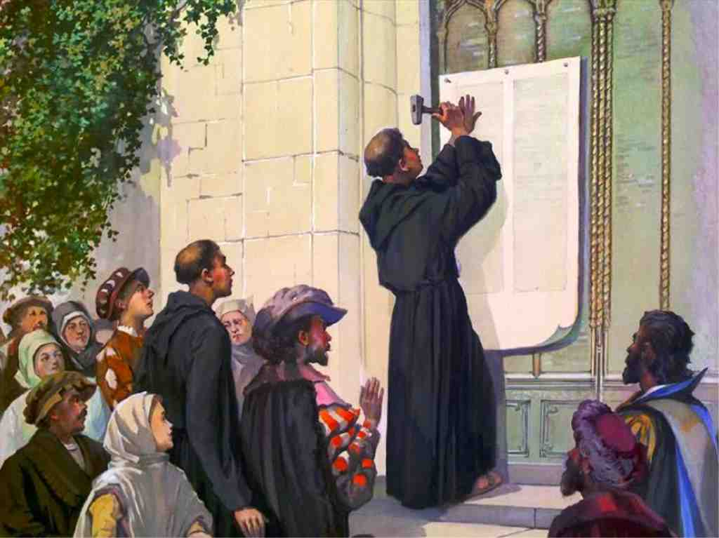
Martin Luther
October 31, 1517

Slide 3
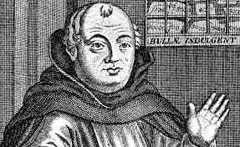
Sale of indulgences..
Used to build St Peter’s basilica in Rome

Slide 4
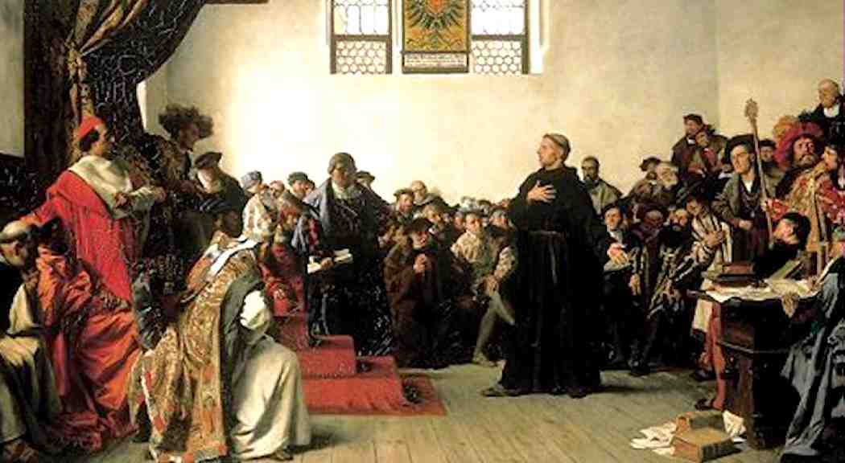
Luther’s interrogation..
“Here I stand..”

Slide 6
Scripture is sufficient..
2 Peter 1:3-4 as His divine power has given to us all things that pertain to life and godliness, through the knowledge of Him who called us by glory and virtue,
4 by which have been given to us exceedingly great and precious promises, that through these you may be partakers of the divine nature, having escaped the corruption that is in the world through lust.

Slide 7
General revelation in nature..
Psalm 19:1 The heavens declare the glory of God; And the firmament shows His handiwork.
Psalm 19:7-8 “The law of the Lord is perfect, converting the soul: the testimony of the Lord is sure, making wise the simple.”

Slide 8
Our standard of truth
2 Tim 3:16-17 All Scripture is given by inspiration of God, and is profitable for doctrine, for reproof, for correction, for instruction in righteousness, 17 that the man of God may be complete, thoroughly equipped for every good work.
John 17:17 Sanctify them by Your truth. Your word is truth.

Slide 9
Sufficient for salvation..
Romans 10:17 So then faith comes by hearing, and hearing by the word of God.
John 20:30-31 And truly Jesus did many other signs in the presence of His disciples, which are not written in this book; 31 but these are written that you may believe that Jesus is the Christ, the Son of God, and that believing you may have life in His name.

Slide 10
Go to the Bible..
Creation vs Evolution..
Genesis 1:1 In the beginning God created the heavens and the earth.
Genesis 1:31 Then God saw everything that He had made, and indeed it was very good. So the evening and the morning were the sixth day.

Slide 11
The ultimate test of truth..
Psychology says man is basically good..
Self-esteem, self-exaltation, self-fulfillment, self-promotion
Bible: “all have sinned and come short of the glory of God”.. “Love the Lord your God”.. “if any would come to Me, let him deny himself.. Follow Me”.

Slide 12
Rejection of authority in our culture..
Many today unwilling to say the Bible is the absolute authority..
Satan’s first lie (Gen 3:1) “Did God really say”?..
Isaiah 5:20-21 Woe to those who call evil good, and good evil; Who put darkness for light, and light for darkness; Who put bitter for sweet, and sweet for bitter! 21 Woe to those who are wise in their own eyes, And prudent in their own sight!

Slide 13
Truth or Tolerance?
Isaiah 8:20 To the law and to the testimony! If they do not speak according to this word, it is because there is no light in them.
Jude 3 Beloved, while I was very diligent to write to you concerning our common salvation, I found it necessary to write to you exhorting you to contend earnestly for the faith which was once for all delivered to the saints.

Slide 14
Scripture is complete..
John 14:26 But the Helper, the Holy Spirit, whom the Father will send in My name, He will teach you all things, and bring to your remembrance all things that I said to you.
John 16:13 However, when He, the Spirit of truth, has come, He will guide you into all truth; for He will not speak on His own authority, but whatever He hears He will speak; and He will tell you things to come.

Slide 15
Additional revelation?..
Gal 1:8 But even if we, or an angel from heaven, preach any other gospel to you than what we have preached to you, let him be accursed.
Revelation 22:18 For I testify to everyone who hears the words of the prophecy of this book: If anyone adds to these things, God will add to him the plagues that are written in this book;

Slide 16
SCRIPTURE ALONE
2 Timothy 3:10-17

