Slide 1
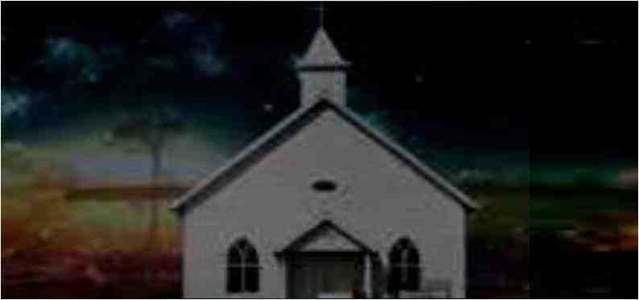
The Enemy Among Us
1 Peter 5:6-11

Slide 2
God’s word warns us..
1 Pet 5:8 Be sober, be vigilant; because your adversary the devil walks about like a roaring lion, seeking whom he may devour.
2 Cor 2:11.. lest Satan should take advantage of us; for we are not ignorant of his devices.

Slide 3
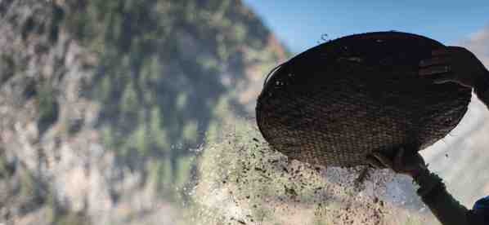
Tactics: Where does he start..
With the individual (you and me)
Luke 22:30 .. And the Lord said, “Simon, Simon! Indeed, Satan has asked for you, that he may sift you as wheat....
Influencing the leadership
Acts 20:28-30 Therefore take heed to yourselves and to all the flock, among which the Holy Spirit has made you overseers, to shepherd the church of God which He purchased with His own blood… also from among yourselves men will rise up, speaking perverse things, to draw away the disciples..

Slide 4
Tactics: how does he pursue..
1 John 2:15 Do not love the world nor the things that are in the world 16 For all that is in the world.. the lust of the flesh, the lust of the eye, the pride of life are not of the Father, but are of the world. 17 and the world is passing away, and the lust thereof.. but he who does the will of God abides forever..

Slide 5
Tactics: what is he after..
Revelation 2:1-5 "To the angel of the church of Ephesus write,'These things says He who holds the seven stars in His right hand, who walks in the midst of the seven golden lampstands: 2 I know your works, your labor, your patience, and that you cannot bear those who are evil. And you have tested those who say they are apostles and are not, and have found them liars; 3 and you have persevered and have patience, and have labored for My name's sake and have not become weary.
4 Nevertheless I have this against you, that you have left your first love. 5 Remember therefore from where you have fallen; repent and do the first works, or else I will come to you quickly and remove your lampstand from its place--unless you repent.

Slide 6
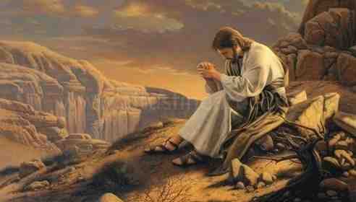
Learning from Christ..
Matt 4:1-11 Then Jesus was led up by the Spirit into the wilderness to be tempted by the devil. And when he had fasted forty days and forty nights, afterward he was hungry. Now when the tempter came to him, he said, “If You are the Son of God, command that these stones become bread.”

Slide 7
Learning from Christ..
Gratification of the physical.. Vs 3
Command these stones become bread
Appeal to the sensational .. Vs 6
Pinnacle of temple cast yourself down
Reasonable compromise .. Vs 9
All these kingdoms if you bow down and worship me..

Slide 8
Satan influencing the church..
Turning from the word of God…
Offer them bread first (John 6:51, 66-68)
Sensationalism in worship…
Let us entertain you (John 4:24, Heb 12:28)
Gradual compromise..
A little here, a little there (2 Tim 4:2-5, Matt 7:21-23)

Slide 9
The Enemy Among Us
1 Peter 5:6-11

