Slide 1
The Mystery of Godliness
1 Timothy 3:14-16

Slide 2
Godliness is a mystery..
1 Tim 3:16 And without controversy great is the mystery of godliness: God was manifested in the flesh, Justified in the Spirit, Seen by angels, Preached among the Gentiles, Believed on in the world, Received up in glory.
It is worthy of our interest, time, and study..

Slide 3
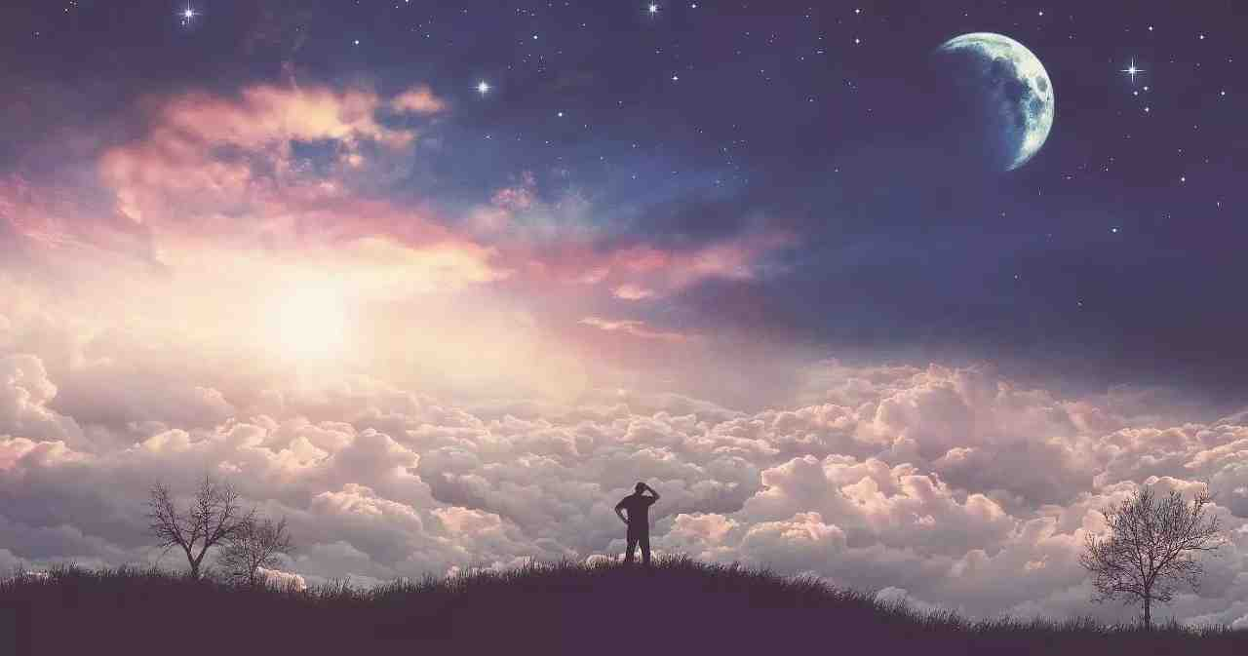
All things of God have mystery
Creation is mysterious..
Sin is mysterious..
Heaven is mysterious..
We are created with a sense of wonder..

Slide 4
Godliness produces mystery
1 Peter 1:10-12 Of this salvation the prophets have inquired and searched carefully, who prophesied of the grace that would come to you,
11 searching what, or what manner of time, the Spirit of Christ who was in them was indicating when He testified beforehand the sufferings of Christ and the glories that would follow.
12 To them it was revealed that, not to themselves, but to us they were ministering the things which now have been reported to you through those who have preached the gospel to you by the Holy Spirit sent from heaven--things which angels desire to look into.
Mysterious even to prophets and angels..

Slide 5
Godliness should draw us in..
It should grab our attention
Draw us deeper to search
Not just a casual glance..
It can only be grasped from a lifelong focus..

Slide 6
God is worthy of our lifelong focus..
1 Sam 16:7 the Lord said to Samuel, "Do not look at his appearance or at the height of his stature, because I have refused him. For the Lord does not see as man sees; for man looks at the outward appearance, but the Lord looks at the heart."
Heb 11:6 But without faith it is impossible to please Him, for he who comes to God must believe that He is, and that He is a rewarder of those who diligently seek Him.

Slide 7
The deep things of God..
1 Cor 2:6-11 However, we speak wisdom among those who are mature, yet not the wisdom of this age, nor of the rulers of this age, who are coming to nothing.
7 But we speak the wisdom of God in a mystery, the hidden wisdom which God ordained before the ages for our glory,
8 which none of the rulers of this age knew; for had they known, they would not have crucified the Lord of glory.

Slide 8
The deep things of God..
9 But as it is written: "Eye has not seen, nor ear heard, Nor have entered into the heart of man The things which God has prepared for those who love Him."
10 But God has revealed them to us through His Spirit. For the Spirit searches all things, yes, the deep things of God.
11 For what man knows the things of a man except the spirit of the man which is in him? Even so no one knows the things of God except the Spirit of God.

Slide 9
Godliness requires seeing as God sees..
1 Sam 16:7 the Lord said to Samuel, "Do not look at his appearance or at the height of his stature, because I have refused him. For the Lord does not see as man sees; for man looks at the outward appearance, but the Lord looks at the heart."
God sees what is within us
We cannot do this..
How then can we see as God sees..

Slide 10
We can seek to gain His perspective..
See ourselves ..
The world ..
Truth/error..
Gain a perspective that reflects God’s view..

Slide 11
Godliness in human form..
1 Tim 3:16 And without controversy great is the mystery of godliness: God was manifested in the flesh, Justified in the Spirit, Seen by angels, Preached among the Gentiles, Believed on in the world, Received up in glory.
We learn a godly perspective by looking at Christ
Christ shows us godliness in action

Slide 12
Godliness requires a willing mind..
Matthew 13:10-17 And the disciples came and said to Him, "Why do You speak to them in parables?"
11 He answered and said to them, "Because it has been given to you to know the mysteries of the kingdom of heaven, but to them it has not been given.
12 For whoever has, to him more will be given, and he will have abundance; but whoever does not have, even what he has will be taken away from him.

Slide 13
Godliness requires a willing mind..
13 Therefore I speak to them in parables, because seeing they do not see, and hearing they do not hear, nor do they understand.
14 And in them the prophecy of Isaiah is fulfilled, which says: 'Hearing you will hear and shall not understand, And seeing you will see and not perceive;
15 For the hearts of this people have grown dull. Their ears are hard of hearing, And their eyes they have closed, Lest they should see with their eyes and hear with their ears, Lest they should understand with their hearts and turn, So that I should heal them.'

Slide 14
Godliness requires a willing mind..
16 "But blessed are your eyes for they see, and your ears for they hear;
17 for assuredly, I say to you that many prophets and righteous men desired to see what you see, and did not see it, and to hear what you hear, and did not hear it.

Slide 15
Choosing God’s wisdom above our own..
1 Cor 1:18-25 For the message of the cross is foolishness to those who are perishing, but to us who are being saved it is the power of God.
19 For it is written: "I will destroy the wisdom of the wise, And bring to nothing the understanding of the prudent."
20 Where is the wise? Where is the scribe? Where is the disputer of this age? Has not God made foolish the wisdom of this world?

Slide 16
Choosing God’s wisdom above our own..
21 For since, in the wisdom of God, the world through wisdom did not know God, it pleased God through the foolishness of the message preached to save those who believe.
22 For Jews request a sign, and Greeks seek after wisdom;
23 but we preach Christ crucified, to the Jews a stumbling block and to the Greeks foolishness,
24 but to those who are called, both Jews and Greeks, Christ the power of God and the wisdom of God.

Slide 17
God’s ways are above ours..
Isaiah 55:8-9 "For My thoughts are not your thoughts, Nor are your ways My ways," says the Lord. 9 "For as the heavens are higher than the earth, So are My ways higher than your ways, And My thoughts than your thoughts.

Slide 18
The Mystery of Godliness
1 Timothy 3:14-16

