Slide 1
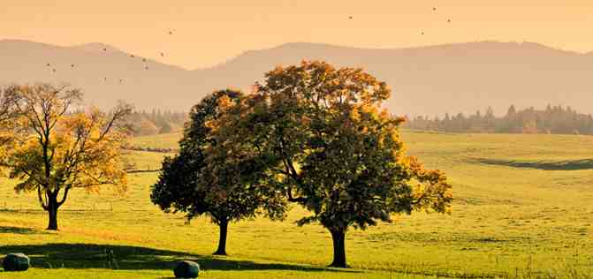
We Give Thanks
Colossians 1:3-14

Slide 2
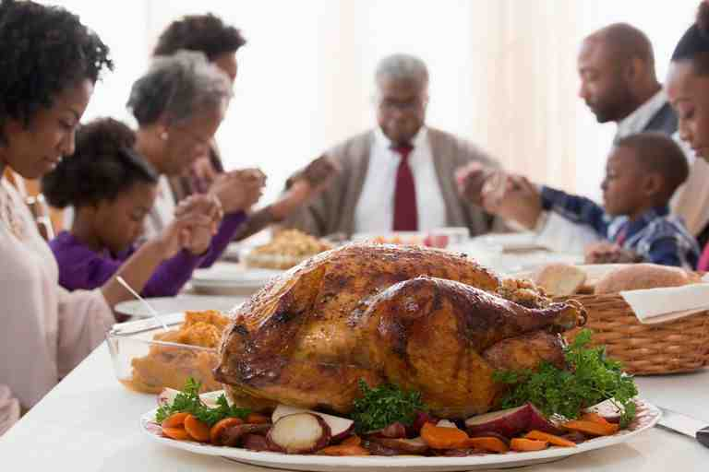
Why our National Day of Thanksgiving..

Slide 3
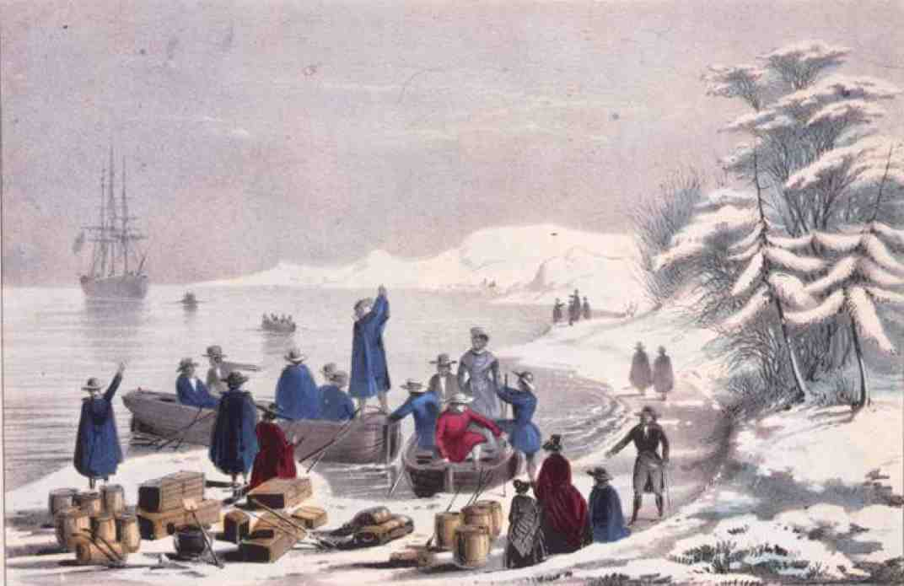
Pilgrims.. November 1620

Slide 4
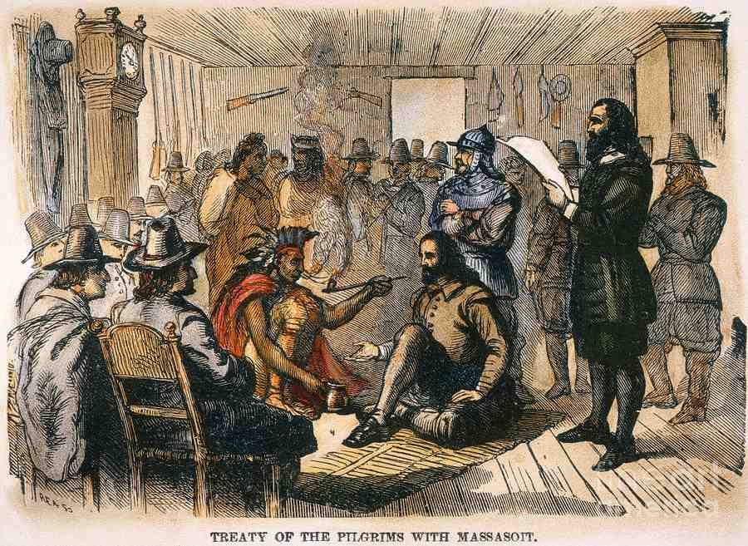
Treaty with Wampanoag..

Slide 5
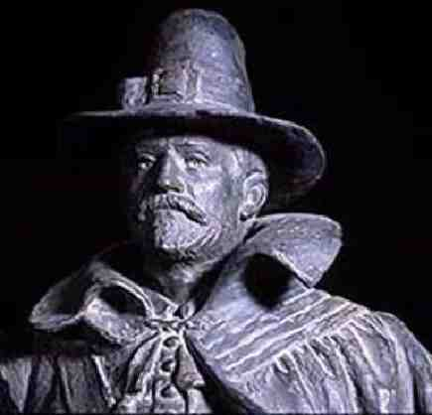
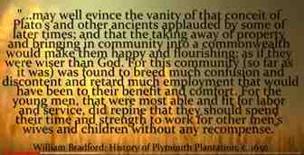
The story of Thanksgiving
Governor William Bradford..
Gave each family their own land to grow crops..

Slide 6
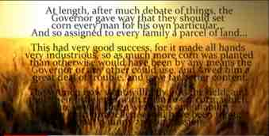
The story of Thanksgiving
Governor William Bradford..
All crops planted and growing well until July..

Slide 7
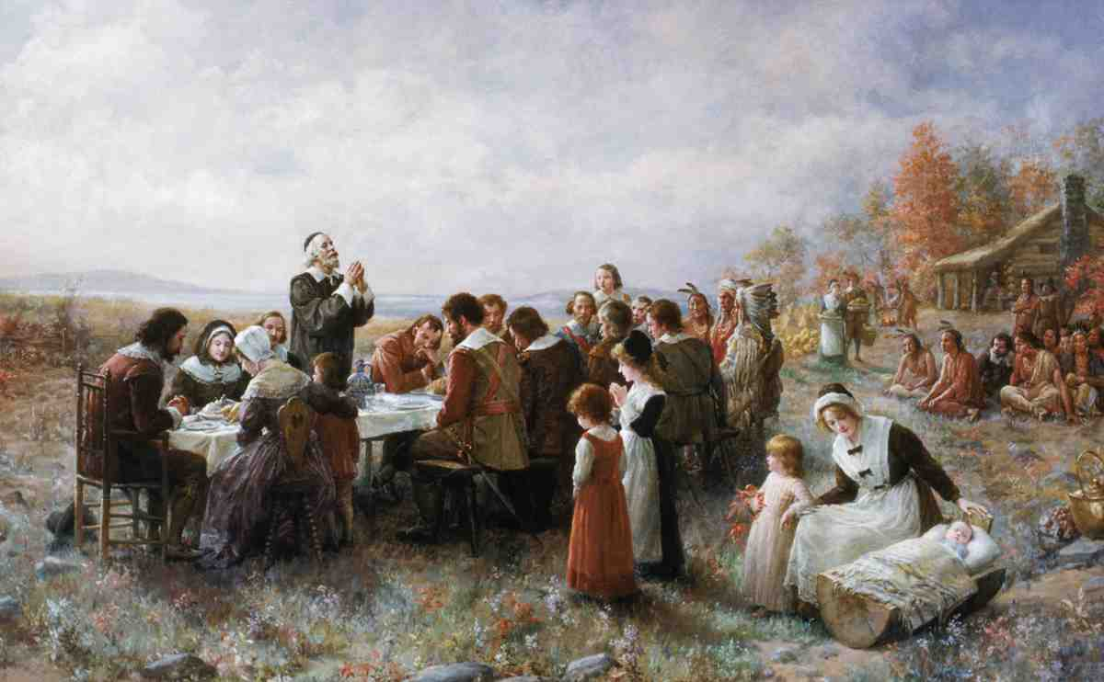
Day of humiliation, prayer..
Day of humiliation, fasting, prayer..
Bradford set November 29 to give thanks to God..
All crops planted and growing well until July..

Slide 8
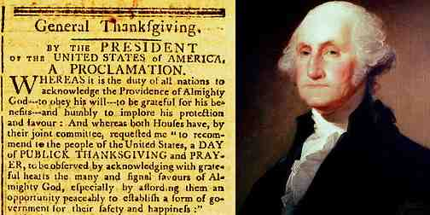
National Proclamation..
Proclaimed by Washington, Lincoln, Roosevelt..

Slide 9
Danger of forgetting the Lord..
Deut 8:11-14 11 "Beware that you do not forget the Lord your God by not keeping His commandments, His judgments, and His statutes which I command you today, 12 lest--when you have eaten and are full, and have built beautiful houses and dwell in them; 13 and when your herds and your flocks multiply, and your silver and your gold are multi-plied, and all that you have is multiplied; 14 when your heart is lifted up, and you forget the Lord your God who brought you out of the land of Egypt, from the house of bondage..

Slide 10
Danger of forgetting the Lord..
Psalm 103:1-5 Bless the Lord, O my soul; And all that is within me, bless His holy name! 2 Bless the Lord, O my soul, And forget not all His benefits: 3 Who forgives all your iniquities, Who heals all your diseases, 4 Who redeems your life from destruction, Who crowns you with loving kindness and tender mercies, 5 Who satisfies your mouth with good things, So that your youth is renewed like the eagle's.

Slide 11
We give thanks for each other..
Colossians 1:3-8 We give thanks to the God and Father of our Lord Jesus Christ, praying always for you, 4 since we heard of your faith in Christ Jesus and of your love for all the saints; 5 because of the hope which is laid up for you in heaven, of which you heard before in the word of the truth of the gospel, 6 which has come to you, as it has also in all the world, and is bringing forth fruit, as it is also among you since the day you heard and knew the grace of God in truth..

Slide 12
We give thanks (vs 3-8)..
You heard the gospel and obeyed..
Your faith in Christ and love for the saints..
Your hope laid up for you in heaven..
Your fruitful life based on the word of truth..

Slide 13
Prayer for your growth (9-14)..
Col 1:9-11 For this reason we also, since the day we heard it, do not cease to pray for you, and to ask that you may be filled with the knowledge of His will in all wisdom and spiritual understanding; 10 that you may walk worthy of the Lord, fully pleasing Him, being fruitful in every good work and increasing in the knowledge of God; 11 strengthened with all might, according to His glorious power, for all patience and longsuffering with joy..

Slide 14
Our prayer for you..
Filled with knowledge of His will
Wisdom and spiritual understanding
Walk in a manner worthy of the Lord
Bearing fruit, increasing, strengthened
A lifestyle giving thanks to the Father

Slide 15
Thankfulness ..
Col 2:6-7 As you have therefore received Christ Jesus the Lord, so walk in Him, 7 rooted and built up in Him and established in the faith, as you have been taught, abounding in it with thanksgiving.
Col 3:15-16 And let the peace of God rule in your hearts, to which also you were called in one body; and be thankful. 16 Let the word of Christ dwell in you richly in all wisdom, teaching and admonishing one another in psalms and hymns and spiritual songs, singing with grace in your hearts to the Lord.

Slide 16
We Give Thanks
Colossians 1:3-14

