Slide 1
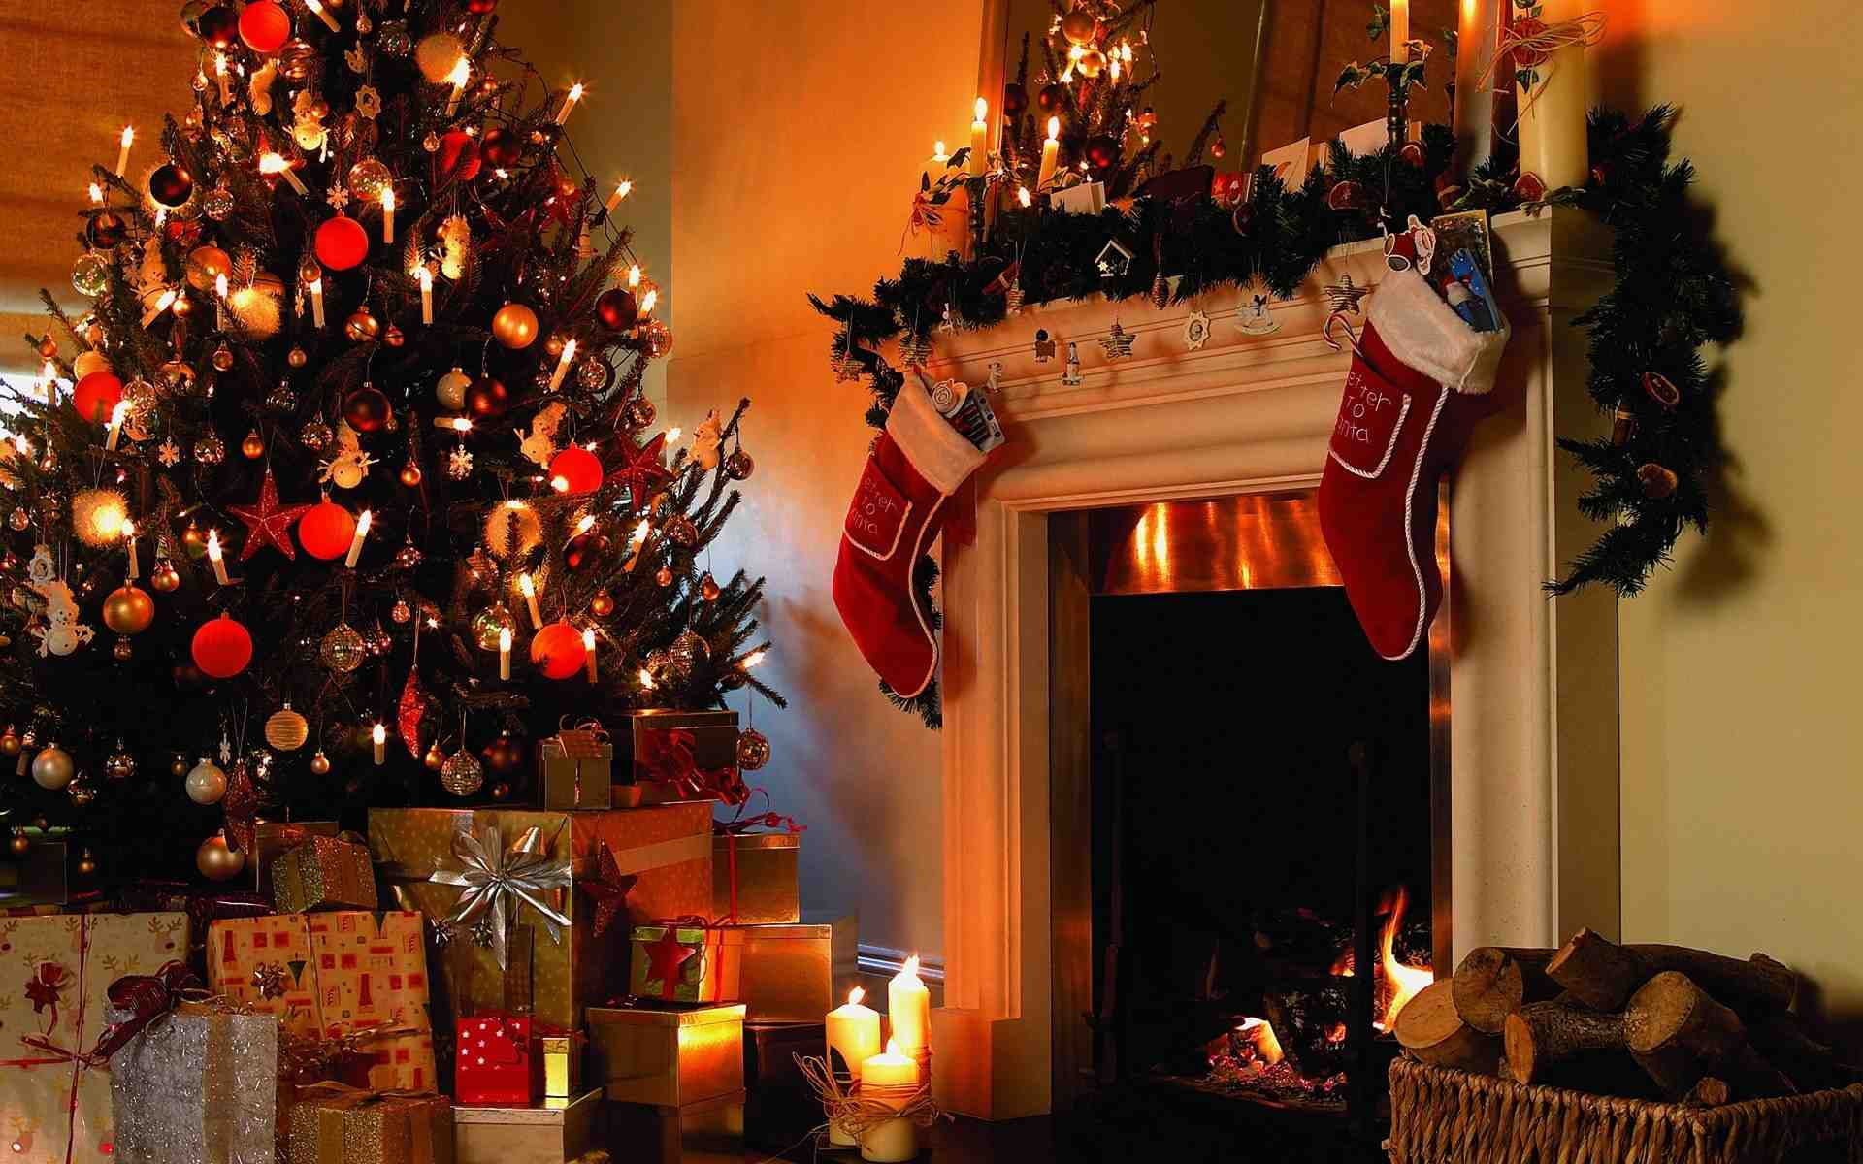
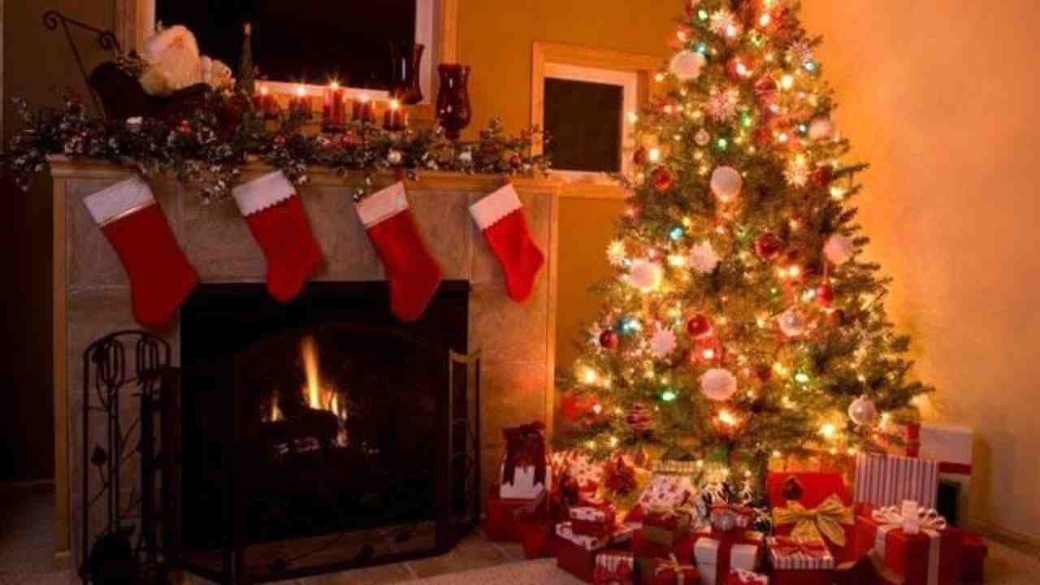
How Should We Celebrate Christmas?
Romans 14:1-13

Slide 2
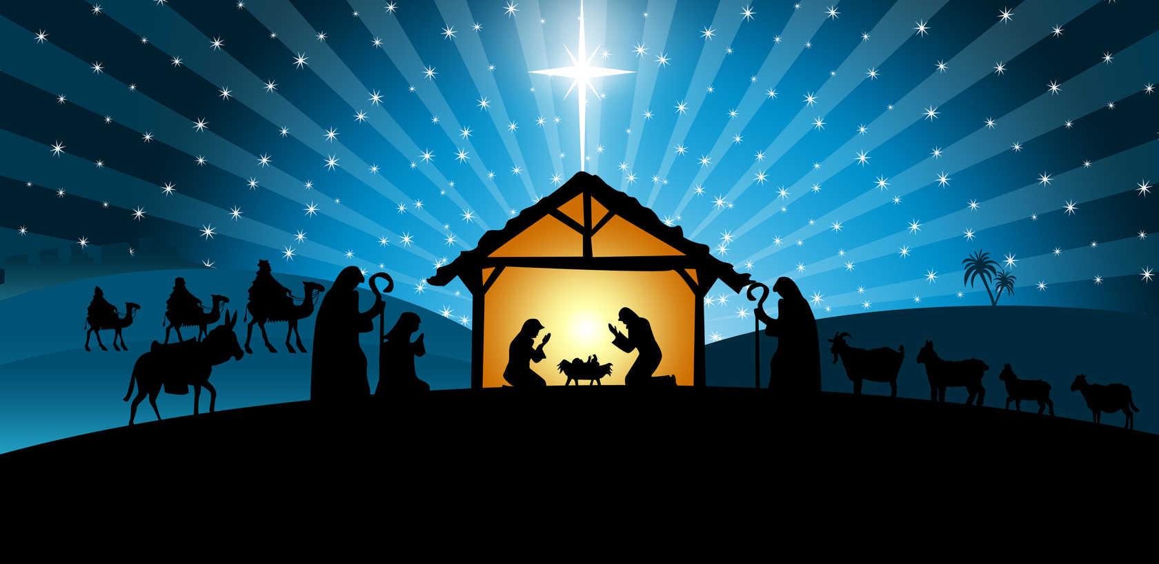
Focusing on Jesus’ birth..
How God became flesh..
Are we missing the real message?

Slide 3
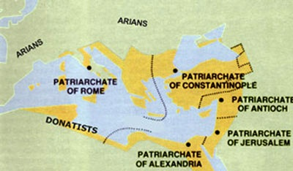
History of Christmas..
Bishop Liberius 354 AD chose Dec 25
Giving gifts
Evergreen wreath, mistletoe
Christmas tree
St Nicholas, gifts, switches
Manger scenes

Slide 4
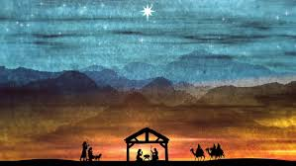
Is Christmas a “holy day”?
Early Christians and Jewish or Roman days?
Gal 3:24-25 Therefore the law was our tutor to bring us to Christ, that we might be justified by faith. 25 But after faith has come, we are no longer under a tutor.
Gal 5:1 It is for freedom that Christ has set us free. Stand firm, then, and do not let yourselves be burdened again by a yoke of slavery.
Gal 4:10-11 You are observing special days and months and seasons and years! 11 I fear for you, that somehow I have wasted my efforts on you.

Slide 5
Sunday is not a holy day..
Acts 20:7 Now on the first day of the week, when the disciples came together to break bread, Paul, ready to depart the next day, spoke to them and continued his message until midnight.
1 Cor 11:23-24 For I received from the Lord that which I also delivered to you: that the Lord Jesus on the same night in which He was betrayed took bread; 24 and when He had given thanks, He broke it and said, "Take, eat; this is My body which is broken for you; do this in remembrance of Me."

Slide 6
How should we take part?
Romans 14:1-6 One person esteems one day above another; another esteems every day alike. Let each be fully convinced in his own mind.
6 He who observes the day, observes it to the Lord; and he who does not observe the day, to the Lord he does not observe it. He who eats, eats to the Lord, for he gives God thanks; and he who does not eat, to the Lord he does not eat, and gives God thanks.
20 All things indeed are pure, but it is evil for the man who eats with offense.

Slide 7
Use liberties out of love..
1 Cor 8:5-9 for us there is but one God, the Father, from whom all things came and for whom we live; and there is but one Lord, Jesus Christ, through whom all things came and through whom we live. 7 But not everyone possesses this knowledge. Some people are still so accustomed to idols that when they eat sacrificial food they think of it as having been sacrificed to a god, and since their conscience is weak, it is defiled.
8 But food does not bring us near to God; we are no worse if we do not eat, and no better if we do. 9 Be careful, however, that the exercise of your rights does not become a stumbling block to the weak.

Slide 8
Traditions vs religious practice..
Matthew 15:4-9 3 Jesus replied, “And why do you break the command of God for the sake of your tradition? 4 For God said, ‘Honor your father and mother’and ‘Anyone who curses their father or mother is to be put to death.’
5 But you say that if anyone declares that what might have been used to help their father or mother is ‘devoted to God,’ 6 they are not to ‘honor their father or mother’ with it. Thus you nullify the word of God for the sake of your tradition.

Slide 9
Rejoice in the Lord ..
Phil 4:4-6 4 Rejoice in the Lord always. I will say it again: Rejoice! 5 Let your gentleness be evident to all. The Lord is near. 6 Do not be anxious about anything, but in every situation, by prayer and petition, with thanksgiving, present your requests to God.

Slide 10
How Should We Celebrate Christmas?
Romans 14:1-13

